Slide 1
ECONOMICS
Chapter 7.4: Putting Supply and Demand Together
Learning Target: Understand the Interaction of Supply & Demand & Government Restrictions

Slide 2
ECONOMICS Ch. 7.4: Putting Supply and Demand Together Learning Target: Understand the Interaction of Supply & Demand & Government Restrictions
Success Criteria
You should be able to…
1. Graph & explain Equilibrium Price
2. Explain how Shortages & Surpluses disappear
3. Describe Government involvement in the marketplace such as
Price Ceilings, Price Floors & Rationing

Slide 3
How are prices determined in a free market?

Slide 4
How are prices determined in a free market? | By the interaction of supply and demand.

Slide 5
Equilibrium price

Slide 6
Equilibrium price | The price at which the amount producers are willing to supply is equal to the amount consumers are willing to buy.

Slide 7
Equilibrium price | The price at which the amount producers are willing to supply is equal to the amount consumers are willing to buy. On a graph it is where the supply and demand curves intersect. (see figure 7.10, page 195)

Slide 8
Equilibrium price | The price at which the amount producers are willing to supply is equal to the amount consumers are willing to buy. On a graph it is where the supply and demand curves intersect. (see figure 7.10, page 195) The interaction of supply and demand determines the equilibrium price.

Slide 9
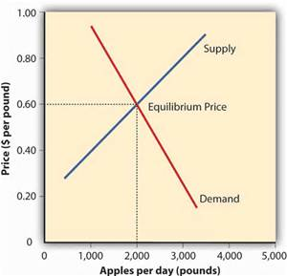
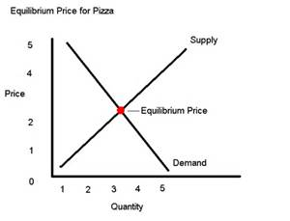

Slide 10
ECONOMICS Ch. 7.4: Putting Supply and Demand Together Learning Target: Understand the Interaction of Supply & Demand & Government Restrictions
Success Criteria
You should be able to…
1. Graph & explain Equilibrium Price
2. Explain how Shortages & Surpluses disappear
3. Describe Government involvement in the marketplace such as
Price Ceilings, Price Floors & Rationing

Slide 11
How are prices used as signals between producers and consumers?

Slide 12
How are prices used as signals between producers and consumers? | Rising prices signal producers to produce more and consumers to buy less. Falling prices…

Slide 13
How are prices used as signals between producers and consumers? | Rising prices signal producers to produce more and consumers to buy less. Falling prices signal producers to produce less and consumers to purchase more.

Slide 14
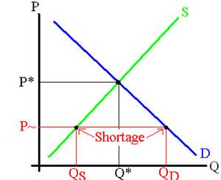
What is a shortage?

Slide 15
What is a shortage? | When the quantity demanded is greater than the quantity supplied at the current price.

Slide 16
What is a surplus?

Slide 17
What is a surplus? | When the quantity supplied is greater than the quantity demanded at the current price.

Slide 18
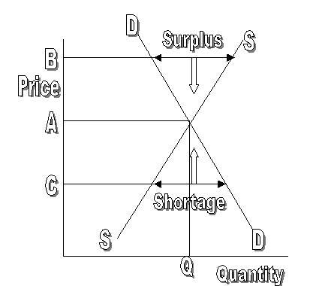
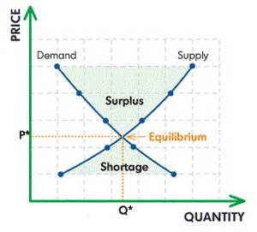

Slide 19
SUMMARIZE
Discuss at your table.
1. Explain how prices are determined in a free market.
2. What is Equilibrium Price?
3. How can you find the Equilibrium Price?
4. Explain how consumers and producers react to falling prices.
5. Explain the difference between a surplus and a shortage.
Are you on target (white, black, blue, red or yellow)?
Did you hit the bullseye?
Learning Target: Understand the Interaction of Supply & Demand and Government Restrictions

Slide 20
What causes shortages and surpluses to eventually disappear?

Slide 21
What causes shortages and surpluses to eventually disappear? | Market forces take care of it.

Slide 22
What causes shortages and surpluses to eventually disappear? | Market forces take care of it. When shortages occur, prices go up to eliminate the shortage. When surpluses occur, prices fall to eliminate the surplus.

Slide 23
What causes shortages and surpluses to eventually disappear? | Market forces take care of it. When shortages occur, prices go up to eliminate the shortage. When surpluses occur, prices fall to eliminate the surplus. Shortages and surpluses eventually disappear when markets are allowed to operate without governmental restrictions.

Slide 24
ECONOMICS Ch. 7.4: Putting Supply and Demand Together Learning Target: Understand the Interaction of Supply & Demand & Government Restrictions
Success Criteria
You should be able to…
1. Graph & explain Equilibrium Price
2. Explain how Shortages & Surpluses disappear
3. Describe Government involvement in the marketplace such as
Price Ceilings, Price Floors & Rationing

Slide 25
Why does the government get involved in setting/ limiting some prices?

Slide 26
Why does the government get involved in setting/ limiting some prices? | To protect consumers or suppliers.

Slide 27
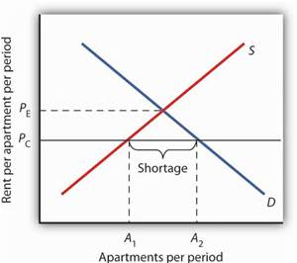
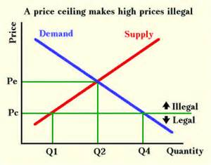
Price ceiling

Slide 28
Price ceiling | A government set maximum price that can be charged for a good or service. Examples?

Slide 29
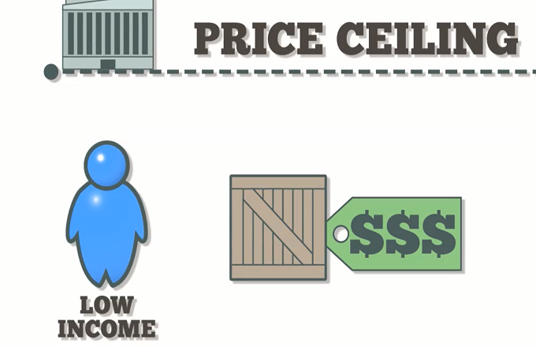

Slide 31
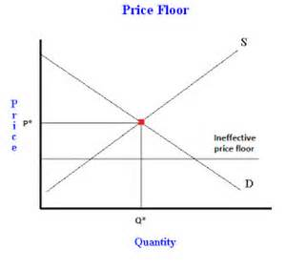
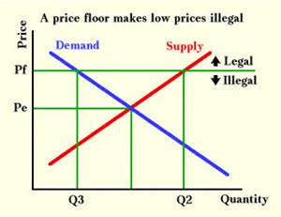
Price floor

Slide 32
Price floor | A government set minimum price that can be charged for a good or service. Examples?

Slide 33
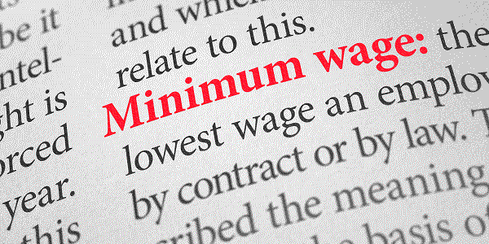

Slide 34
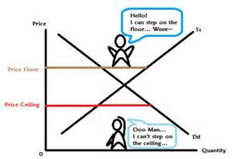

Slide 35
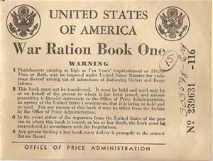
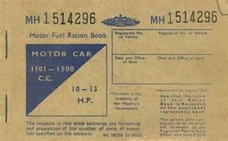
Rationing

Slide 36
Rationing | When the government limits items that are in short supply.

Slide 37
Black market

Slide 38
Black market | An “underground” or illegal market where goods (some illegal) are sold (some prices may be above/below the legal limits).

Slide 39
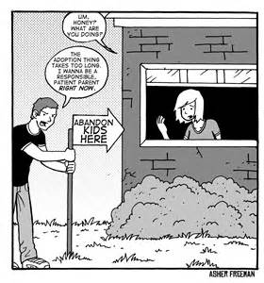
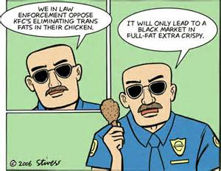
Black market | An “underground” or illegal market where goods (some illegal) are sold (some prices may be above/below the legal limits).

Slide 40
“Econ 2.5 Price Ceilings and Floors” (4:30 mins.)

Slide 41
SUMMARIZE
Discuss at your table.
6. Explain why shortages and surpluses are generally temporary.
7. Why does the government get involved with some prices?
8. What is a price ceiling? Give an example.
9. What is a price floor? Give an example.
10. Give an example of a product that was rationed and when it occurred.
11. What is a Black Market and what might be sold there?
Are you on target (white, black, blue, red or yellow)?
Did you hit the bullseye?
Learning Target: Understand the Interaction of Supply & Demand and Government Restrictions

Slide 43
ECONOMICS Ch. 7.4: Putting Supply and Demand Together Learning Target: Understand the Interaction of Supply & Demand & Government Restrictions
Success Criteria
You should be able to…
1. Graph & explain Equilibrium Price
2. Explain how Shortages & Surpluses disappear
3. Describe Government involvement in the marketplace such as
Price Ceilings, Price Floors & Rationing

