Slide 1
ECONOMICS
Chapter 7.3: The Law of Supply
Learning Target: Explain the Law of Supply, the Determinants
of Supply and the Law of Diminishing Returns

Slide 2
ECONOMICS Ch. 7.3: The LAW OF SUPPLY Learning Target: Explain the Law of Supply, the Determinants of Supply and the Law of Diminishing Returns
Success Criteria
You should be able to…
1. Explain the Law of Supply
2. Explain & graph the Determinants of Supply & show how they shift the supply curve left or right
3. Describe the Law of Diminishing Returns & give an example

Slide 3
How are prices determined in a marketplace?

Slide 4
How are prices determined in a marketplace? | Through supply and demand.

Slide 5
Law of Supply | An economic rule stating that price and quantity supplied move in the same direction.

Slide 6
Law of Supply | An economic rule stating that price and quantity supplied move in the same direction. As price goes up/down, the quantity supplied goes up/down.

Slide 8
ECONOMICS Ch. 7.3: The LAW OF SUPPLY Learning Target: Explain the Law of Supply, the Determinants of Supply and the Law of Diminishing Returns
Success Criteria
You should be able to…
1. Explain the Law of Supply
2. Explain & graph the Determinants of Supply & show how they shift the supply curve left or right
3. Describe the Law of Diminishing Returns & give an example

Slide 9
Quantity supplied | The amount of a good or service that a producer is willing and able to supply at a specific price.

Slide 10
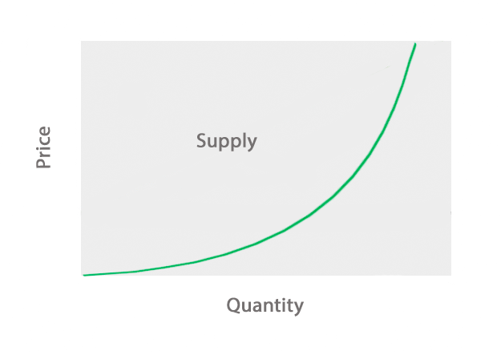
Supply schedule
Supply curve

Slide 11
Supply schedule | A table showing quantities supplied at different possible prices. (see figure 7.7A, page 188)
Supply curve

Slide 12
Supply schedule | A table showing quantities supplied at different possible prices. (see figure 7.7A, page 188)
Supply curve | A graph with an upward sloping line that shows the quantities supplied at each possible price. (see figure 7.7B, page 189) Supply goes to the sky.

Slide 13
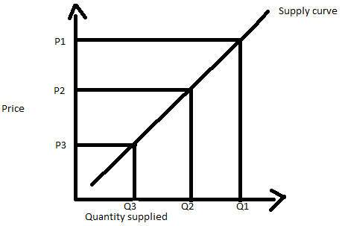

Slide 14
QUESTIONS
Discuss at your table.
1. Explain how prices are determined in your own words.
2. Explain the relationship between price and supply.
3. What things impact the amount supplied of a good or service.
4. How would you describe a supply curve?
5. Draw an example of a supply curve.
Are you on target (white, black, blue, red or yellow)?
Did you hit the bullseye?
Learning Target: Explain the Law of Supply, the Determinants of Supply and the Law of Diminishing Returns

Slide 15
What determines Supply? See graphs on pages 190-191. | Four major determinants of supply: 1. Price of inputs needed to make a product

Slide 16
What determines Supply? See graphs on pages 190-191. | Four major determinants of supply: 1. Price of inputs needed to make a product 2. Number of firms in the industry (more firms increases availability)

Slide 17
What determines Supply? See graphs on pages 190-191. | Four major determinants of supply: 1. Price of inputs needed to make a product 2. Number of firms in the industry (more firms increases availability) 3. Taxes (as taxes go up, supply goes down)

Slide 18
What determines Supply? See graphs on pages 190-191. | Four major determinants of supply: 1. Price of inputs needed to make a product 2. Number of firms in the industry (more firms increases availability) 3. Taxes (as taxes go up, supply goes down) 4. Technology (improved technology generally leads to decreased costs which leads to an increase in supply)

Slide 19
ECONOMICS Ch. 7.3: The LAW OF SUPPLY Learning Target: Explain the Law of Supply, the Determinants of Supply and the Law of Diminishing Returns
Success Criteria
You should be able to…
1. Explain the Law of Supply
2. Explain & graph the Determinants of Supply & show how they shift the supply curve left or right
3. Describe the Law of Diminishing Returns & give an example

Slide 20
What is the Law of Diminishing Returns?

Slide 21
What is the Law of Diminishing Returns? | An economic rule stating that as more units of a factor of production are added, total output continues to increase, but at a diminishing rate. (see figure 7.9, page 193)

Slide 22
What is the Law of Diminishing Returns? Why is it important for a business to understand the law of diminishing returns? | An economic rule stating that as more units of a factor of production are added, total output continues to increase, but at a diminishing rate. (see figure 7.9, page 193)

Slide 23
What is the Law of Diminishing Returns? Why is it important for a business to understand the law of diminishing returns? | An economic rule stating that as more units of a factor of production are added, total output continues to increase, but at a diminishing rate. (see figure 7.9, page 193) The law of diminishing returns helps business managers decide how much of each factor of production to employ.

Slide 24
QUESTIONS
Discuss at your table.
6. List the factors that impact supply.
7. Which factor(s) likely will lead to a decrease in supply?
8. Which factor(s) likely will lead to an increase in supply
9. Explain the Law of Diminishing Returns.
10. Give an example of the Law of Diminishing Returns.
Are you on target (white, black, blue, red or yellow)?
Did you hit the bullseye?
Learning Target: Explain the Law of Supply, the Determinants of Supply and the Law of Diminishing Returns

Slide 25
I Love Lucy
“Econ 2.2 Demand and Supply Explained” (5 mins.)

Slide 27
ECONOMICS Ch. 7.3: The LAW OF SUPPLY Learning Target: Explain the Law of Supply, the Determinants of Supply and the Law of Diminishing Returns
Success Criteria
You should be able to…
1. Explain the Law of Supply
2. Explain & graph the Determinants of Supply & show how they shift the supply curve left or right
3. Describe the Law of Diminishing Returns & give an example

