Slide 1
ECONOMICS
Ch. 7.2
The Demand Curve and Elasticity of Demand
Learning Target: Explore and understand the Determinants of Demand

Slide 2
ECONOMICS
Ch. 7.2: The Demand Curve and Elasticity of Demand
Learning Target: Explore and understand the Determinants of Demand
Success Criteria
You should be able to…
1. Explain & graph the Determinants of Demand & show how they shift the demand curve left or right
2. Explain the Price Elasticity of Demand
3. Describe Elastic & Inelastic Demand & provide examples

Slide 3
What is a demand schedule?

Slide 4
What is a demand schedule? | A table showing quantities demanded at different possible prices.

Slide 5
What is a demand schedule? | A table showing quantities demanded at different possible prices. As prices go down, the quantity demanded goes up. (see figure 7.3 A, page 178)

Slide 6
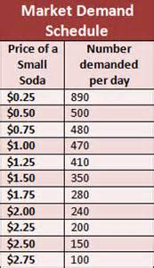

Slide 7
What is a demand curve?

Slide 8
What is a demand curve? | A downward sloping line that shows in graph form the quantities demanded at each possible price. (see figure 7.3 B, page 179)

Slide 9
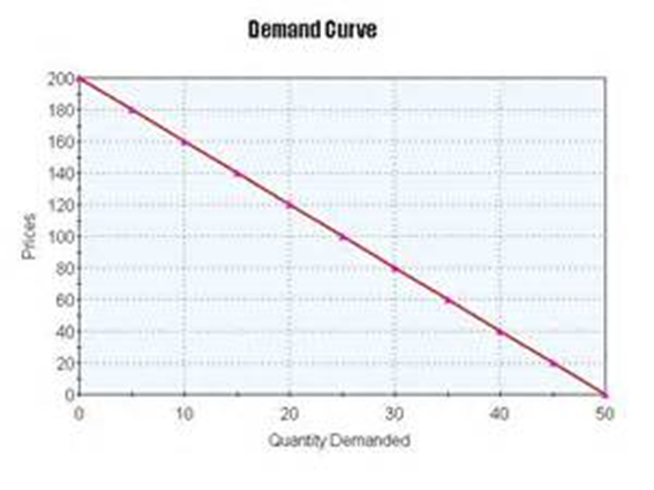

Slide 10
What causes a change in quantity demanded? How is this shown visually?

Slide 11
What causes a change in quantity demanded? How is this shown visually? | The quantity demanded varies inversely with price.

Slide 12
What causes a change in quantity demanded? How is this shown visually? | The quantity demanded varies inversely with price. As price falls, quantity demanded increases, and vice versa.

Slide 13
What causes a change in quantity demanded? How is this shown visually? | The quantity demanded varies inversely with price. As price falls, quantity demanded increases, and vice versa. It is shown visually on a graph with price on the vertical axis and quantity demanded on the horizontal axis (see figure 7.3 B, page 179).

Slide 14
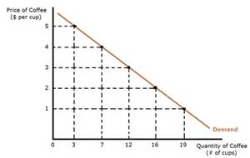

Slide 15
What factors affect demand for products or services? And how does this change the demand curves?

Slide 16
What factors affect demand for products or services? And how does this change the demand curves? | 1) Population

Slide 17
What factors affect demand for products or services? And how does this change the demand curves? | 1) Population: Increase in population = Increase in Demand

Slide 18
What factors affect demand for products or services? And how does this change the demand curves? | 1) Population: Increase in population = Increase in Demand 2) Income

Slide 19
What factors affect demand for products or services? And how does this change the demand curves? | 1) Population: Increase in population = Increase in Demand 2) Income: Increase in income = Increase in Demand

Slide 20
What factors affect demand for products or services? And how does this change the demand curves? | 1) Population: Increase in population = Increase in Demand 2) Income: Increase in income = Increase in Demand 3) Tastes and preferences

Slide 21
What factors affect demand for products or services? And how does this change the demand curves? | 1) Population: Increase in population = Increase in Demand 2) Income: Increase in income = Increase in Demand 3) Tastes and preferences: Increase in popularity = Increase in Demand

Slide 22
What factors affect demand for products or services? And how does this change the demand curves? | 1) Population: Increase in population = Increase in Demand 2) Income: Increase in income = Increase in Demand 3) Tastes and preferences: Increase in popularity = Increase in Demand 4) Substitutes

Slide 23
What factors affect demand for products or services? And how does this change the demand curves? | 1) Population: Increase in population = Increase in Demand 2) Income: Increase in income = Increase in Demand 3) Tastes and preferences: Increase in popularity = Increase in Demand 4) Substitutes: More or low cost substitutes = Decrease in Demand

Slide 24
What factors affect demand for products or services? And how does this change the demand curves? | 1) Population: Increase in population = Increase in Demand 2) Income: Increase in income = Increase in Demand 3) Tastes and preferences: Increase in popularity = Increase in Demand 4) Substitutes: More or low cost substitutes = Decrease in Demand 5) Complementary goods (items often sold together; such as I-pods and ear buds)

Slide 25
What factors affect demand for products or services? And how does this change the demand curves? | 1) Population: Increase in population = Increase in Demand 2) Income: Increase in income = Increase in Demand 3) Tastes and preferences: Increase in popularity = Increase in Demand 4) Substitutes: More or low cost substitutes = Decrease in Demand 5) Complementary goods (items often sold together; such as I-pods and ear buds): Decrease in price of one = Increase in Demand of the other

Slide 26


SUMMARIZE
Discuss at your table.
1. What is the difference between a demand schedule and a demand curve?
2. What direction do demand curves always slope?
3. Explain why and how the quantity demanded changes.
4. Explain several factors that might affect the quantity demanded.
Are you on target (white, black, blue, red or yellow)?
Did you hit the bullseye?
Learning Target: Explore and understand the Determinants of Demand

Slide 27
ECONOMICS
Ch. 7.2: The Demand Curve and Elasticity of Demand
Learning Target: Explore and understand the Determinants of Demand
Success Criteria
You should be able to…
1. Explain & graph the Determinants of Demand & show how they shift the demand curve left or right
2. Explain the Price Elasticity of Demand
3. Describe Elastic & Inelastic Demand & provide examples

Slide 28
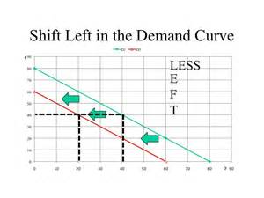

Slide 29
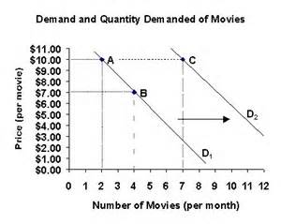

Slide 32
Elasticity
Price elasticity of demand

Slide 33
Elasticity | Consumers’ responsiveness to an increase or decrease in price.
Price elasticity of demand

Slide 34
Elasticity | Consumers’ responsiveness to an increase or decrease in price.
Price elasticity of demand | How much demand varies according to changes in price. (see figure 7.4, page 182)

Slide 35
ECONOMICS
Ch. 7.2: The Demand Curve and Elasticity of Demand
Learning Target: Explore and understand the Determinants of Demand
Success Criteria
You should be able to…
1. Explain & graph the Determinants of Demand & show how they shift the demand curve left or right
2. Explain the Price Elasticity of Demand
3. Describe Elastic & Inelastic Demand & provide examples

Slide 36
Elastic demand. Give examples.

Slide 37
Elastic demand. Give examples. | A given rise or fall in a product’s price greatly affects the amount that people are willing to buy.

Slide 38
Elastic demand. Give examples. | A given rise or fall in a product’s price greatly affects the amount that people are willing to buy. Items may be considered luxuries.

Slide 39
Elastic demand. Give examples. | A given rise or fall in a product’s price greatly affects the amount that people are willing to buy. Items may be considered luxuries. There is flexibility in people’s paying of the product. Examples:

Slide 40
Elastic demand. Give examples. | Examples: Junk food, Slurpees, CDs or DVDs, concert or sports tickets

Slide 41
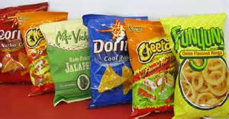



Slide 42
Inelastic demand. Give examples.

Slide 43
Inelastic demand. Give examples. | A product’s price change has little impact on the quantity demanded by consumers.

Slide 44
Inelastic demand. Give examples. | A product’s price change has little impact on the quantity demanded by consumers. Items may be considered necessities. Examples:

Slide 45
Inelastic demand. Give examples. | A product’s price change has little impact on the quantity demanded by consumers. Items may be considered necessities. Examples: Medicine, milk, light bulbs, electricity (?), gasoline (?)

Slide 46
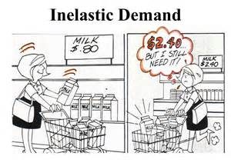

Slide 47

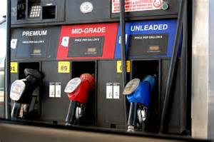




Slide 48
SUMMARIZE
Discuss at your table.
5. Explain what a substitute good is.
6. Explain what a complimentary good is.
7. Write a definition for elasticity in your own words.
8. What is the difference between elastic and inelastic demand?
Are you on target (white, black, blue, red or yellow)?
Did you hit the bullseye?
Learning Target: Explore and understand the Determinants of Demand

Slide 49
ECONOMICS
Ch. 7.2: The Demand Curve and Elasticity of Demand
Learning Target: Explore and understand the Determinants of Demand
Success Criteria
You should be able to…
1. Explain & graph the Determinants of Demand & show how they shift the demand curve left or right
2. Explain the Price Elasticity of Demand
3. Describe Elastic & Inelastic Demand & provide examples

Slide 50
What determines price elasticity of demand?

Slide 51
What determines price elasticity of demand? | Substitutes.

Slide 52
What determines price elasticity of demand? | Substitutes. The % of your budget used to purchase an item.

Slide 53
What determines price elasticity of demand? | Substitutes. The % of your budget used to purchase an item. Time – It takes time to adjust to price changes and adjust accordingly.

Slide 54
Determinants of Demand

Slide 55
SUMMARIZE
Discuss at your table.
9. Explain several factors that impact the price elasticity of demand.
10. Give an example of substitute goods.
11. Give an example of complimentary goods.
12. Give several examples of elastic goods.
13. Give several examples of inelastic goods.
Are you on target (white, black, blue, red or yellow)?
Did you hit the bullseye?
Learning Target: Explore and understand the Determinants of Demand

Slide 56
ECONOMICS
Ch. 7.2: The Demand Curve and Elasticity of Demand
Learning Target: Explore and understand the Determinants of Demand
Success Criteria
You should be able to…
1. Explain & graph the Determinants of Demand & show how they shift the demand curve left or right
2. Explain the Price Elasticity of Demand
3. Describe Elastic & Inelastic Demand & provide examples

