Slide 1
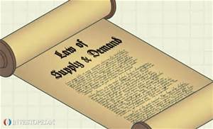
ECONOMICS
Ch. 7.1: Demand
Learning Target: Explore the Law of Demand and its affect

Slide 2
ECONOMICS
Ch. 7.1: Demand
Learning Target: Explore the Law of Demand and its affect
Success Criteria
You should be able to…
1. Explain the Law of Demand using the concept of Voluntary Exchange
2. Describe the Real Income Effect & the Substitution Effect & give an example of each
3. Explain Utility, Marginal Utility & the Law of Diminishing Marginal Utility & give an example

Slide 3
What is a market? Give some examples.

Slide 4
What is a market? Give some examples. | Any place where buyers and sellers come together.

Slide 5
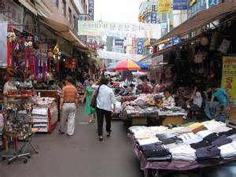

What is a market? Give some examples. | Any place where buyers and sellers come together. Examples: stores, services, entertainment, internet stores

Slide 6
Demand
Supply

Slide 7
Demand | Amount of a good or service that consumers are able and willing to buy at various prices during a set time period.
Supply

Slide 8
Demand | Amount of a good or service that consumers are able and willing to buy at various prices during a set time period.
Supply | Amount of a good or service that producers are able and willing to sell at various prices during a set time period.

Slide 9
Who makes the decisions in a market economy?

Slide 10
Who makes the decisions in a market economy? | The buyers and sellers.

Slide 11
Voluntary exchange

Slide 12
Voluntary exchange | Buyers and sellers exercise economic freedom by working out their own terms of exchange.

Slide 13
ECONOMICS
Ch. 7.1: Demand
Learning Target: Explore the Law of Demand and its affect
Success Criteria
You should be able to…
1. Explain the Law of Demand using the concept of Voluntary Exchange
2. Describe the Real Income Effect & the Substitution Effect & give an example of each
3. Explain Utility, Marginal Utility & the Law of Diminishing Marginal Utility & give an example

Slide 14
How are prices set in a market economy?

Slide 15
How are prices set in a market economy? | By the voluntary exchange between buyers and sellers.

Slide 16
What is the law of demand?

Slide 17
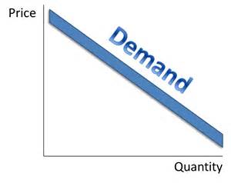
What is the law of demand? | An economic rule stating that the quantity demanded and price move in opposite directions (see figure 7.2, page 172).

Slide 18

Demand curves go to the dirt.

Slide 19
Quantity demanded

Slide 20
Quantity demanded | The amount of a good or service that a consumer is willing and able to purchase at a specific price.

Slide 21
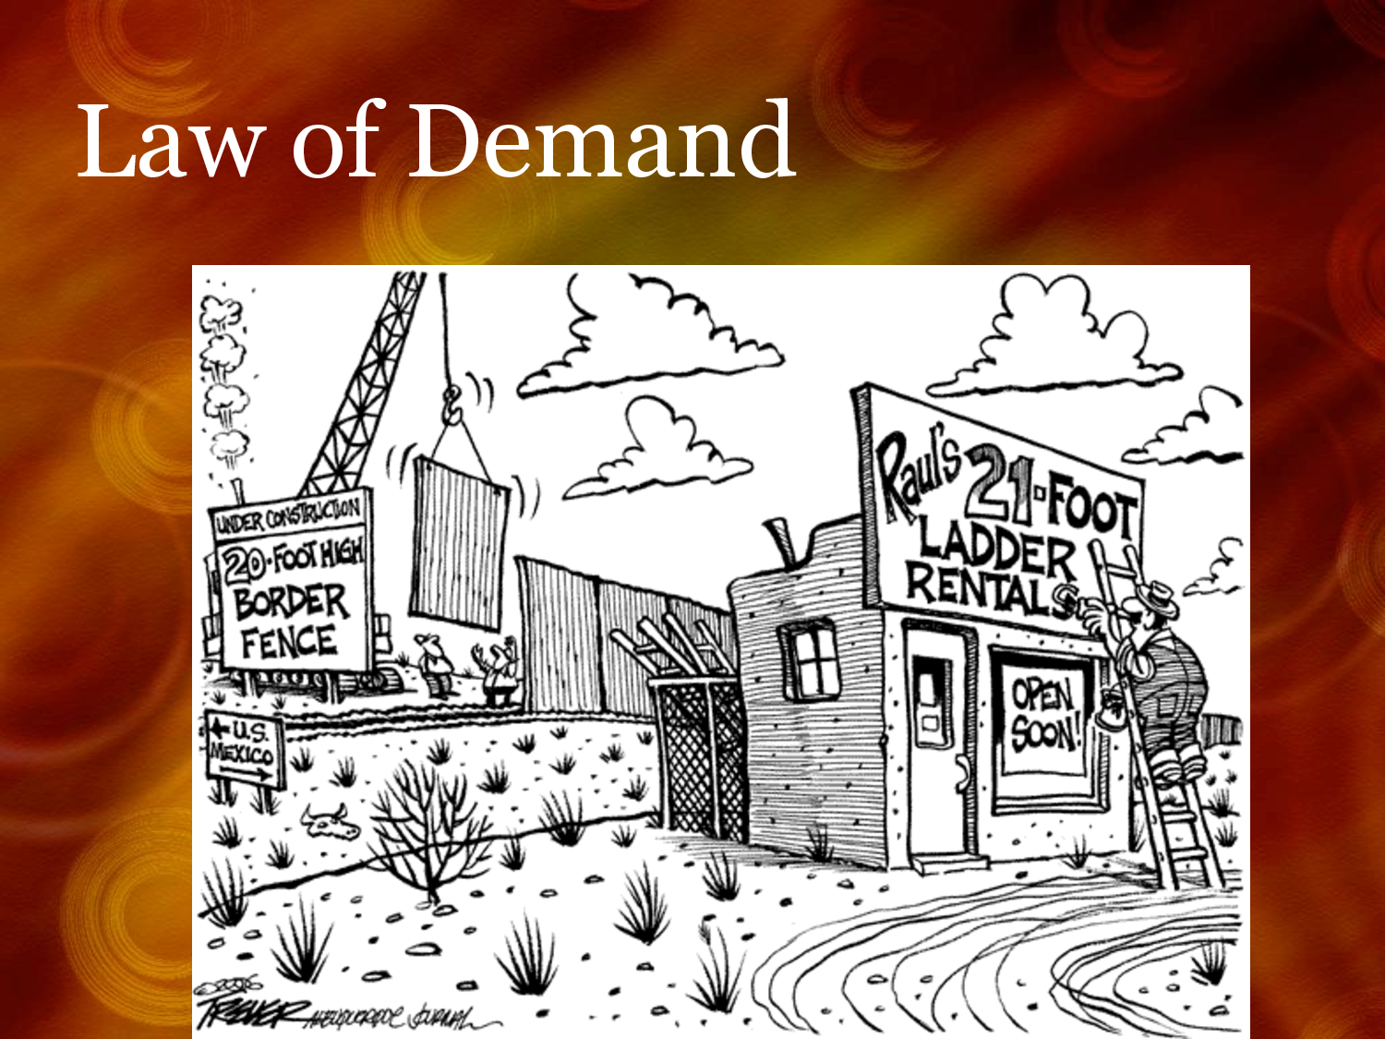

Slide 22
Figure 7.2: The Law of Demand

Slide 23
Figure 7.2: The Law of Demand

Slide 24


SUMMARIZE
Discuss at your table & answer on your response sheet.
1. Give several examples of a market.
2. Who makes the decisions in a market economy?
3. Describe Voluntary Exchange in you own words.
4. Explain the Law of Demand.
5. Describe how to determine the quantity demanded.
Are you on target (white, black, blue, red or yellow)?
Did you hit the bullseye?
Learning Target: Explore the Law of Demand and its affect

Slide 25
What is the Real Income Effect?

Slide 26
What is the Real Income Effect? | Economic rule stating that individuals cannot keep buying the same quantity of a product if its price rises while income stays the same.

Slide 27
What is the substitution effect?

Slide 28
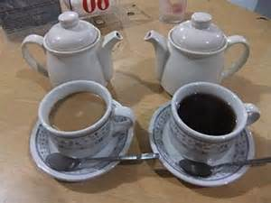
What is the substitution effect? | Economic rule stating that if two items satisfy the same need and the price of one rises, people will buy the other. Examples:

Slide 29
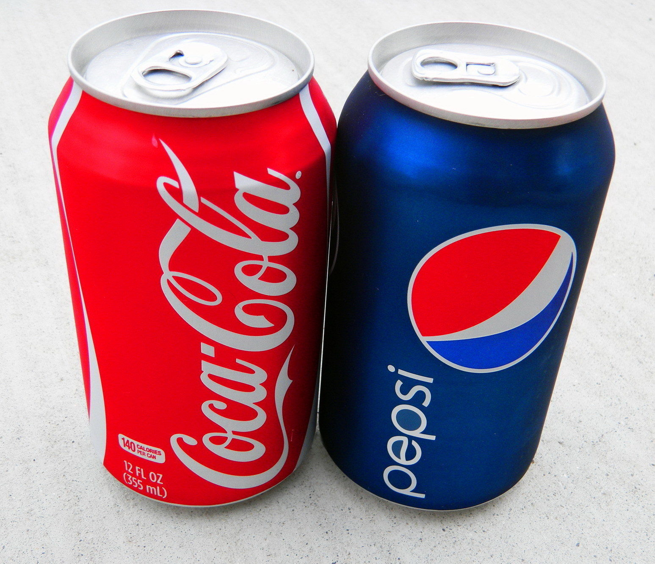

Slide 30
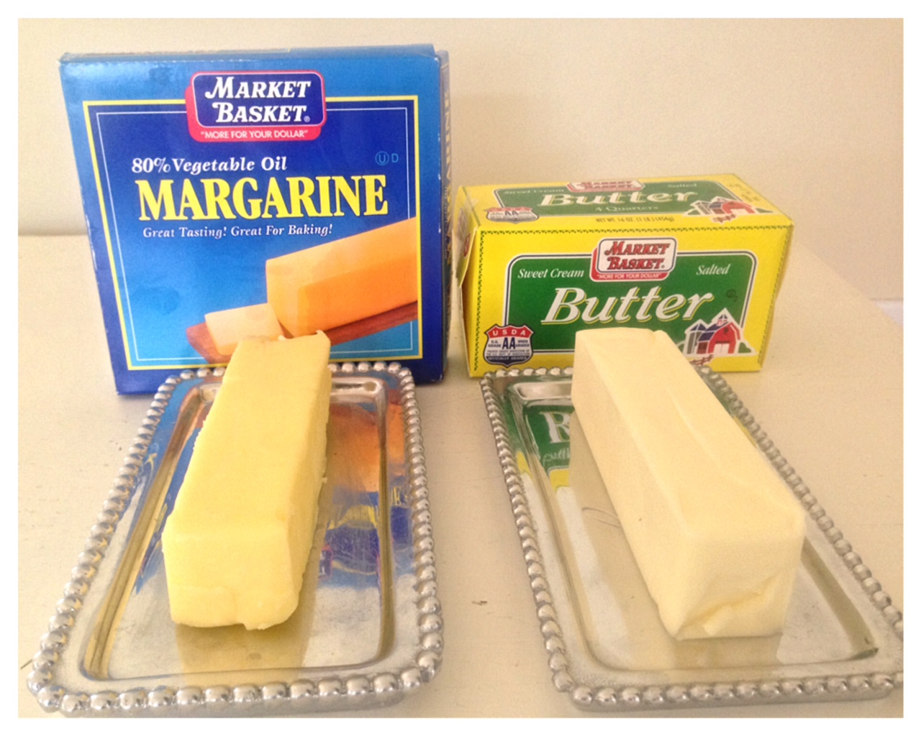

Slide 31
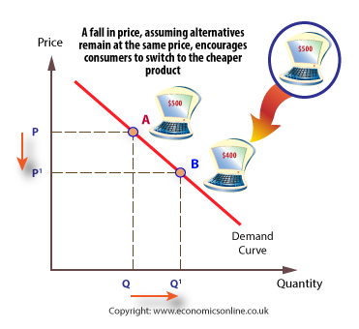

Slide 32
ECONOMICS
Ch. 7.1: Demand
Learning Target: Explore the Law of Demand and its affect
Success Criteria
You should be able to…
1. Explain the Law of Demand using the concept of Voluntary Exchange
2. Describe the Real Income Effect & the Substitution Effect & give an example of each
3. Explain Utility, Marginal Utility & the Law of Diminishing Marginal Utility & give an example

Slide 33
Utility

Slide 34
Utility | The ability of any good or service to satisfy consumer wants.

Slide 35
Purchasing Power

Slide 36
Purchasing Power | The amount of goods and services people can actually buy.

Slide 37
Marginal utility

Slide 38
Marginal utility | An additional amount of satisfaction. Example: The satisfaction gained from additional amounts of the same product.

Slide 39
What is the law of diminishing marginal utility?

Slide 40
What is the law of diminishing marginal utility? | Rule stating that the additional satisfaction a consumer gets from purchasing one more unit of a product will lessen with each additional unit purchased.

Slide 41
What is the law of diminishing marginal utility? | Rule stating that the additional satisfaction a consumer gets from purchasing one more unit of a product will lessen with each additional unit purchased. Example: 1 dog – Fun; 2 dogs – Not as much fun & more work; 3 dogs – Diminishing marginal utility, Not so fun anymore; 4 dogs – Am I crazy ☺ Your enjoyment (satisfaction) with each additional dog is less.

Slide 42
Examples of the law of diminishing marginal utility?

Slide 43

Examples of the law of diminishing marginal utility? | 1 Slurpee – Yum 2 Slurpees – Brain Freeze 3 Slurpees – Stomach Ache 4 Slurpees – ???

Slide 44
Examples of the law of diminishing marginal utility? | Other examples:
Law of Diminishing Marginal Utility video

Slide 45

Examples of the law of diminishing marginal utility? | Other examples:
Law of Diminishing Marginal Utility video

Slide 46
SUMMARIZE
Discuss at your table & answer on your response sheet.
6. Describe an example showing the Real Income Effect.
7. Describe an example showing the Substitution Effect.
8. What economic term explains the ability of a good or service to satisfy consumers wants?
9. The amount a person can actually buy is known as this.
10. What is Marginal Utility?
11. Create your own example of the Law of Diminishing Marginal Utility.
Are you on target (white, black, blue, red or yellow)?
Did you hit the bullseye?
Learning Target: Explore the Law of Demand and its affect

Slide 47
ECONOMICS
Ch. 7.1: Demand
Learning Target: Explore the Law of Demand and its affect
Success Criteria
You should be able to…
1. Explain the Law of Demand using the concept of Voluntary Exchange
2. Describe the Real Income Effect & the Substitution Effect & give an example of each
3. Explain Utility, Marginal Utility & the Law of Diminishing Marginal Utility & give an example

