Slide 1
What do these things have in common?
401k
403b
IRA
Roth IRA
Social Security
Pension

Slide 3
ECONOMICS
Ch. 6.3: Special Saving Plans
Learning Target: Understand and Compare Retirement Plans including IRAs, Keogh and Pension Plans

Slide 4
ECONOMICS Ch. 6.3: Special Saving Plans Learning Target: Understand and Compare Retirement Plans including IRAs, Keogh and Pension Plans
Success Criteria
You should be able to…
1. Explain the importance of having a retirement plan
2. Describe retirement plans including IRAs, Keogh and Pension Plans
3. Explain the benefits of those plans

Slide 5
What are some possible reasons for saving and investing?

Slide 6
What are some possible reasons for saving and investing? | College. Down payment on a home or auto. Other major purchases. Retirement.

Slide 7
Social Security

Slide 8
Social Security | A federal program that provides monthly payments to retired people. Not much money. Age requirement has gone up. Will it still exist?

Slide 10
Pension plans

Slide 11
Pension plans | A company retirement plan that provides income upon retirement.

Slide 12
Pension plans | Who gets one? Will you?

Slide 13
SUMMARIZE
Discuss at your table & answer on your response sheet.
1. List several things people save money for.
2. Who runs the Social Security program.
3. Who benefits from Social Security?
4. Explain what a pension is.
5. Give several examples of who might get a pension.
Are you on target (white, black, blue, red or yellow)?
Did you hit the bullseye?
Learning Target: Understand and Compare Retirement Plans including IRAs, Keogh and Pension Plans

Slide 14
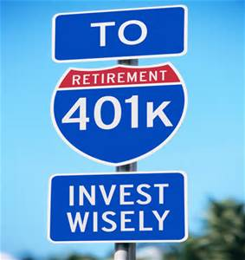
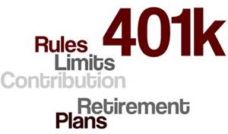
401(k)

Slide 15
401(k) | A retirement plan in which the employee has money withheld from their paycheck for retirement. The employer generally matches the amount.

Slide 17
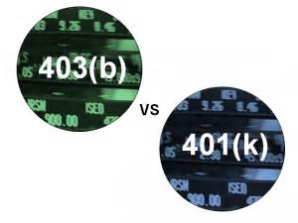

Slide 18
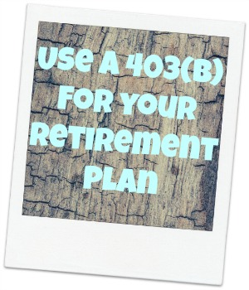
403(b) | Like a 401(k) but no employer match. For government / state employees such as police, state workers or teachers.

Slide 19
Keogh plan | A retirement plan for the self-employed.

Slide 20
IRA

Slide 21
IRA | Individual Retirement Account – a private retirement plan.

Slide 22
SUMMARIZE
Discuss at your table & answer on your response sheet.
6. How does a 401k work?
7. What are the primary differences between a 401k and 403b?
8. Who might have a Keogh plan?
9. How does an IRA differ from a 401k or pension plan?
Are you on target (white, black, blue, red or yellow)?
Did you hit the bullseye?
Learning Target: Understand and Compare Retirement Plans including IRAs, Keogh and Pension Plans

Slide 24
ECONOMICS Ch. 6.3: Special Saving Plans Learning Target: Understand and Compare Retirement Plans including IRAs, Keogh and Pension Plans
Success Criteria
You should be able to…
1. Explain the importance of having a retirement plan
2. Describe retirement plans including IRAs, Keogh and Pension Plans
3. Explain the benefits of those plans

Slide 25
Should Real Estate be used as an investment option? Benefits and drawbacks?

Slide 26
Should Real Estate be used as an investment option? Benefits and drawbacks? | Yes and No! Benefits – Has traditionally been a good and safe investment. You can write off property taxes, mortgage interest, and some improvements.

Slide 27
Should Real Estate be used as an investment option? Benefits and drawbacks? | Yes and No! Benefits – Has traditionally been a good and safe investment. You can write off property taxes, mortgage interest, and some improvements. Drawbacks – Can lose value (bad economy, location, …) Can take time to sell.

Slide 28
How much to save and invest? | How long do you plan to work? How much are you willing to risk? More risk can mean more return.

Slide 29
How much to save and invest? | How long do you plan to work? How much are you willing to risk? More risk can mean more return. Diversification – spreading out your investments; Not putting all your eggs in one basket. Values – What is important to you?

Slide 30
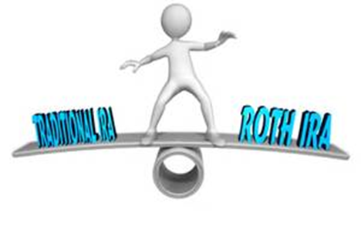
401 K | Keogh | IRA | Roth IRA
Company plan | Self-employed plan | Individual or married couple’s plan | Individual or married couple’s plan
Portion of pay withheld and matched by company | Up to 15% of yearly income set aside | Tax-deferred contributions | Contributions taxed
Tax deferred on income and interest | Amount is tax deductible | Tax-deferred interest income | Interest income never taxed
Maximum contribution limit | Maximum contribution limit | Maximum contribution limit | Maximum contribution limit
Pension Plans video (1:42 mins.)

Slide 31
SUMMARIZE
Discuss at your table & answer on your response sheet.
10. Describe some risks involved with investing in real estate.
11. Why is diversification a good idea when it comes to investing?
12. How is a Roth IRA different than a traditional IRA?
Are you on target (white, black, blue, red or yellow)?
Did you hit the bullseye?
Learning Target: Understand and Compare Retirement Plans including IRAs, Keogh and Pension Plans

Slide 32
ECONOMICS Ch. 6.3: Special Saving Plans Learning Target: Understand and Compare Retirement Plans including IRAs, Keogh and Pension Plans
Success Criteria
You should be able to…
1. Explain the importance of having a retirement plan
2. Describe retirement plans including IRAs, Keogh and Pension Plans
3. Explain the benefits of those plans

