Slide 1
ECONOMICS Ch. 6.1: Saving and Investing
Learning Target: Understand the benefits to saving and the types of accounts available

Slide 2
ECONOMICS Ch. 6.1: Saving and Investing
Learning Target: Understand the benefits to saving and the types of accounts available
Success Criteria
You should be able to…
1. Explain the benefits to saving
2. Describe several types of savings accounts
3. Explain who insures bank accounts and how much is insured

Slide 3
Why save?

Slide 4
Why save? | To have money in the future for emergencies; for security; for investments.

Slide 6
Savings | Setting aside income for a period of time so that it can be used later.

Slide 7
What is a savings account and what are the advantages of having one?

Slide 8
What is a savings account and what are the advantages of having one? | A basic bank account that you put money into and earn interest on the balance (low interest rate). You can take money out at anytime with no penalty. May have a minimum balance (usually a low amount).

Slide 9
What is the interest rate on a regular savings account today? | Is it 1%, 2%, ????

Slide 10
What is the interest rate on a regular savings account today? | NO! More like… .01% at Comerica .05% at Huntington .15% at MSGCU (As of 10/02/18)

Slide 11
What do these interest rates look like as a decimal? | .01% = .05% = .15% =

Slide 12
What do these interest rates look like as a decimal? | 1% = .01 .01% = 2% = .05 .05% = 15% = .15 .15% =

Slide 13
What do these interest rates look like as a decimal? | 1% = .01 .01% = .0001 5% = .05 .05% = .0005 15% = .15 .15% = .0015

Slide 14
SUMMARIZE
Discuss at your table & answer on your response sheet.
1. What things might you save for?
2. Explain an advantage and a disadvantage to a savings account.
3. How much interest would you earn after one year at Huntington bank on a savings deposit of $3,412.18?
Are you on target (white, black, blue, red or yellow)?
Did you hit the bullseye?
Learning Target: Understand the benefits to saving and the types of accounts available

Slide 15
ECONOMICS Ch. 6.1: Saving and Investing
Learning Target: Understand the benefits to saving and the types of accounts available
Success Criteria
You should be able to…
1. Explain the benefits to saving
2. Describe several types of savings accounts
3. Explain who insures bank accounts and how much is insured

Slide 16
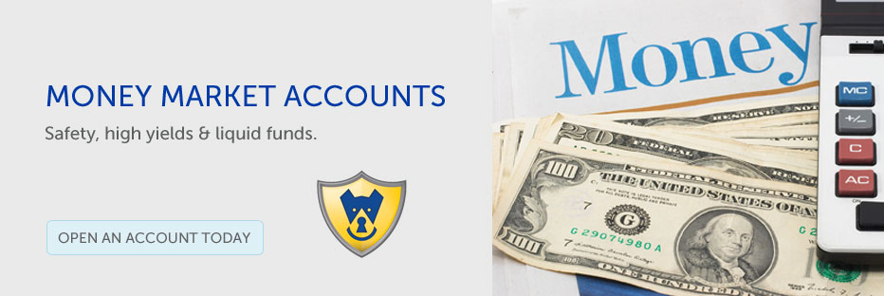
What are money market deposit accounts and what are the advantages?

Slide 17
What are money market deposit accounts and what are the advantages? | An account that pays a higher interest rate but also has a higher minimum balance. May be limited to only writing a few checks each month. You can take money out at anytime with no penalty.

Slide 18
Time deposits

Slide 19
Time deposits | Savings plan that requires savers to leave their money on deposit for a certain (set) period of time. They have a higher interest rate and penalties for early withdrawal.

Slide 20
Maturity

Slide 21
Maturity | The period of time after which time deposits will pay the stated interest rate.

Slide 22
What is a Certificate of Deposit and what are the advantages?

Slide 23
What is a Certificate of Deposit and what are the advantages? | A time deposit that states the amount of the deposit, the maturity date, and the rate of interest.

Slide 24
What is a Certificate of Deposit and what are the advantages? | A time deposit that states the amount of the deposit, the maturity date, and the rate of interest. Also known as a CD. Advantages – higher interest rate and very safe.

Slide 25
SUMMARIZE
Discuss at your table & answer on your response sheet.
4. Explain an advantage and a disadvantage to a money market account.
5. Explain what a time deposit is.
6. Give an example that explains what maturity is.
7. Explain an advantage and a disadvantage of a CD.
Are you on target (white, black, blue, red or yellow)?
Did you hit the bullseye?
Learning Target: Understand the benefits to saving and the types of accounts available

Slide 26
ECONOMICS Ch. 6.1: Saving and Investing
Learning Target: Understand the benefits to saving and the types of accounts available
Success Criteria
You should be able to…
1. Explain the benefits to saving
2. Describe several types of savings accounts
3. Explain who insures bank accounts and how much is insured

Slide 28
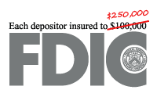
What is the FDIC and the NCUA and what do they do? | FDIC –

Slide 29
What is the FDIC and the NCUA and what do they do? | FDIC – Federal Deposit Insurance Corporation NCUA –

Slide 30
What is the FDIC and the NCUA and what do they do? | FDIC – Federal Deposit Insurance Corporation NCUA – National Credit Union Association

Slide 31
What is the FDIC and the NCUA and what do they do? | FDIC – Federal Deposit Insurance Corporation NCUA – National Credit Union Association The FDIC insures bank accounts and the NCUA insures credit union accounts.

Slide 32
What is the FDIC and the NCUA and what do they do? | FDIC – Federal Deposit Insurance Corporation NCUA – National Credit Union Association The FDIC insures bank accounts and the NCUA insures credit union accounts. The standard deposit insurance amount is $250,000 per depositor, per insured bank, for each account ownership category. (The textbook has the old amount of $100,000)

Slide 34
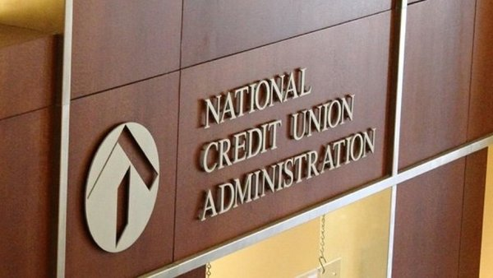

Slide 35
Figure 6.2, p. 144: Money Now or Later? Understanding interest rates and time. MSGCU (9/26/17)
Type of account | Amount of original investment | Interest rate | Original investment plus interest income after 12 months (simple interest, not compound)
Savings account | $1,000 | 0.15 %
Certificate of Deposit (CD) (1 year) | $1,000 | 0.95%

Slide 36
Figure 6.2, p. 144: Money Now or Later? Understanding interest rates and time. MSGCU (9/26/17)
Type of account | Amount of original investment | Interest rate | Original investment plus interest income after 12 months (simple interest, not compound)
Savings account | $1,000 | 0.15 % | $1,001.50
Certificate of Deposit (CD) (1 year) | $1,000 | 0.95% | $1,009.50

Slide 37
SUMMARIZE
Discuss at your table & answer on your response sheet.
8. What does FDIC stand for?
9. What is the purpose of the FDIC and NCUA?
10. How much does the FDIC and NCUA protect?
Are you on target (white, black, blue, red or yellow)?
Did you hit the bullseye?
Learning Target: Understand the benefits to saving and the types of accounts available

Slide 38
ECONOMICS Ch. 6.1: Saving and Investing
Learning Target: Understand the benefits to saving and the types of accounts available
Success Criteria
You should be able to…
1. Explain the benefits to saving
2. Describe several types of savings accounts
3. Explain who insures bank accounts and how much is insured

