Slide 1
ECONOMICS
Ch. 2.4: Socialism and Capitalism
Learning Target: Compare Socialism & Capitalism

Slide 2
Socialism

Slide 3
Socialism | Economic system in which there is little private property and the government owns nearly all factors of production. Examples:

Slide 4
Socialism | Economic system in which there is little private property and the government owns nearly all factors of production. Examples: North Korea and Cuba

Slide 5
Who was Karl Marx?

Slide 6
Who was Karl Marx? | A German philosopher and economist.

Slide 7
Who was Karl Marx? | A German philosopher and economist. One of the most influential supporters of Socialism.

Slide 8
Who was Karl Marx? | A German philosopher and economist. One of the most influential supporters of Socialism. He felt capitalists exploited (took advantage of) the workers (proletariat).

Slide 9
Who was Karl Marx? | A German philosopher and economist. One of the most influential supporters of Socialism. He felt capitalists exploited (took advantage of) the workers (proletariat). He said the workers in a Capitalist economy would eventually rise up and overthrow capitalism. These workers would then create a socialist system that would evolve into pure communism (p. 53).

Slide 10
Who was Karl Marx? | A German philosopher and economist. One of the most influential supporters of Socialism. He felt capitalists exploited (took advantage of) the workers (proletariat). He said the workers in a Capitalist economy would eventually rise up and overthrow capitalism. These workers would then create a socialist system that would evolve into pure communism (p. 53). Wrote the Communist Manifesto (1848).

Slide 12
Proletariat

Slide 13
Proletariat | The term Karl Marx used to refer to workers.

Slide 14
Communism | Marx envisioned an economic system with no need for government.

Slide 15
Communism | Marx envisioned an economic system with no need for government. Workers would own and control the means of production and take/ have just the necessities. Everyone would be equal (no rich/no poor).

Slide 16
Communism | Marx envisioned an economic system with no need for government. Workers would own and control the means of production and take/ have just the necessities. Everyone would be equal (no rich/no poor). Modern Communist countries control the entire economy (Command economy).

Slide 17
SUMMARIZE
Discuss at your table & answer on your response sheet.
1. Describe the key elements in a socialist economy.
2. Explain the beliefs of Karl Marx.
3. What was Marx’s term for workers.
4. Explain why Communism might appeal to many people.
Are you on target (white, black, blue, red or yellow)?
Did you hit the bullseye?
Learning Target: Compare Socialism & Capitalism

Slide 18
Democratic Socialism | Elects socialists into office. Government only controls some areas of the economy.

Slide 19
Authoritarian Socialism | Also known as Communism.

Slide 20
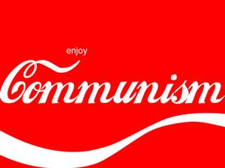
Authoritarian Socialism | Also known as Communism. Supports revolution to overthrow capitalism. The entire economy is controlled by the government.

Slide 21
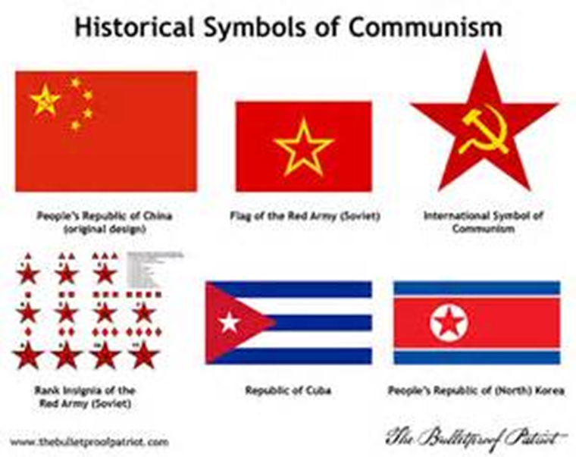

Slide 22
What are some benefits of Capitalism? | Economic efficiency and personal freedom. Higher rate of economic growth.

Slide 24
What are some criticisms of Capitalism? | Uneven distribution of wealth.

Slide 25
What are some criticisms of Capitalism? | Uneven distribution of wealth. Some may have inadequate services.

Slide 26
What are some criticisms of Capitalism? | Uneven distribution of wealth. Some may have inadequate services. Entrepreneurs may fail.

Slide 27
SUMMARIZE
Discuss at your table & answer on your response sheet.
5. Compare and contrast Democratic and Authoritarian Socialism.
6. Give some examples of why we prefer Capitalism.
7. What are some drawbacks to Capitalism?
Are you on target (white, black, blue, red or yellow)?
Did you hit the bullseye?
Learning Target: Compare Socialism & Capitalism

Slide 28
What are some criticisms of Socialism? | Too much government interference in the economy.

Slide 29
What are some criticisms of Socialism? | Too much government interference in the economy. Limited personal freedoms.

Slide 30
What are some criticisms of Socialism? | Too much government interference in the economy. Limited personal freedoms. Inefficiency. Slow rate of economic growth.

Slide 31
Pure Socialism | The government (state) owns the means of production. The government controls all economic planning (centralized).

Slide 32
What are the characteristics of Pure Socialism? (page 52) | 1. Prices are set by the state.

Slide 33
What are the characteristics of Pure Socialism? (page 52) | 1. Prices are set by the state. 2. Strict control of the movement of resources and labor.

Slide 34
What are the characteristics of Pure Socialism? (page 52) | 1. Prices are set by the state. 2. Strict control of the movement of resources and labor. 3. State ownership of the factors of production. Limited private property.

Slide 35
What are the characteristics of Pure Socialism? (page 52) | 1. Prices are set by the state. 2. Strict control of the movement of resources and labor. 3. State ownership of the factors of production. Limited private property. 4. State makes business decisions. No individual risk taking.

Slide 36
What are the characteristics of Pure Socialism? (page 52) | 1. Prices are set by the state. 2. Strict control of the movement of resources and labor. 3. State ownership of the factors of production. Limited private property. 4. State makes business decisions. No individual risk taking. 5. Economic decisions are made by the state.

Slide 37
What are the characteristics of Pure Socialism? (page 52) | 1. Prices are set by the state. 2. Strict control of the movement of resources and labor. 3. State ownership of the factors of production. Limited private property. 4. State makes business decisions. No individual risk taking. 5. Economic decisions are made by the state. 6. Taxation used to redistribute income.

Slide 38
What are the characteristics of Capitalism? | 1. Personal freedom.

Slide 39
What are the characteristics of Capitalism? | 1. Personal freedom. 2. Individual initiative.

Slide 40
What are the characteristics of Capitalism? | 1. Personal freedom. 2. Individual initiative. 3. Efficiency.

Slide 41
What are the characteristics of Capitalism? | 1. Personal freedom. 2. Individual initiative. 3. Efficiency. 4. Economic growth.

Slide 42
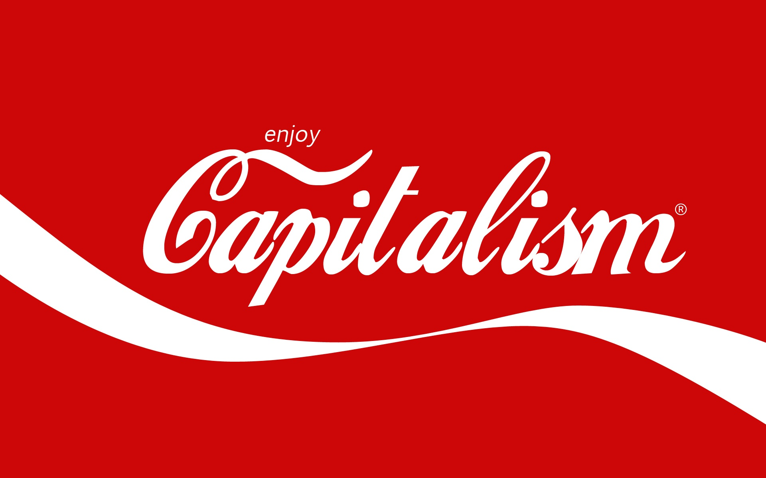
What is a Market Economy? Give an example. | Capitalism – The U.S. Individuals own the means of production and make economic decisions with no (or very limited) government involvement. The free exchange of goods and services between buyers and sellers.

Slide 43
Pair Share
Are there benefits in a Socialist society? Explain.

Slide 44
Who does the planning for socialist and capitalist economies? | Capitalism – Democratic Socialism – Authoritarian Socialism –

Slide 45
Who does the planning for socialist and capitalist economies? | Capitalism – Private individuals Democratic Socialism – Authoritarian Socialism –

Slide 46
Who does the planning for socialist and capitalist economies? | Capitalism – Private individuals Democratic Socialism – Limited governmental control Authoritarian Socialism –

Slide 47
Who does the planning for socialist and capitalist economies? | Capitalism – Private individuals Democratic Socialism – Limited governmental control Authoritarian Socialism – Government controls everything

Slide 48
SUMMARIZE
Discuss at your table & answer on your response sheet.
8. Explain why Capitalism is better than Socialism. Or is it?
9. Explain Pure Socialism.
10. Should we have more or less government involvement in the economy in the U.S. or is it about right? Explain.
Are you on target (white, black, blue, red or yellow)?
Did you hit the bullseye?
Learning Target: Compare Socialism & Capitalism

Slide 49
Success Criteria
Did you hit the Target?
Can you explain how you met the goals of today’s lesson?
Some aspects of a socialist economy include…
An example of a country with socialist economy is…
Some aspects of a capitalist economy include…
An example of a country with capitalist economy is…
Learning Target: Compare Socialism & Capitalism

