Slide 1
ECONOMICS
Ch. 2.3: The Goals of the Nation
Learning Target: Identify the goals of our Free-enterprise system and the rights and responsibilities of individuals

Slide 2
What are the goals of Free Enterprise? | 1. 4. 2. 5. 3. 6.

Slide 3
What are the goals of Free Enterprise? | 1. Freedom 4. Security 2. Efficiency 5. Stability 3. Equity 6. Growth

Slide 4
Economic Freedom | Freedom to make choices.

Slide 5
Economic Efficiency | Using limited resources wisely. Lowest cost of production and the least amount of waste (due to scarcity).

Slide 6
Economic Equity | The balancing of economic policy so that it is fair and just. Such as equal pay, fairness in hiring, and no discrimination.

Slide 7
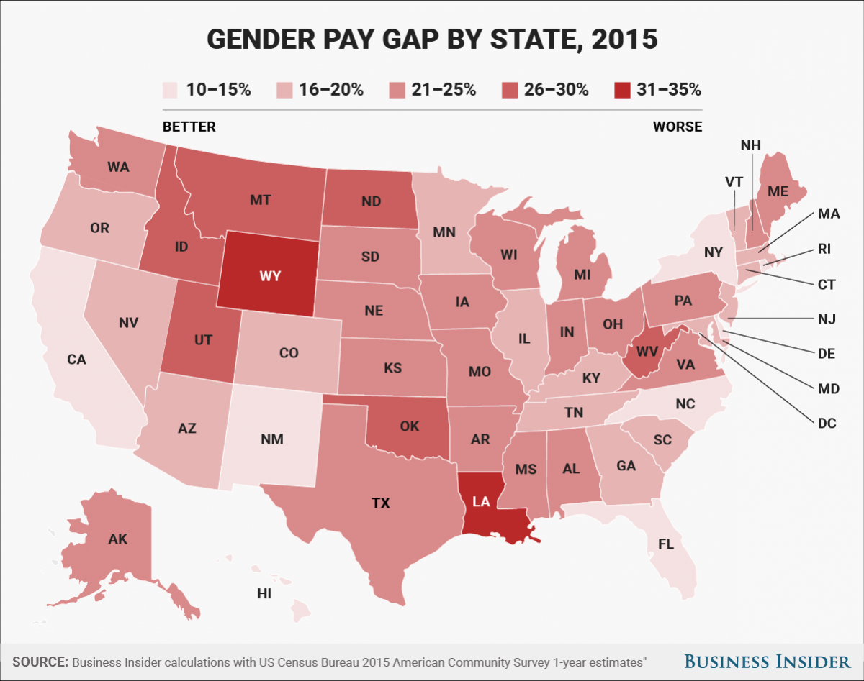

Slide 8
http://www.businessinsider.com
March 08, 2017

Slide 9
According to data taken from the US Census Bureau, the average gender pay gap in the United States is around 21%, meaning that, on average, a woman earns 21% less than her male counterpart. That gap can be larger or smaller depending on the state someone lives in.
In Louisiana, for instance, the gender pay gap is 34.7%, the biggest wage gap in the nation. 21 states in the country currently have gender pay gaps that are larger than the national average.
Most states have implemented laws against gender discrimination, and all but three have laws prohibiting employers from discriminating on the basis of gender, the report says.
Washington, D.C. has the smallest pay gap at 10.4%, which means that women earn an average of 10.4% less than men in the area.

Slide 10
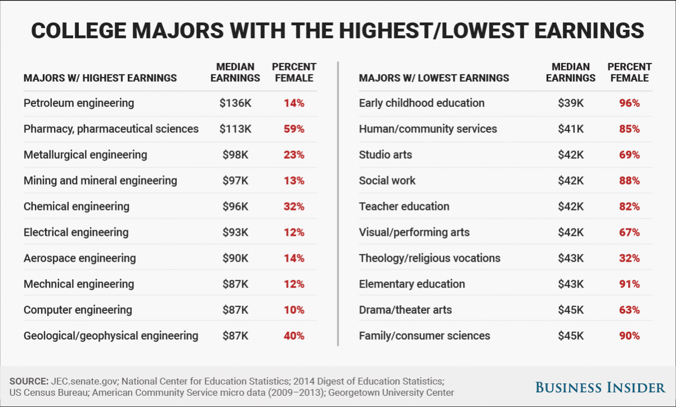

Slide 11
Economic Security | Protection against risks beyond our control – natural disasters, injury, business or bank failures, old age. Examples: Government social programs: Social Security, unemployment benefits, etc.

Slide 12
Economic Stability | Reduce extreme ups and downs in the standard of living.

Slide 13
What is the standard of living and how is it measured?

Slide 14
What is the standard of living and how is it measured? | The material well-being of an individual, group, or nation.

Slide 15
What is the standard of living and how is it measured? | The material well-being of an individual, group, or nation. Measured by the average value of goods and services used by the average citizen over a given period of time.

Slide 16
Economic growth | Producing more goods and services over the long term. As population increases, so must the economy. More goods = more choice = more hiring = more investment…

Slide 17
Why is economic growth an important goal of the free-enterprise system?

Slide 18
Why is economic growth an important goal of the free-enterprise system? | As population increases the economy needs to expand to satisfy the additional needs and wants. Economic growth helps nations meet other goals.

Slide 19
SUMMARIZE
Discuss at your table & answer on your response sheet.
1. Which goal refers to fair and just economic policy?
2. Which goal deals with using resources in the best way?
3. What is the goal of Economic Growth?
4. The material well-being of an individual or group is…
Are you on target (white, black, blue, red or yellow)?
Did you hit the bullseye?
Learning Target: Identify the goals of our Free-enterprise system and the rights and responsibilities of individuals

Slide 20
What are some individual rights in a free enterprise system?

Slide 21
What are some individual rights in a free enterprise system? | Career choice.

Slide 22
What are some individual rights in a free enterprise system? | Career choice. Be a “workaholic” or work very little.

Slide 23
What are some individual rights in a free enterprise system? | Career choice. Be a “workaholic” or work very little. Buy what you want and reject others.

Slide 24
What are some individual rights in a free enterprise system? | Career choice. Be a “workaholic” or work very little. Buy what you want and reject others. Spend, save or invest your money.

Slide 25
What are some individual rights in a free enterprise system? | Career choice. Be a “workaholic” or work very little. Buy what you want and reject others. Spend, save or invest your money. Bankruptcy.

Slide 26
What are some individual responsibilities in a free enterprise system?

Slide 27
What are some individual responsibilities in a free enterprise system? | Support yourself and your family. Pay taxes.

Slide 28
What are some individual responsibilities in a free enterprise system? | Support yourself and your family. Pay taxes. Use your education to be a productive member of society.

Slide 29
What are some individual responsibilities in a free enterprise system? | Support yourself and your family. Pay taxes. Use your education to be a productive member of society. Be knowledgeable about government and issues and vote.

Slide 30
What are trade-offs among the goals of a free enterprise system? | Freedom – Some business will fail.

Slide 31
What are trade-offs among the goals of a free enterprise system? | Freedom – Some business will fail. Efficiency – Scarcity, not enough to go around.

Slide 32
What are trade-offs among the goals of a free enterprise system? | Freedom – Some business will fail. Efficiency – Scarcity, not enough to go around. Equity – In trying to be fair, some may get discriminated against.

Slide 33
What are trade-offs among the goals of a free enterprise system? | Freedom – Some business will fail. Efficiency – Scarcity, not enough to go around. Equity – In trying to be fair, some may get discriminated against. Security – Limits resources that could have been used elsewhere.

Slide 34
What are trade-offs among the goals of a free enterprise system? | Freedom – Some business will fail. Efficiency – Scarcity, not enough to go around. Equity – In trying to be fair, some may get discriminated against. Security – Limits resources that could have been used elsewhere. Stability – Some will enjoy large gains from other’s losses.

Slide 35
PAIR SHARE
Is there something better than the Free Enterprise System?
Discuss this with a neighbor and then with the whole neighborhood ☺.

Slide 36
SUMMARIZE
Discuss at your table & answer on your response sheet.
5. Describe some economic rights that we have.
6. Describe some economic responsibilities in the U.S.
7. Is there something better than the Free Enterprise System? Explain.
8. Write your own definition for Standard of Living.
Are you on target (white, black, blue, red or yellow)?
Did you hit the bullseye?
Learning Target: Identify the goals of our Free-enterprise system and the rights and responsibilities of individuals

Slide 37
Pair Share
What responsibilities do we have as citizens of the U.S.?
Do you agree with these?
Are they different other places?

Slide 38
Did you hit the target?
Success Criteria
Can you identify goals of our Free-enterprise system?
Can you identify the rights and responsibilities of individuals in our country?
Explain on your Response Sheet.
Learning Target: Identify the goals of our Free-enterprise system and the rights and responsibilities of individuals

