Slide 1
ECONOMICS
Ch. 2.2: Characteristics of the American Economy
Learning Target: Identify characteristics of a Market Economy

Slide 2
Adam Smith (p. 43 & 11) | In An Inquiry into the Nature and Causes of Wealth of Nations he described a system where government has little role in the economy.

Slide 3
Adam Smith (p. 43 & 11) | In An Inquiry into the Nature and Causes of Wealth of Nations he described a system where government has little role in the economy. He said people left on their own would work for their own self-interest and be led by an “invisible hand” to use resources efficiently and achieve the maximum good for society.

Slide 4
Adam Smith (p. 43 & 11) | In An Inquiry into the Nature and Causes of Wealth of Nations he described a system where government has little role in the economy. He said people left on their own would work for their own self-interest and be led by an “invisible hand” to use resources efficiently and achieve the maximum good for society. In other words, the government should not interfere in the marketplace. This system Smith described is Capitalism.

Slide 5

Laissez-faire or Pure Capitalism

Slide 6
Laissez-faire or Pure Capitalism | Minimal government influence in the economy.

Slide 7
Laissez-faire or Pure Capitalism | Minimal government influence in the economy. Does not exist in the U.S.

Slide 8
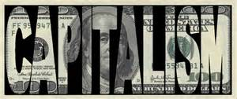
Capitalism
Learning Target: Identify characteristics of a Market Economy

Slide 9
Capitalism | Private property. Individuals own means of production.

Slide 10


SUMMARIZE
Discuss at your table & answer on your response sheet.
1. What did Adam Smith say about the government’s role in the economy?
2. Explain a Laissez-faire economic system.
3. This is an economic system where individuals own the factors of production and make their own decisions.
Are you on target (white, black, blue, red or yellow)?
Did you hit the bullseye?
Learning Target: Identify characteristics of a Market Economy

Slide 11
What role does the government play in the American economy?

Slide 12

What role does the government play in the American economy? | Role of government in the U.S. economy is on the increase.

Slide 13




What role does the government play in the American economy? | Role of government in the U.S. economy is on the increase. Government regulates: - food and drugs - banks - working conditions; OSHA - the environment; EPA - social programs; Social Security, Medicare - others…

Slide 14
What is a Free-enterprise system?

Slide 15
What is a Free-enterprise system? | Same as Capitalism – The U.S. Individuals own the means of production and make economic decisions with no (or very limited) government involvement.

Slide 16
What does it mean to have freedom of choice?

Slide 17
What does it mean to have freedom of choice? | Individuals freely choose what to buy.

Slide 18

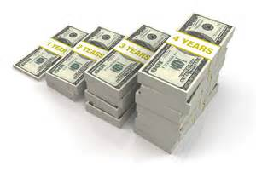
Profit | The amount left over after all the costs of production have been paid.
Learning Target: Identify characteristics of a Market Economy

Slide 19
What is a profit incentive?
Learning Target: Identify characteristics of a Market Economy

Slide 20
What is a profit incentive? | The desire to make a profit. This motivates entrepreneurs to produce new goods and services.

Slide 21
SUMMARIZE
Discuss at your table & answer on your response sheet.
4. Give several examples of how the government is involved in the U.S. economy.
5. This is the amount left over after paying the costs of production.
6. What motivates entrepreneurs?
Are you on target (white, black, blue, red or yellow)?
Did you hit the bullseye?
Learning Target: Identify characteristics of a Market Economy

Slide 22
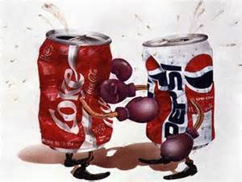
How does competition fit into the free-enterprise system?
Learning Target: Identify characteristics of a Market Economy

Slide 23
How does competition fit into the free-enterprise system? | Competition leads to lower prices and/or better goods/service.

Slide 24

Private property | Individuals or groups own the property, NOT the government. Risk is involved – you could lose everything.

Slide 26
List 5 items you own or have access to that would be considered private property on the left. How could these items be used to generate wealth?
Item | How could these items be used to generate wealth?
1. Shovel | Snow removal.
2.
3.
4.
5.

Slide 27
SUMMARIZE
Discuss at your table & answer on your response sheet.
7. Why is competition a good thing?
8. What would a business have if they had no competition?
9. What risk is involved with private property?
10. Who owns the means of production in the U.S.?
Are you on target (white, black, blue, red or yellow)?
Did you hit the bullseye?
Learning Target: Identify characteristics of a Market Economy

Slide 28
ECONOMICS
Ch. 2.2: Characteristics of the American Economy
Learning Target: Identify characteristics of a Market Economy
Success Criteria:
I can explain several characteristics of a market economy.
They are…
An example of a market economy is…

