Slide 1
ECONOMICS
Ch. 2.1: Economic Systems
Learning Target: Understand types of Economic Systems (Economies) & the Circular Flow of Income and Output

Slide 2
What are the 3 Basic Questions in Economics?
Learning Target: Understand types of Economic Systems (Economies) & the Circular Flow of Income and Output

Slide 3
1. What should be produced?

Slide 4
1. What should be produced? | If more of a product is produced, less of something else will be produced. All choices have trade-offs. What a nation produces often depends on its natural resources.

Slide 5
2. How should it be produced?

Slide 6
2. How should it be produced? | How many workers (skilled or unskilled)? Will capital goods (machines) be used (this will lower the number of workers needed)? What types of technology will be used? What are the trade-offs?

Slide 7
3. For whom should it be produced?

Slide 8
3. For whom should it be produced? | Who receives the goods? Who decides?

Slide 9
3. For whom should it be produced? | Who receives the goods? Who decides? - In the U.S. anyone willing and able to pay for it.

Slide 10
3. For whom should it be produced? | Who receives the goods? Who decides? - In the U.S. anyone willing and able to pay for it. - In other countries goods may be distributed by majority rule, a lottery, first-come-first serve, sharing equally, military force, government distribution or in other ways.

Slide 11
What is an Economic system?
Learning Target: Understand types of Economic Systems (Economies) & the Circular Flow of Income and Output

Slide 12
What is an Economic system? | The way a nation uses its resources to satisfy its people’s needs and wants. Answers the three basic questions.

Slide 13
What is a Traditional Economy?
Learning Target: Understand types of Economic Systems (Economies) & the Circular Flow of Income and Output

Slide 14
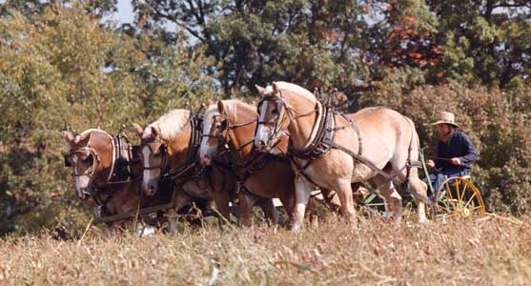
What is a Traditional Economy? | Done the way things have always been.

Slide 15
What is a Traditional Economy? | Done the way things have always been. Economy is based on customs and beliefs handed down from generation to generation. Things tend to stay the same. Examples: some native groups throughout the world

Slide 16
What is a Command Economy?
Learning Target: Understand types of Economic Systems (Economies) & the Circular Flow of Income and Output

Slide 17
What is a Command Economy? | Government leaders, not tradition, control the economy.

Slide 18
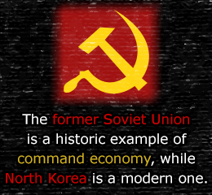
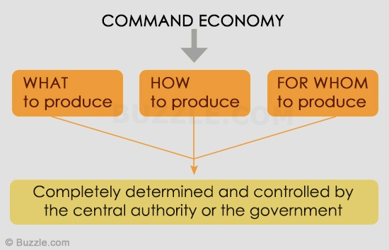
What is a Command Economy? | Government leaders, not tradition, control the economy. All economic decisions and factors of production are controlled by the government. Examples: North Korea and Cuba, China (to a lesser extent)

Slide 19
What type of economy lacks Incentives?
Learning Target: Understand types of Economic Systems (Economies) & the Circular Flow of Income and Output

Slide 20
What type of economy lacks Incentives? | Command economies lack incentives (rewards) for working hard. Why?

Slide 21
What is a Market Economy? Give an example.
Learning Target: Understand types of Economic Systems (Economies) & the Circular Flow of Income and Output

Slide 22
What is a Market Economy? Give an example. | Capitalism – The U.S.

Slide 23
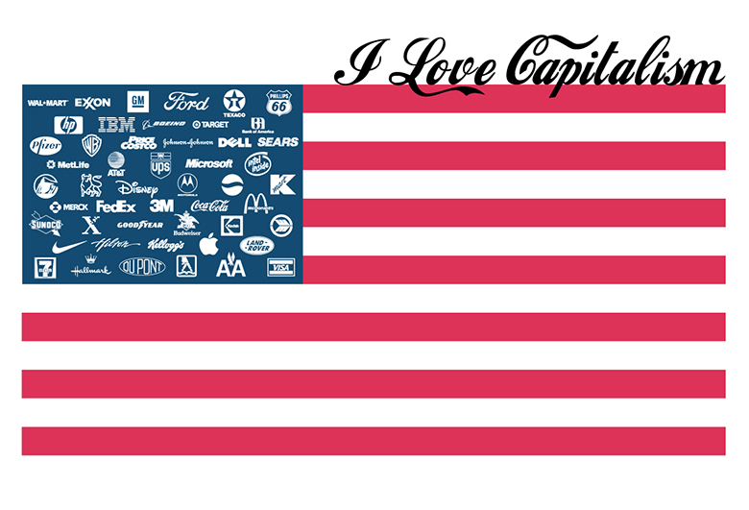
What is a Market Economy? Give an example. | Capitalism – The U.S. Individuals own the means of production and make economic decisions with no (or very limited) government involvement. The free exchange of goods and services between buyers and sellers.

Slide 24
SUMMARIZE
Discuss at your table & answer on your response sheet.
1. All economies answer what three questions?
2. Explain a traditional economy.
3. Explain a command economy and give an example.
4. Describe a market economy. What is another name for it?
Are you on target (white, black, blue, red or yellow)?
Did you hit the bullseye?
Learning Target: Understand types of Economic Systems (Economies) & the Circular Flow of Income and Output

Slide 25
What is a Market Economy? Give an example. | Capitalism – The U.S. Individuals own the means of production and make economic decisions with no (or very limited) government involvement. The free exchange of goods and services between buyers and sellers.

Slide 26
What is a PURE Market Economy?
Learning Target: Understand types of Economic Systems (Economies) & the Circular Flow of Income and Output

Slide 27
What is a PURE Market Economy? | One with UNRESTRICTED competition. Does it exist?

Slide 28
Explain the Circular flow of Income and Output model. | See figure 2.2 on page 39.
Learning Target: Understand types of Economic Systems (Economies) & the Circular Flow of Income and Output

Slide 29
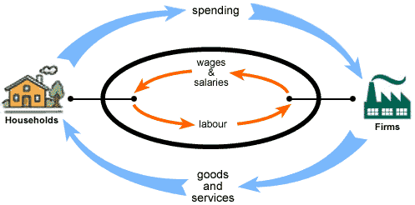
Explain the Circular flow of Income and Output model. | Income flows continuously between businesses and consumers. See figure 2.2 on page 39.

Slide 30
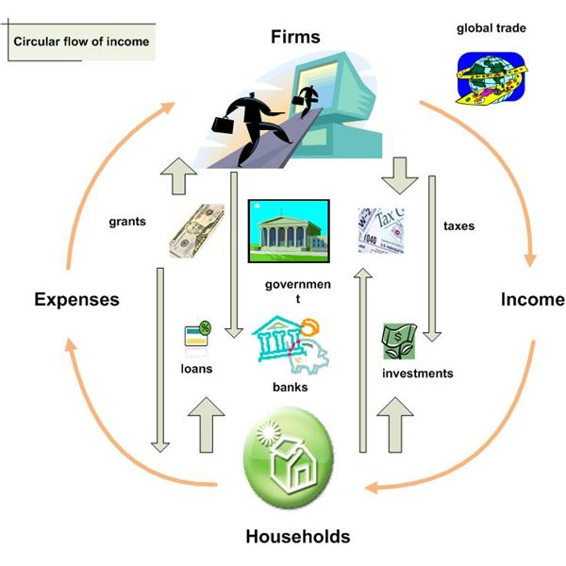

Slide 31
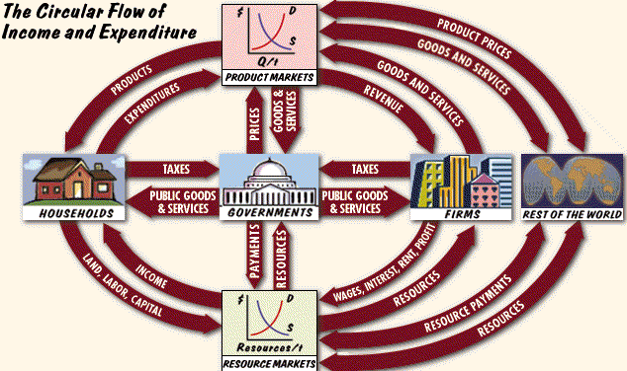

Slide 32
What is a Mixed Economy? Give an example of a country with a mixed economy.
Learning Target: Understand types of Economic Systems (Economies) & the Circular Flow of Income and Output

Slide 33
What is a Mixed Economy? Give an example of a country with a mixed economy. | Combines basic features of a market economy and a command economy. Most developed countries have a mixed economy with limited government intervention and regulations.

Slide 34
What is a Mixed Economy? Give an example of a country with a mixed economy. | Combines basic features of a market economy and a command economy. Most developed countries have a mixed economy with limited government intervention and regulations. Examples of government involvement include safety regulations, environmental protections, and laws to protect consumers. Examples: Canada, the U.S.?

Slide 35
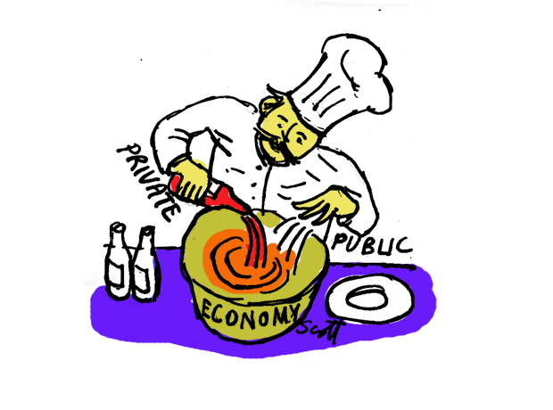

Slide 36
SUMMARIZE
Discuss at your table & answer on your response sheet.
5. What is a pure market economy?
6. What does the circular flow of income and output show?
7. A mixed economy combines features of what types of economies?
8. Give an example of a mixed economy.
Are you on target (white, black, blue, red or yellow)?
Did you hit the bullseye?
Learning Target: Understand types of Economic Systems (Economies) & the Circular Flow of Income and Output

Slide 37
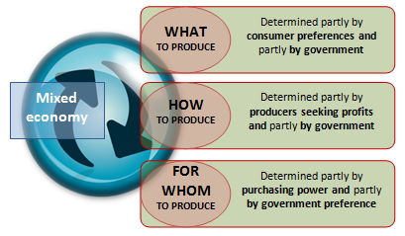

Slide 38
Economic Systems
Type of System (example) | Who answers 3 questions? | Advantages | Disadvantages
Traditional
Command
Market
Mixed
Learning Target: Understand types of Economic Systems (Economies) & the Circular Flow of Income and Output

Slide 39
Economic Systems
Type of System (example) | Who answers 3 questions? | Advantages | Disadvantages
Traditional | Customs
Command | Government
Market | Individuals
Mixed | Individuals and Government

Slide 40
Economic Systems
Type of System (example) | Who answers 3 questions? | Advantages | Disadvantages
Traditional | Customs | Clearly defined roles | Inefficient and hard to change
Command | Government | Helps the needy | Few incentives to work hard and a lack of consumer choice.
Market | Individuals | Freedom to choose careers. Choice in goods and services. | Some will struggle
Mixed | Individuals and Government | Checks and Balances | Government control can be excessive

Slide 41
ECONOMICS
Ch. 2.1: Economic Systems
Learning Target: Understand types of Economic Systems (Economies) & the Circular Flow of Income and Output
Success Criteria:
I can explain the types of Economic Systems (Economies).
They are… An example is…
I can explain the Circular Flow of Income and Output model.
It shows…

