Slide 1

ECONOMICS
Chapter 15.2: Money Supply and the Economy
Learning Target: Understand how the Fed controls the money supply & interest rates

Slide 2
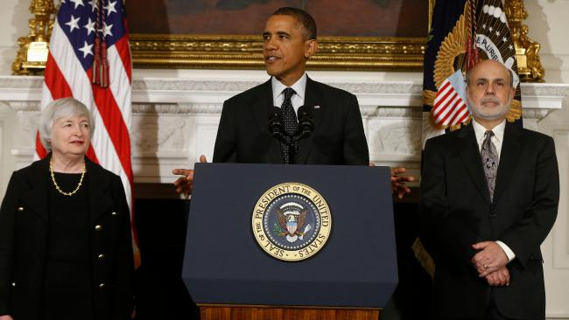
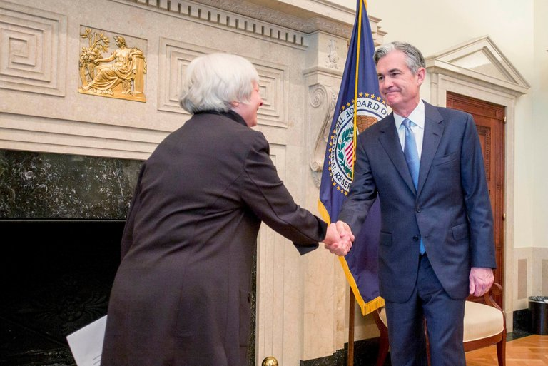
Who is the current Chairman of the FED?

Slide 3
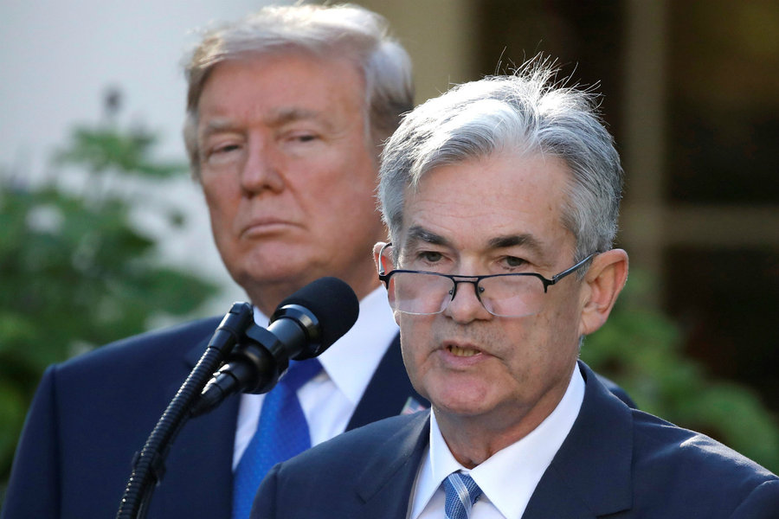
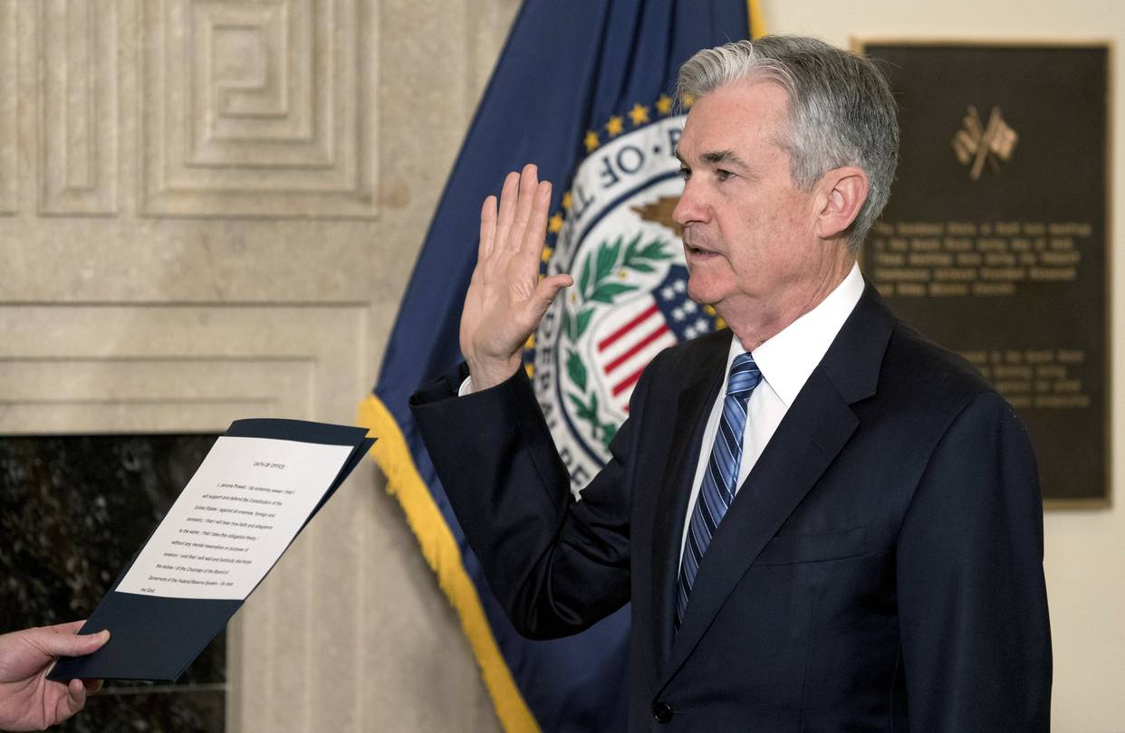

Slide 4
ECONOMICS
Chapter 15.2: Money Supply and the Economy
Learning Target: Understand how the Fed controls the money supply & interest rates
Success Criteria
You should be able to…
1. Describe loose and tight money policies
2. Analyze how fractional reserve banking works
3. Explain how the Fed can expand the amount of money in circulation

Slide 5
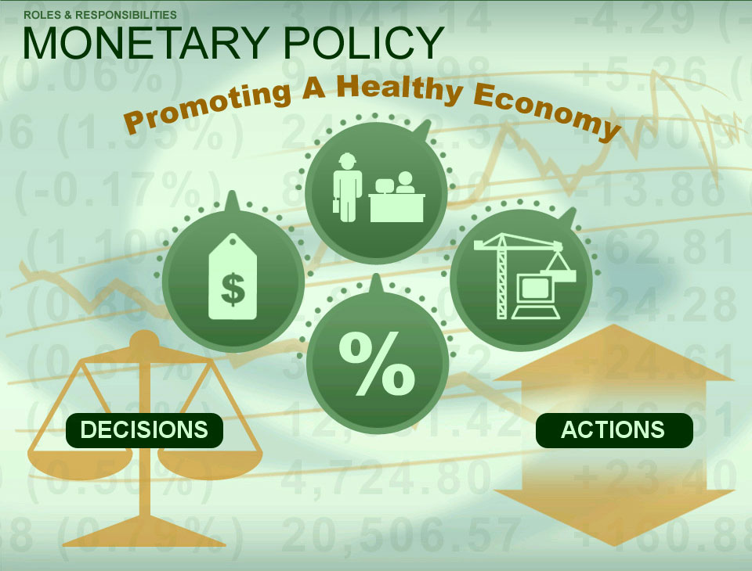
What is the goal of monetary policy? | To promote economic growth & employment without causing inflation.

Slide 6


What cost goes along with extending credit? How is the cost of credit related to the demand for borrowing? | The cost of credit is Interest. As the cost of credit (borrowing) increases, amount demanded decreases. As the cost of credit (borrowing) decreases, amount demanded increases.

Slide 7

Loose money policy Figure 15.4, page 399 | Also called expansionary. Credit is inexpensive and abundant. Encourages economic growth. May lead to inflation.

Slide 8

Tight money policy Figure 15.4, page 399 | Also called contractionary. Credit is expensive and in short supply. Controls inflation. May lead to a recession.

Slide 9
ECONOMICS
Chapter 15.2: Money Supply and the Economy
Learning Target: Understand how the Fed controls the money supply & interest rates
Success Criteria
You should be able to…
1. Describe loose and tight money policies
2. Analyze how fractional reserve banking works
3. Explain how the Fed can expand the amount of money in circulation

Slide 10
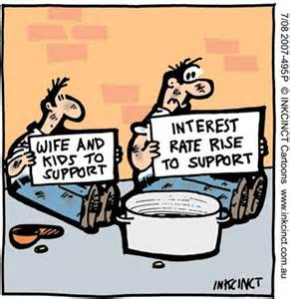

Slide 11
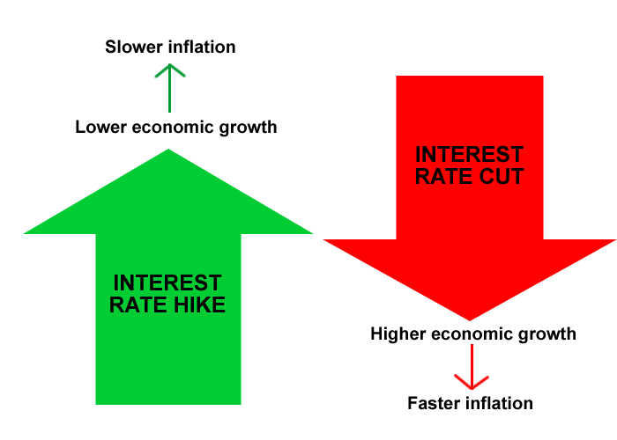

Slide 12
Under what conditions might the Fed want to institute a loose money policy? A tight money policy? | Loose money policy – To encourage borrowing and stimulate business. Tight money policy – To slow economic growth and reduce inflation.

Slide 13


Let’s Review
Discuss at your table.
Explain the goal of monetary policy?
Describe an expansionary money policy?
Describe a contractionary money policy?
Why would a tight or loose money policy be implemented?
Are you on target (white, black, blue, red or yellow)?
Did you hit the bullseye?
Learning Target: Understand how the Fed controls the money supply & interest rates

Slide 14
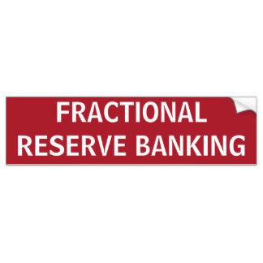
Fractional Reserve Banking | A system in which only a portion of the deposits in a bank is kept on reserve. The remainder is available to lend.

Slide 15
ECONOMICS
Chapter 15.2: Money Supply and the Economy
Learning Target: Understand how the Fed controls the money supply & interest rates
Success Criteria
You should be able to…
1. Describe loose and tight money policies
2. Analyze how fractional reserve banking works
3. Explain how the Fed can expand the amount of money in circulation

Slide 16
Reserve requirements | Regulations set by the Fed requiring banks to keep a certain percentage (currently 10%) of their deposits as cash in their own vaults or as deposits in their Federal Reserve banks.

Slide 17
What do banks do with the money that is not required to be kept in reserve? How does this expand the money supply? | It is used for loans. The lending of the money results in a multiple expansion of the money supply as the money is re-lent and re-deposited throughout the banking system.

Slide 18
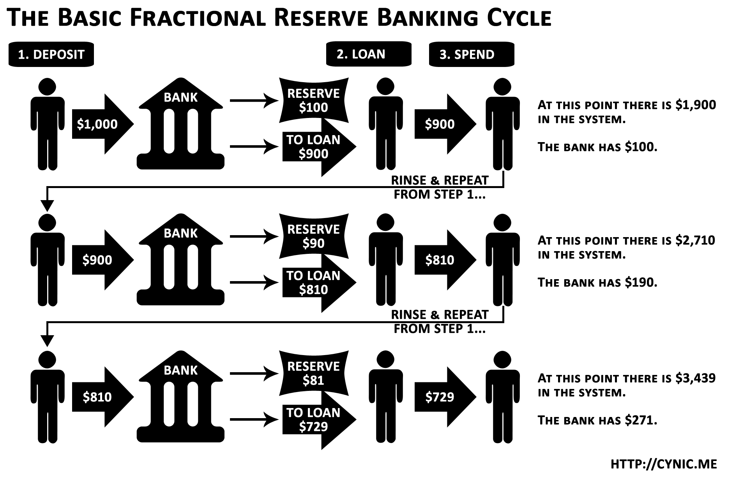

Slide 19
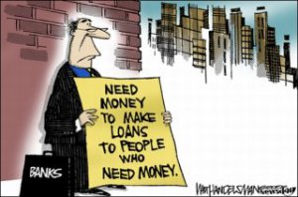

Slide 20
Why does the government require banks to keep reserves? | So that there is always some cash available for people to withdraw.

Slide 21
What is the advantage to a bank of fractional reserves? | There is always some cash on hand (available).

Slide 22
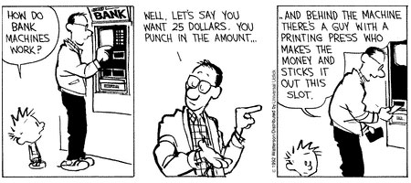

Slide 23
Let’s Review
Discuss at your table.
What is Fractional Reserve Banking?
What are reserve requirements?
What might happen if someone with a large deposit in a bank or credit union wanted to withdraw it all at once?
Are you on target (white, black, blue, red or yellow)?
Did you hit the bullseye?
Learning Target: Understand how the Fed controls the money supply & interest rates

Slide 24
ECONOMICS
Chapter 15.2: Money Supply and the Economy
Learning Target: Understand how the Fed controls the money supply & interest rates
Success Criteria
You should be able to…
1. Describe loose and tight money policies
2. Analyze how fractional reserve banking works
3. Explain how the Fed can expand the amount of money in circulation

Slide 26



SUCCESS CRITERIA
#WeLoveToLearn

