Slide 1
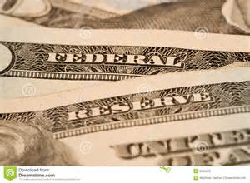
ECONOMICS
Chapter 15.1: Organization and Functions of the Fed
Learning Target: Understand the Fed and its role in Monetary Policy

Slide 2
ECONOMICS
Chapter 15.1: Organization and Functions of the Fed
Learning Target: Understand the Fed and its role in Monetary Policy
Success Criteria
You should be able to…
1. Explain how the Fed is organized and how it governs
2. Identify the different functions of the Fed
3. Explain how a check clears

Slide 3
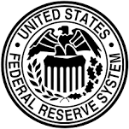
What are some ways the government can influence economic stability and growth? | Raising or lowering taxes, buying goods or services, encouraging saving or spending by influencing inflation rates, passing laws…
Why was the Fed created? | The Federal Reserve System (Fed) was created in 1913 to set monetary policy and limit recessions.

Slide 4
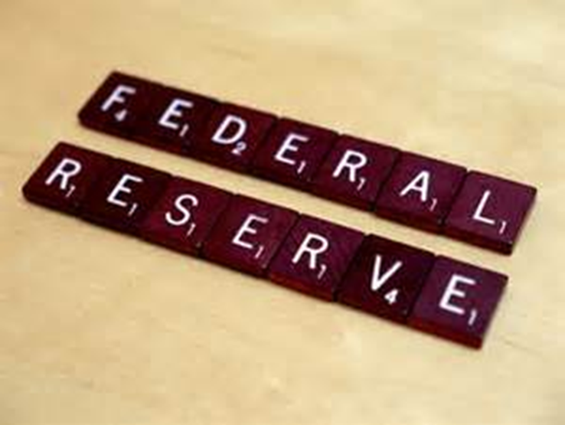
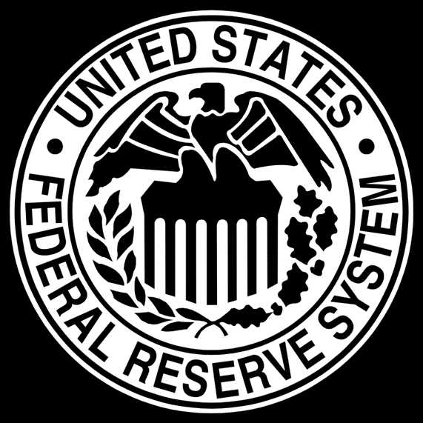

Slide 5
Monetary Policy | Involves changing the rate of growth of the supply of money in circulation in order to affect the cost and availability of credit.
Organization of the Federal Reserve System (Fed) Figure 15.1, page 392 | Board of Governors Federal Advisory Council Federal Open Market Committee Federal Reserve Banks

Slide 6
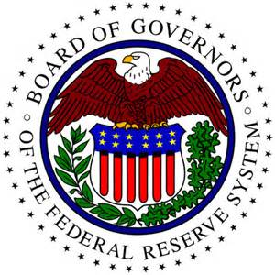
Board of Governors | Directs the operations of the Fed and supervises the 12 Federal reserve district banks. Also regulates some activities of member banks. 7 members appointed by the President and approved by the Senate.
How is the Board’s independence protected? | They serve for 14 years but cannot be reappointed and their decisions are not subject to Presidential or Congressional approval.

Slide 7
Federal Advisory Council (FAC) | Assists and reports to the Board of Governors. 12 members elected by the directors of the Federal district banks. Report on the general business conditions in the U.S.
Why is it important that members of the FAC be from different parts of the country? | Business conditions can be different in different regions of the country, and the Fed must make policy for the nation’s economy as a whole.

Slide 8


Let’s Review
Discuss at your table.
When and why was the FED create?
What are the duties of the Board of Governors?
Explain the term for a member of the Board of Governors?
What is the job of the Federal Advisory Council?
Are you on target (white, black, blue, red or yellow)?
Did you hit the bullseye?
Learning Target: Understand the Fed and its role in Monetary Policy

Slide 9
Federal Open Market Committee (FOMC) | 12 member committee in the Federal Reserve System that decides how the Fed should control the nation’s money supply. Decides whether to raise or lower interest rates.
Federal Reserve District Banks Figure 15.2, page 394

Slide 10
Federal Open Market Committee (FOMC) | 12 member committee in the Federal Reserve System that decides how the Fed should control the nation’s money supply. Decides whether to raise or lower interest rates.
Federal Reserve District Banks Figure 15.2, page 394 | The U.S. is divided into 12 districts with each having a Federal district bank. (There are 12 Federal Reserve District Banks). Each is set up as a corporation owned by its member banks.

Slide 11
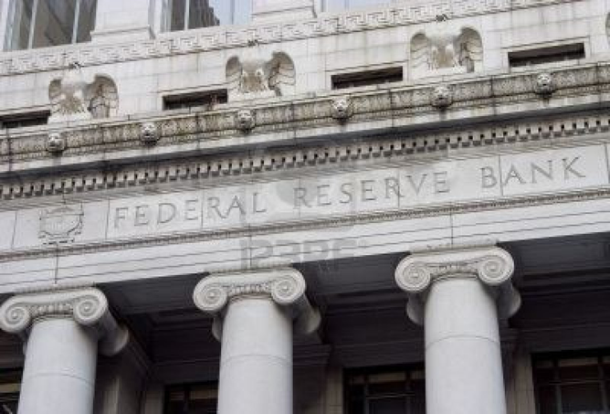

Slide 12
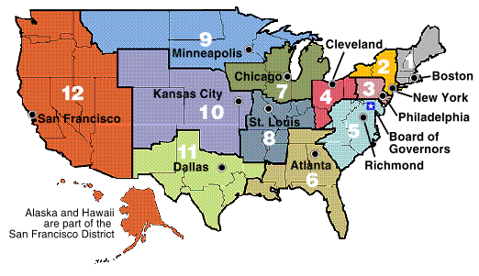

Slide 13
Let’s Review
Discuss at your table.
What does the Federal Open Market Committee decide?
How many Federal Reserve Districts are there?
What Federal Reserve district are we in?
Where is our Federal Reserve District bank?
Are you on target (white, black, blue, red or yellow)?
Did you hit the bullseye?
Learning Target: Understand the Fed and its role in Monetary Policy

Slide 14
ECONOMICS
Chapter 15.1: Organization and Functions of the Fed
Learning Target: Understand the Fed and its role in Monetary Policy
Success Criteria
You should be able to…
1. Explain how the Fed is organized and how it governs
2. Identify the different functions of the Fed
3. Explain how a check clears

Slide 15
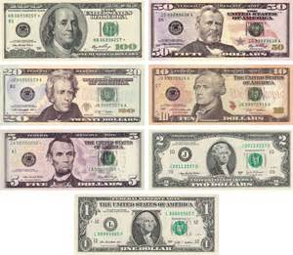
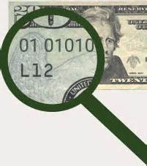
Federal Reserve Notes | Each Federal Reserve Note is issued by one of the 12 Federal Reserve Banks. That bank's district letter (from A through L) and corresponding district number (from 1 through 12) appear on each note.

Slide 16
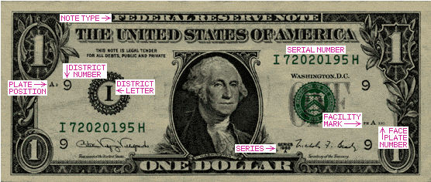
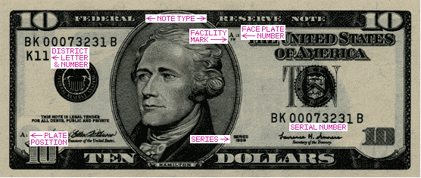

Slide 17
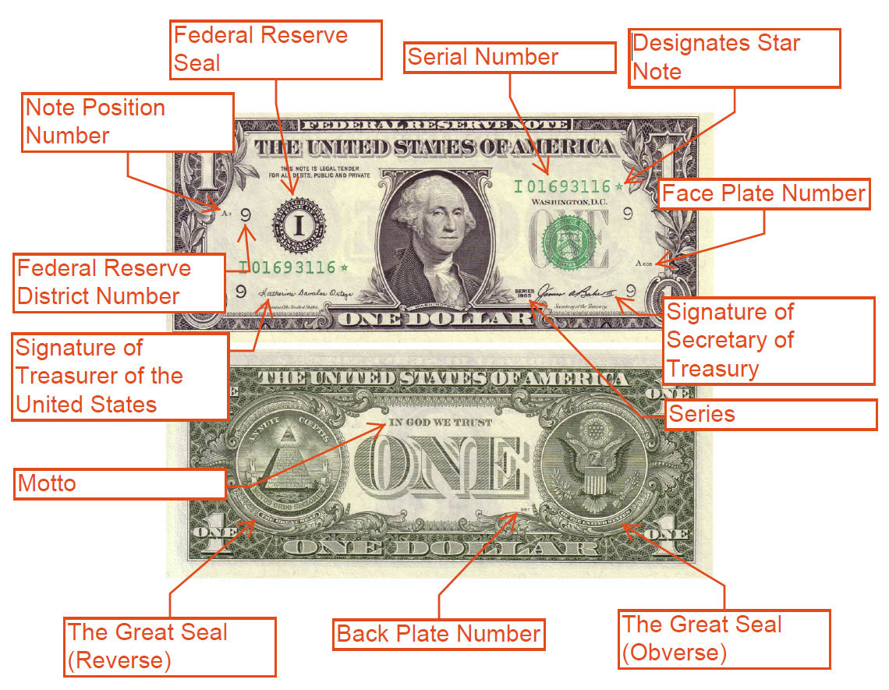

Slide 19
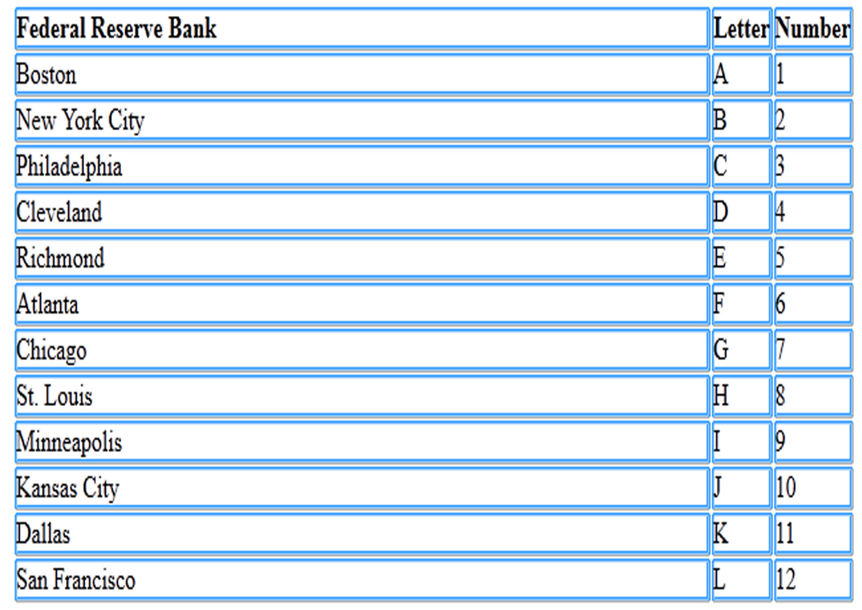

Slide 20
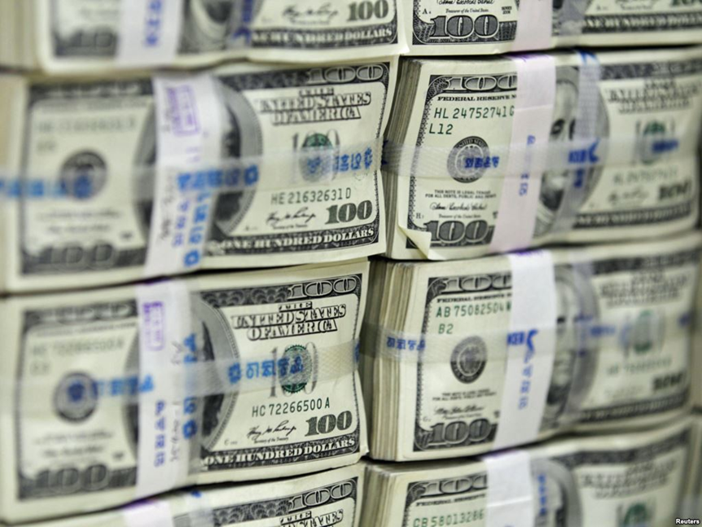
Other banks | All national banks are required to become members of the Federal Reserve System. All institutions that accept deposits must keep funds in their district bank.
What is the primary function of the Fed? | To regulate (control) the money supply in the U.S.

Slide 21
Other functions of the Fed | Check clearing, supervising banks, holding reserves and setting reserve requirements, and supplying paper currency.
Check clearing Figure 15.3, page 395 | Method by which a check that has been deposited in one institution is transferred to the issue’s depository institution.

Slide 22
ECONOMICS
Chapter 15.1: Organization and Functions of the Fed
Learning Target: Understand the Fed and its role in Monetary Policy
Success Criteria
You should be able to…
1. Explain how the Fed is organized and how it governs
2. Identify the different functions of the Fed
3. Explain how a check clears

Slide 23
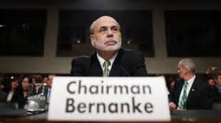
Ben Bernanke | Ben S. Bernanke began a second term as Chairman of the Board of Governors of the Federal Reserve System on February 1, 2010. He originally took office as Chairman on February 1, 2006, when he also began a 14-year term as a member of the Board. His second term as Chairman ended January 31, 2014, and his term as a Board member was to end January 31, 2020. He resigned in 2014. His job is to maintain economic growth while keeping inflation and unemployment low.

Slide 24
Let’s Review
Discuss at your table.
What do the letters and numbers on our currency tell us?
Explain the relationship between a bank and its Federal Reserve bank.
What else does the FED do?
What is the job of the Chairman of the Board of Governors ?
Are you on target (white, black, blue, red or yellow)?
Did you hit the bullseye?
Learning Target: Understand the Fed and its role in Monetary Policy

Slide 25
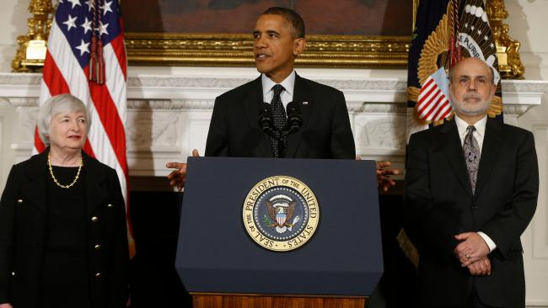
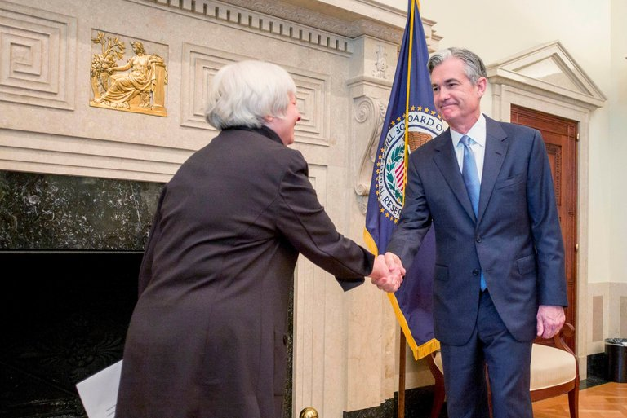
Who is the current Chairman of the FED? | Find out for tomorrow for Extra Credit ☺

Slide 26
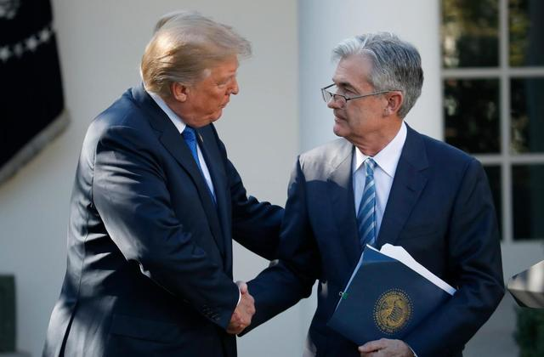
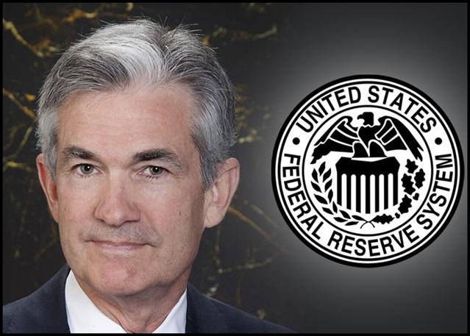

Slide 27
Explain how the Fed performs each function:
Clearing checks | Transfers money from one bank to another through checks.
Supervising members | Sees that Fed requirements are enforced.
Setting and managing reserves | Adjusts required deposits by banks (affects money supply).
Supplying paper money | Determines how much money to make available.

Slide 28
ECONOMICS
Chapter 15.1: Organization and Functions of the Fed
Learning Target: Understand the Fed and its role in Monetary Policy
Success Criteria
You should be able to…
1. Explain how the Fed is organized and how it governs
2. Identify the different functions of the Fed
3. Explain how a check clears

Slide 30



SUCCESS CRITERIA
#WeLoveToLearn

