Slide 1
ECONOMICS
Ch. 1.3: What Do Economists Do?
p. 20-25
Learning Target: Understand Economic Models, Laissez-faire and Economic theories

Slide 2
What are economic models, who uses these models and what are they used for?

Slide 3
What are economic models, who uses these models and what are they used for? | Used by economists to explain and predict economic behavior.

Slide 4
Economy

Slide 5
Economy | The production and distribution of goods and services in a society.

Slide 6
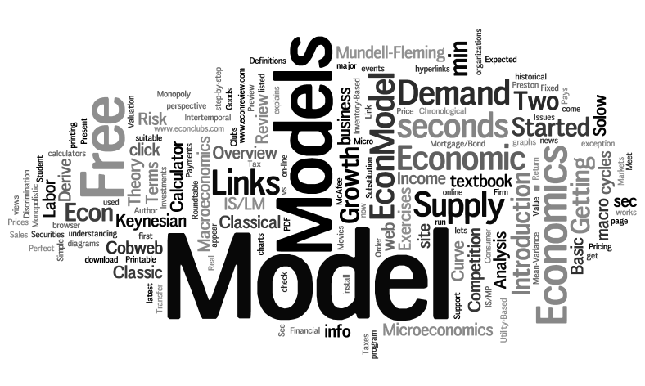
Economic models

Slide 7
Economic models | A theory or simplified representation that helps explain and predict economic behavior in the real world.

Slide 8
Theory (Hypothesis)

Slide 9
Theory (Hypothesis) | An educated guess or prediction.

Slide 10
What do economic models show?

Slide 11
What do economic models show? | Economic models show visual representations of economic behavior.

Slide 12
What are the steps to making an economic model?

Slide 13
What are the steps to making an economic model? | Begin with an idea about the way things work.

Slide 14
What are the steps to making an economic model? | Begin with an idea about the way things work. 2. Collect facts and discard those not relevant.

Slide 15
What are the steps to making an economic model? | Begin with an idea about the way things work. 2. Collect facts and discard those not relevant. 3. Test the theory (hypothesis).

Slide 16
SUMMARIZE
Discuss at your table & answer on your response sheet.
1. Why are economic models used?
2. Write a definition for Economy in your own words.
3. Explain the steps in creating an economic model.
Are you on target (white, black, blue, red or yellow)?
Did you hit the bullseye?
Learning Target: Understand Economic Models, Laissez-faire and Economic theories

Slide 17
How are economic models tested? | See figure 1.5, page 23.

Slide 18
How are economic models tested? | Collect data and input it into the model to see if the theory is supported. See figure 1.5, page 23.

Slide 19
Can economic models be applied to real life? How?

Slide 20
Can economic models be applied to real life? How? | Yes and no. Economists can use models in an attempt to predict how people will react in different economic situations. Models may not take into account multiple factors influencing people’s behavior. No model can be perfect…

Slide 21
What are the different schools of economic thought?

Slide 22
What are the different schools of economic thought? | Government Involvement or Intervention vs. Government maintaining a “hands off” policy toward the economy.

Slide 23
Laissez-faire

Slide 24
Laissez-faire | “Hands off”

Slide 25
SUMMARIZE
Discuss at your table & answer on your response sheet.
4. Draw an example of a usable economic model.
5. What might cause an economic model to be wrong?
6. Explain Laissez-faire.
Are you on target (white, black, blue, red or yellow)?
Did you hit the bullseye?
Learning Target: Understand Economic Models, Laissez-faire and Economic theories

Slide 27
What is the general economic thought of democrats?

Slide 28
What is the general economic thought of democrats? | Free markets are unstable and government involvement is sometimes necessary.

Slide 29
What is the general economic thought of republicans?

Slide 30
What is the general economic thought of republicans? | Free markets will take care of themselves and government involvement should be minimal.

Slide 31
SUMMARIZE
Discuss at your table & answer on your response sheet.
7. Who is more likely to follow Laissez-faire - Democrats or Republicans?
8. Compare and contrast the different economic beliefs of Democrats and Republicans
9. What animals are used to represent Democrats and Republicans?
Are you on target (white, black, blue, red or yellow)?
Did you hit the bullseye?
Learning Target: Understand Economic Models, Laissez-faire and Economic theories

Slide 32
Economic Models
Benefits | Drawbacks

Slide 33
Economic Models
Benefits | Drawbacks
Help explain economic behavior.

Slide 34
Economic Models
Benefits | Drawbacks
Help explain economic behavior.
Simplify relationships and variables.

Slide 35
Economic Models
Benefits | Drawbacks
Help explain economic behavior.
Simplify relationships and variables.
Help to predict future events.

Slide 36
Economic Models
Benefits | Drawbacks
Help explain economic behavior. | May oversimplify real-world situations.
Simplify relationships and variables.
Help to predict future events.

Slide 37
Economic Models
Benefits | Drawbacks
Help explain economic behavior. | May oversimplify real-world situations.
Simplify relationships and variables. | May be influenced by personal values and beliefs.
Help to predict future events.

Slide 38
Economic Models
Benefits | Drawbacks
Help explain economic behavior. | May oversimplify real-world situations.
Simplify relationships and variables. | May be influenced by personal values and beliefs.
Help to predict future events. | Economists may disagree about accuracy and usefulness of a model.

Slide 39
Did you hit the target?
Success Criteria
Can you explain what an economic model is and why it is used?
Could you explain the concept of Laissez-faire to a friend?
Can you describe some economic theories and their core beliefs?
I hope so ☺
Explain on your Response Sheet.
Learning Target: Understand Economic Models, Laissez-faire and Economic theories

