Slide 1
ECONOMICS
Ch. 1.2: Trade-Offs
p. 14-19
Learning Target: Learn Trade-Offs and Opportunity Cost; Understand Production Possibilities Curve

Slide 2
What are the Potential Costs associated with Trade-Offs?

Slide 3
What are the Potential Costs associated with Trade-Offs? | What you give up, such as time or money (income or savings).

Slide 4
Trade-Off

Slide 5
Trade-Off | Sacrificing one good or service to buy or make another.

Slide 6
Opportunity Cost

Slide 7
Opportunity Cost | The value of the next best alternative that was given up for the alternative that was chosen.

Slide 8
What is a Production Possibility Curve used for?

Slide 9
What is a Production Possibility Curve used for? | To help determine how much of each item to produce.

Slide 10
What is a Production Possibility Curve used for? | To help determine how much of each item to produce. Shows trade-offs and opportunity costs in each decision.

Slide 11
Production Possibility Curve

Slide 12
Production Possibility Curve | A model that shows the maximum combination of goods and services that can be produced from a fixed amount of resources in a given time period.

Slide 13
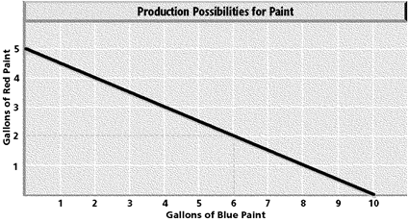
Production Possibility Curve | A model that shows the maximum combination of goods and services that can be produced from a fixed amount of resources in a given time period.

Slide 14
 | What is the opportunity cost of making 2 gallons of red paint?

Slide 15
 | What is the opportunity cost of making 2 gallons of red paint? 4 gallons of blue paint

Slide 16
SUMMARIZE
Discuss at your table & answer on your response sheet.
1. What is a Trade-Off? Give an example.
2. Write a definition for Opportunity Cost in your own words.
3. What is a Production Possibilities Curve used for?
4. What does a Production Possibilities Curve show?
Are you on target (white, black, blue, red or yellow)?
Did you hit the bullseye?
Learning Target: Learn Trade-Offs and Opportunity Cost; Understand Production Possibilities Curve

Slide 17
Guns vs Butter

Slide 18
Guns vs Butter | Classic example comparing spending on military defense and civilian goods. See figure 1.4 on page 18.

Slide 19
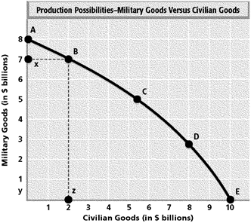

Slide 20
What is the opportunity cost of producing $7 billion of Military Goods?

Slide 21
$8 billion in Civilian Goods

Slide 22
What is the approximate opportunity cost of producing $5 billion in Civilian Goods?

Slide 23
Approximately $3 billion in Military Goods

Slide 24
Trade offs
Choice involves exchanging one good or service for another
People are forced to make a trade off every time they use a resource in one way and not another

Slide 25
Opportunity cost
Value of next best alternative
Opportunity that was given up
If you study you give up free time
If you skip work you give up money
If you miss my class you give up my explanation of the lesson

Slide 26
Decision | Trade-Off | Opportunity Cost
Buying something you want
Saving your money

Slide 27
Decision | Trade-Off | Opportunity Cost
Buying something you want | Time and effort spent earning money.
Saving your money

Slide 28
Decision | Trade-Off | Opportunity Cost
Buying something you want | Time and effort spent earning money. | Sacrificing other purchases and savings.
Saving your money

Slide 29
Decision | Trade-Off | Opportunity Cost
Buying something you want | Time and effort spent earning money. | Sacrificing other purchases and savings.
Saving your money | Time and effort spent earning money.

Slide 30
Decision | Trade-Off | Opportunity Cost
Buying something you want | Time and effort spent earning money. | Sacrificing other purchases and savings.
Saving your money | Time and effort spent earning money. | Delay purchasing things you want.

Slide 31
SUMMARIZE
Discuss at your table & answer on your response sheet.
5. Explain Guns vs. Butter.
6. Figure 1.3, p. 17 – Answer Economic Analysis question
7. Figure 1.4, p. 18 – Answer Economic Analysis question
Are you on target (white, black, blue, red or yellow)?
Did you hit the bullseye?
Learning Target: Learn Trade-Offs and Opportunity Cost; Understand Production Possibilities Curve

Slide 32
Group activity
Create a production possibilities graph and write two question(s) to go with it.
Learning Target: Learn Trade-Offs and Opportunity Cost; Understand Production Possibilities Curve

