Slide 1
Economics
Final Review 2020
Ch. 1
The factors of
production include?

Slide 2
A company's office
buildings
are an example of…

Slide 3
The value of the next best alternative that has to be given up for the action that is chosen is the…

Slide 4
A production
possibilities curve
helps determine this.

Slide 5
Why do Economists
build
economic models?

Slide 6
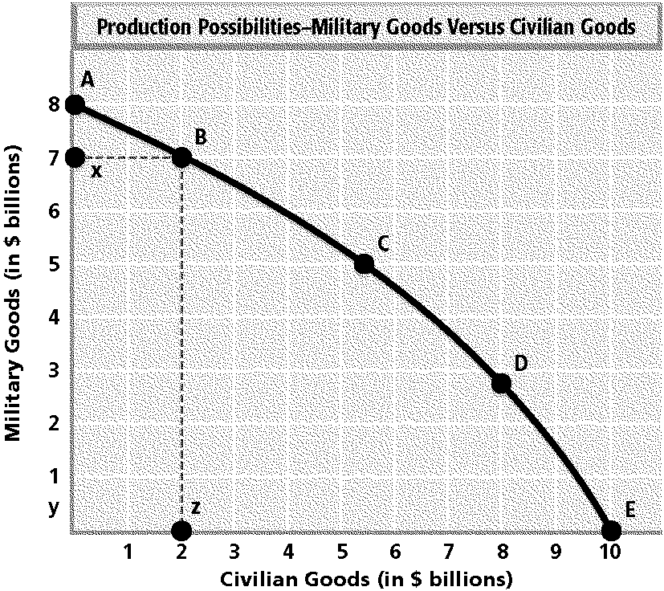
Study the graph. Suppose this nation starts with producing all military goods, represented by point A. It then decides to produce a mix of civilian and military goods, represented by point B. What represents the cost in military goods given up?
the horizontal distance between
point z and point E
the horizontal distance between
point y and point z
the vertical distance from point A
to point x
the vertical distance between
point x and point y

Slide 7
What is the basic
problem of
economics?

Slide 8
Entrepreneurship
refers to the ability to
do this.

Slide 9
Ch. 2
In a capitalist system,
most property is…

Slide 10
It is easier to start
your own business in
this type of economy.

Slide 11
What does the word
"equity“ means…

Slide 12
Pure socialism is characterized by…
________________________
What did Karl Marx believe?

Slide 13
The economic goals of the American free-enterprise system include…

Slide 14
Another term for a capitalist system is…

Slide 15
Ch. 6
What are treasury bonds?

Slide 16
Describe some advantages and disadvantages to investing in real estate.

Slide 17
What is the Dow-Jones Industrial Average?

Slide 18
What is the purpose of the
Federal Deposit
Insurance Corporation
(FDIC)?

Slide 19
What is the difference between a stock and a bond?

Slide 20
A person who sells a stock for more than they payed has earned this.

Slide 21
Ch. 7
The interaction of supply and demand determines this.

Slide 22
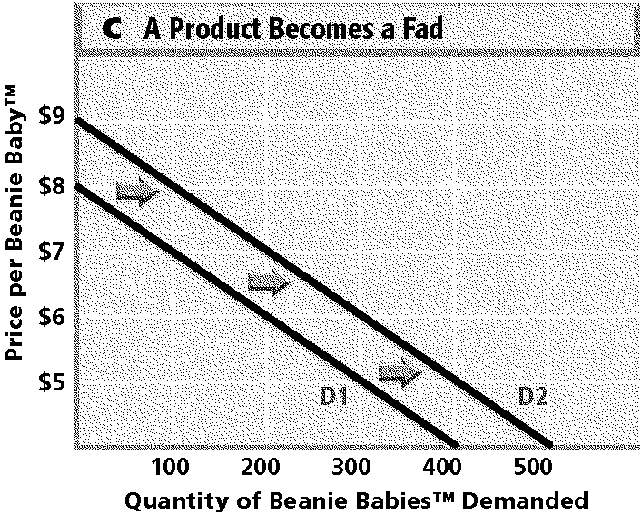
Based on this graph, how many Beanie Babies™ were demanded at a price of $6 before they became a fad?
a. 200 c. 400
b. 300 d. 100

Slide 23
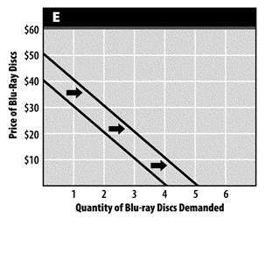
Which of the following choices could cause the movement shown in this graph?
a. a decrease in the price of Blu-ray players c. an increase in the price of Blu-ray discs
b. a decrease in the price of Blu-ray discs d. an increase in the price of Blu-ray players

Slide 24
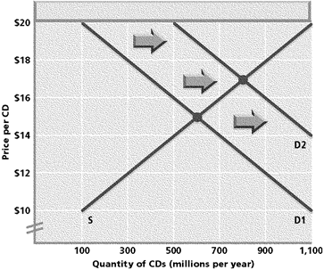
Suppose the demand curve shifts from D1 to D2, as shown on the graph. How do the quantity supplied and quantity demanded change at the new equilibrium price?
a. Quantity supplied decreases and
quantity demanded increases.
Both quantity supplied and
quantity demanded increase.
Both quantity supplied and
quantity demanded decrease.
Quantity supplied increases and
quantity demanded decreases.

Slide 25
When the price of a good is too high for consumers, they look for this.

Slide 26
Explain diminishing marginal utility.

Slide 27
According to the law of supply, higher prices prompt producers to do this.

Slide 28
If the price of an item rises, quantity demanded usually does this.

Slide 29
This is the principle that states that the more you have of something, the less satisfaction you will get from an additional unit.

Slide 30
Explain the difference between elastic and inelastic goods.

Slide 31
Demand for one particular brand of candy is probably…
Generally, the more substitutes there are for a good, the more ___________ the good is.

Slide 32
If the price of a product is above its equilibrium price, the result is a…

Slide 33
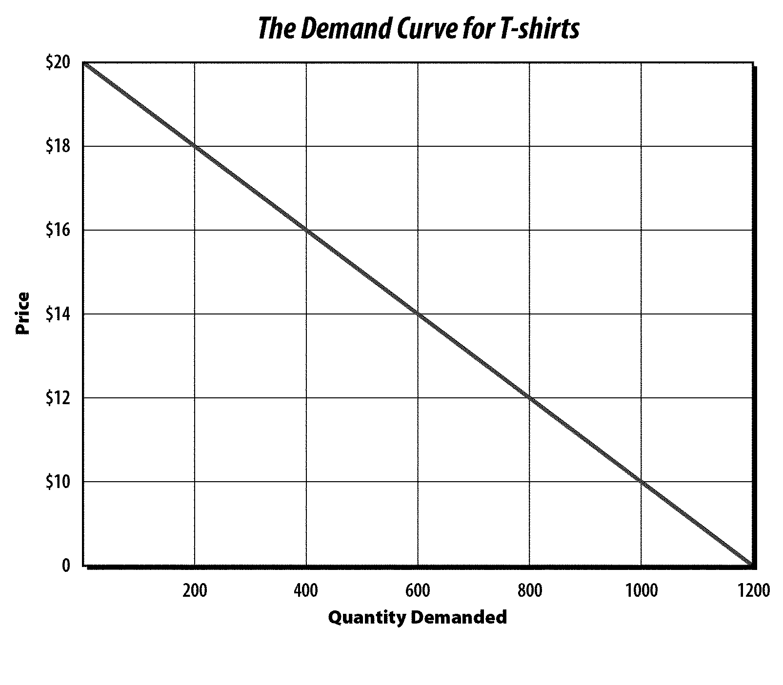
According to this demand curve, how many t-shirts will be demanded at a price of $10?
According to this demand curve, if the price of t-shirts increases from $14 to $16, the quantity demanded will…

Slide 34
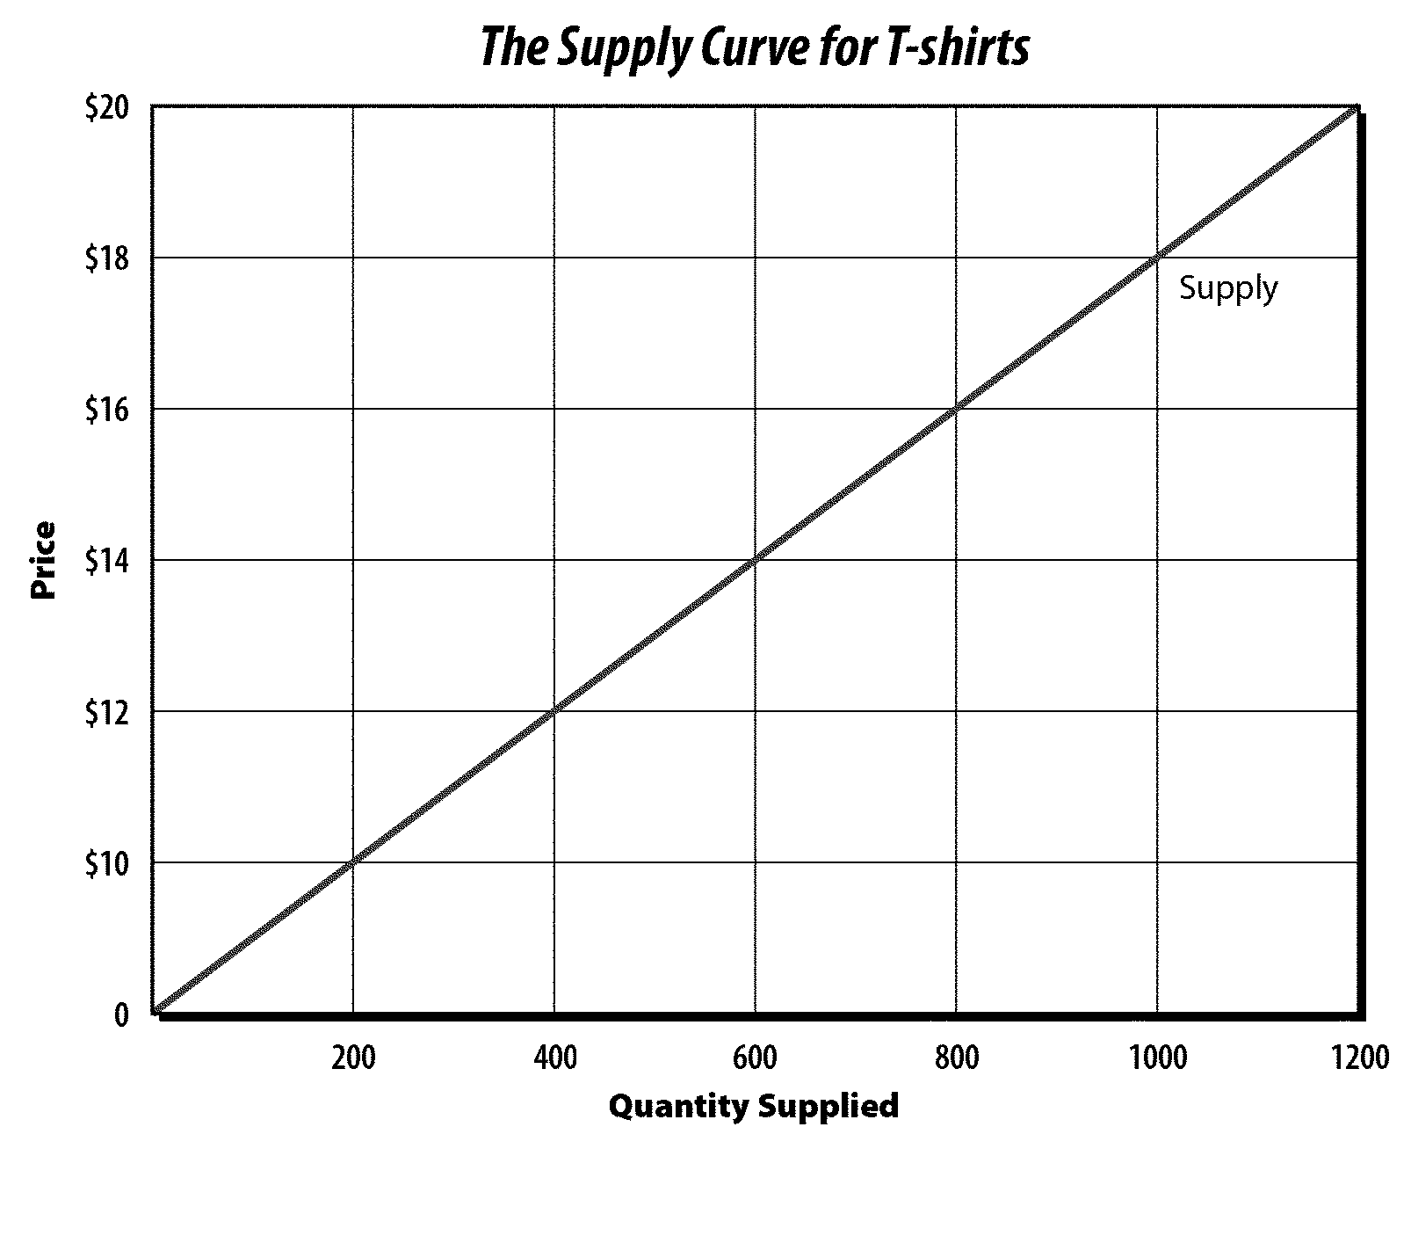
According to this supply curve, if the price of t-shirts decreases from $18 to $16, the quantity supplied will…

Slide 35
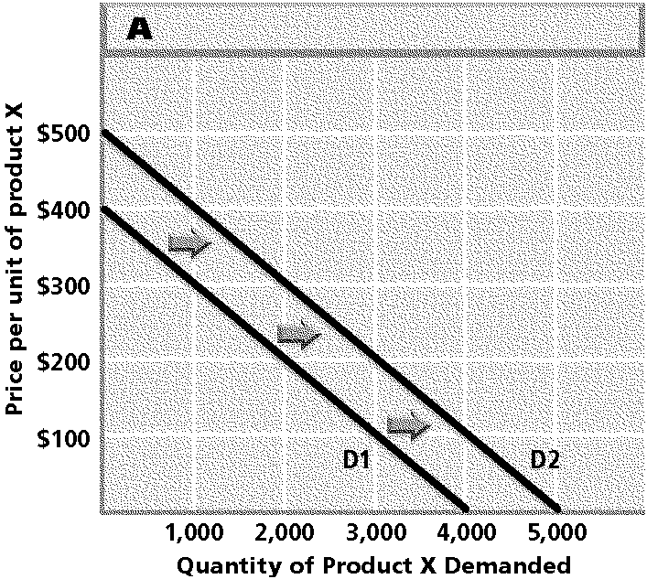
Which of the following choices could cause the movement shown in the graph?
a) a decrease in income?
b) an increase in population?
c) a decrease in the price of a substitute?
d) an increase in the price of a complement?

Slide 36
Ch. 13
A way to measure the economy's performance is to measure categories of national…

Slide 37
The total dollar value of all the nation’s final goods and services produced over the course of a year is called this.

Slide 38
What does the rise or fall
of coincident indicators
indicate?

Slide 39
What do economists use economic indicators for?

Slide 40
How would you describe business cycles in the United States?

Slide 41
What does the producer price index measure?

Slide 42
What happens when inflation occurs?

Slide 43
The part of the business cycle in which the economy starts to slow down is called…

Slide 44
During the 1930s, the United States experienced this.

Slide 45
New orders for consumer goods and changes in the number of building permits issued for private homes are examples of what type of indicator?

Slide 46
Ch. 14
Describe the functions of money.

Slide 47
Which institution makes all of the coins in the United States?

Slide 48
Why was the FDIC created?

Slide 49
Why is it important for money to be durable?

Slide 50
Why was the Federal Reserve System established?

Slide 51
What is included in near moneys?

Slide 52
What is Representative money?
What is Fiat money?
What is Comodity money?

Slide 53
Ch. 15
What tools does the Federal Reserve use to affect the money supply?

Slide 54
Which types of institutions must belong to the Federal Reserve?

Slide 55
When credit is inexpensive and easy to get, the Fed is probably using this type of policy.

Slide 56
Explain what a reserve requirement of 20% means.

Slide 57
How many Federal Reserve districts are in the United States?

Slide 58
Which of the following is affected by decisions of the Federal Open Market Committee?
The amount of individual loans
Check clearing
Interest rates
Congress’ ability to in coins

Slide 59
Ch. 16
An excise tax is a tax paid on…

Slide 60
Where does the budget-making process at the national level begin?

Slide 61
What are negative or positive side effects of the production process called?

Slide 62
Explain deficit financing.

Slide 63
Property taxes, which are calculated as a percentage of the value of a home, are an example of this type of tax/principal.

Slide 64
What historic event made people believe that there was a need for more government programs, particularly “safety net” programs for the needy?

Slide 65
Programs aimed only at people who are poor or disabled are known as this.

Slide 66
Ch. 18
What is an embargo?

Slide 67
Depreciation of the Japanese yen would make Japanese products sold in the United States…

Slide 68
What is a tariff?

Slide 69
The ability of one country, using the same quantity of resources as another country, to produce a specific product at a lower cost is known as this.

Slide 70
This is the ability of one country to produce a product at a lower opportunity cost than another country.

Slide 71
What is the purpose of a protective tariff?

Slide 72
Explain what the International Monetary Fund is and does.
The end. Please study. Good luck! ☺

