Slide 1
ECONOMICS
Chapter 18.2: Financing World Trade
Learning Target: Understand currency exchange rates & Balance of Trade

Slide 2
ECONOMICS Chapter 18.2: Financing World Trade Learning Target: Understand currency exchange rates & Balance of Trade
Success Criteria
You should be able to…
Analyze the changing relationship between the U.S. economy and the global economy including a nation’s balance of trade
2. Assess the impact of monetary policy, exchange rates and interest rates on domestic activity and world trade
3. Describe how interest rates in the U.S. impact the value of the dollar against other currencies and explain how exchange rates affect the value of U.S. goods and services in other markets

Slide 3
Examples of mediums of exchange | U.S. – dollar; Mexico – peso; India – rupee; Japan – yen; Brazil – real; Canada – dollar; China – renminbi (yuan); France – euro; Spain – euro; U.K. – pound; Russia – ruble; Ghana – cedi; Iraq – dinar
Exchange rate | The price of one nation’s currency in terms of another nation’s currency.

Slide 4
Foreign exchange markets | Markets that buy and sell foreign currency allowing businesses to convert money from one currency to another.
How can you convert money into another currency? | At banks or border crossings.

Slide 5
Fixed rate of exchange | A system in which a national government sets the value of its currency in relation to other countries.
How does inflation affect the exchange rate of currency? | Inflation causes a currency to lose value. Its exchange rate will then drop, causing goods in that country to be more costly for foreigners to buy.

Slide 6
Let’s Review
Discuss at your table.
What does a dollar’s exchange rate refer to?
What is a market that buys and sells foreign currency allowing for the conversion of money from one currency to another called?
Explain a fixed rate of exchange.
How does inflation impact exchange rates and the cost of our goods for foreigners?
Are you on target (white, black, blue, red or yellow)?
Did you hit the bullseye?
Learning Target: Understand currency exchange rates & Balance of Trade

Slide 7
Flexible exchange rate When did the U.S. switch from a fixed rate to a flexible one? | When the forces of supply and demand are allowed to set the price of various currencies. President Nixon announced the end of the fixed exchange rate and the beginning of a flexible rate for the U.S. in 1971.
Devaluation How does it affect a country’s role in foreign trade? | The lowering of a currency’s value in relation to other currencies by government order. It makes a country’s products cheaper for other nations to buy.

Slide 8
Depreciation and currency | The fall in the price of a currency through the action of supply and demand.
What affect does depreciation of a country’s currency have on its products? | It will make the country’s products less expensive in foreign countries. For example, if China’s currency depreciates it will make Chinese products sold in the U.S. cheaper.

Slide 9
Let’s Review
Discuss at your table.
Explain how a flexible exchange rate works.
What is devaluation?
Why is depreciation of a country’s currency significant?
Are you on target (white, black, blue, red or yellow)?
Did you hit the bullseye?
Learning Target: Understand currency exchange rates & Balance of Trade

Slide 10
IMF | The International Monetary Fund (IMF) is an international agency that offers monetary advice and provides loans to developing nations.
Balance of trade | The difference between the value of a nation’s exports and imports.

Slide 11
How can depreciation affect balance of trade? | If a nation’s currency depreciates the country will likely export more goods because its products are cheaper for other nations to buy. If a nation’s currency increases in value the amount of exports will likely decline because its products will become more expensive to buy.
What is the difference between a positive and negative balance of trade? | A positive balance of trade occurs when the value of goods exported exceeds the value of goods imported. A negative balance of trade occurs when the value of goods imported is greater than the value of goods exported.

Slide 12
Trade deficit | A negative balance of trade. The U.S. has had a consistent trade deficit since 1976 due to high imports of oil and consumer products (see page 475).
U.S. imports and exports

Slide 13
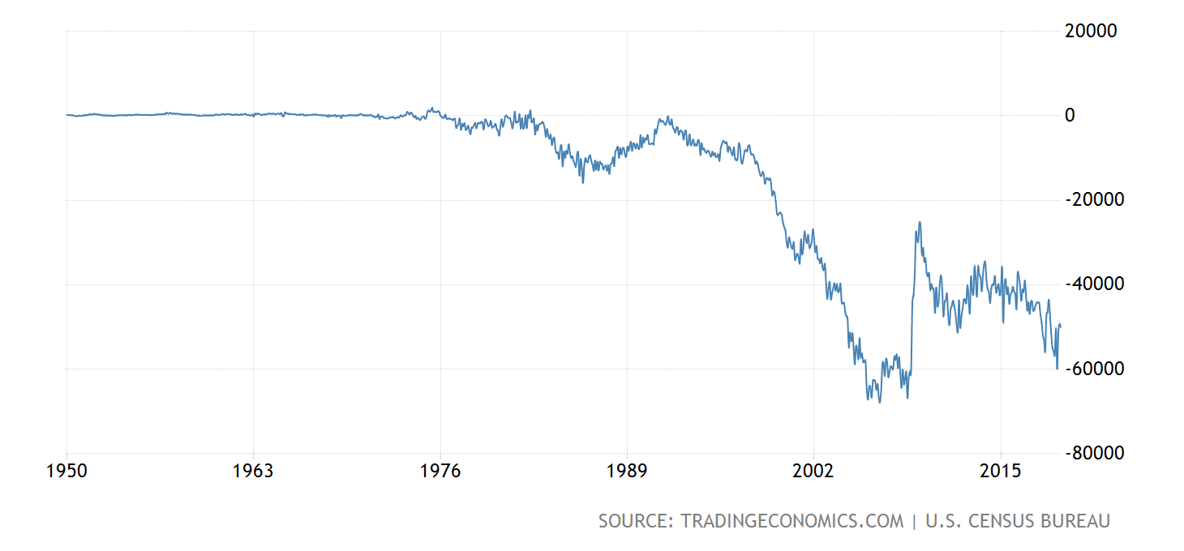
United States Balance of Trade
www.tradingeconomics.com/united-states/balance-of-trade

Slide 14
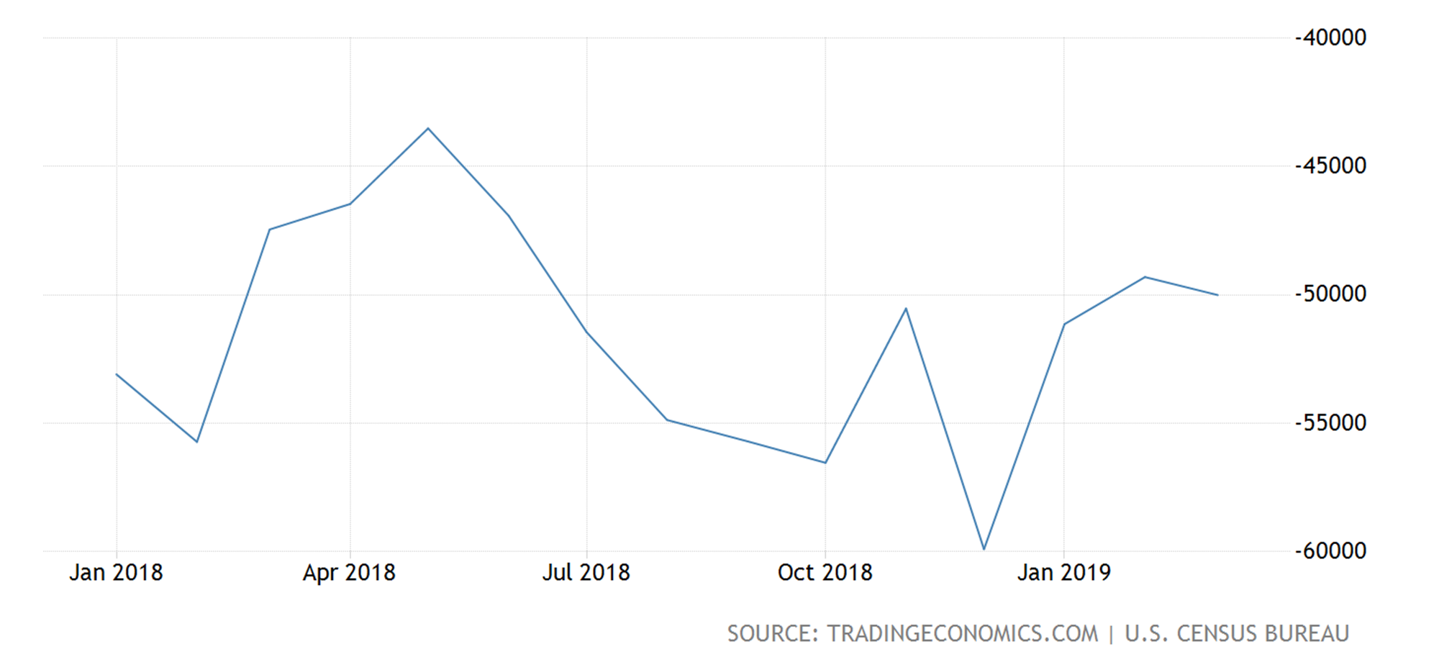
United States Balance of Trade
www.tradingeconomics.com/united-states/balance-of-trade

Slide 15
United States Balance of Trade
US Trade Surplus Widens in March
The US trade deficit widened to USD 50.0 billion in March 2019 from an eight-month low of USD 49.3 billion in the previous month and compared to market expectations of USD 50.2 billion. Exports from the US rose USD 2.1 billion from the previous month to USD 212.0 billion in March. Goods exports increased USD 2.0 billion to USD 141.7 billion, boosted by sales of industrial supplies and materials (up USD 1.7 billion), such as natural gas liquids, fuel oil, metallurgical grade coal, and other petroleum products. In addition, exports of foods, feeds, and beverages were up USD 0.8 billion, led by soybeans. By contrast, sales of civilian aircraft dropped USD 0.7 billion. Exports of services, including maintenance and repair services, and financial services, increased less than USD 0.1 billion to USD 70.3 billion in March. On a non seasonally adjusted basis, goods exports rose to all major trade partners: China (23.6 percent); Japan (18.3 percent); Canada (13.3 percent); the EU (7.2 percent); Mexico (8.0 percent), Brazil (22.9 percent) and OPEC (25.3 percent).
www.tradingeconomics.com/united-states/balance-of-trade

Slide 16
United States Balance of Trade
Imports to the US increased USD 2.8 billion to USD 262.0 billion. Goods imports advanced USD 2.6 billion to USD 214.1 billion, led by industrial supplies and materials (up USD 2.4 billion), in particular crude oil, organic chemicals and other petroleum products. Also, food imports rose USD 1.0 billion to the highest on record. Consumer goods imports, however, fell USD 0.7 billion amid declines in purchases of cellphones and other household goods. Imports of services, including travel and maintenance and repair services, increased USD 0.2 billion to USD 47.8 billion in March. On a non seasonally adjusted basis, goods imports rose from the EU (18.8 percent), Canada (19.2 percent), Japan (14.6 percent), Mexico (13.5 percent), Brazil (16.4 percent) and OPEC (8.2 percent). Imports from China slumped 6.1 percent.
www.tradingeconomics.com/united-states/balance-of-trade

Slide 17
United States Balance of Trade
The politically sensitive goods trade deficit with China decreased to a five-year low of USD 20.7 billion in March from USD 24.8 billion in February. On the other hand, the trade deficit widened with the EU (USD 14.2 billion from USD 9.2 billion); Mexico (USD 9.5 billion from USD 7.4 billion); Canada (USD 1.4 billion from a surplus of USD 17 million); and Japan (USD 6.6 billion from USD 5.9 billion). Meanwhile, the trade surplus with OPEC increased to USD 1.1 billion from USD 0.4 billion in February.
US Census Bureau | Joana Ferreira | joana.ferreira@tradingeconomics.com 5/9/2019 1:02:47 PM
www.tradingeconomics.com/united-states/balance-of-trade

Slide 18
2019 : U.S. trade in goods with China
NOTE: All figures are in millions of U.S. dollars on a nominal basis, not seasonally adjusted unless otherwise specified. Details may not equal totals due to rounding. Table reflects only those months for which there was trade.
Month | Exports | Imports | Balance
January 2019 | 7,134.3 | 41,603.8 | -34,469.5
February 2019 | 8,433.6 | 33,194.4 | -24,760.8
March 2019 | 10,426.5 | 31,175.7 | -20,749.1
TOTAL 2019 | 25,994.4 | 105,973.9 | -79,979.5
www.census.gov/foreign-trade/balance/c5700.html

Slide 19
2018 : U.S. trade in goods with China
NOTE: All figures are in millions of U.S. dollars on a nominal basis, not seasonally adjusted unless otherwise specified. Details may not equal totals due to rounding. Table reflects only those months for which there was trade.
Month | Exports | Imports | Balance
January 2018 | 9,835.3 | 45,788.0 | -35,952.8
February 2018 | 9,806.1 | 39,067.6 | -29,261.5
March 2018 | 12,382.1 | 38,256.7 | -25,874.6
April 2018 | 10,268.0 | 38,230.0 | -27,962.0
May 2018 | 10,610.8 | 43,797.4 | -33,186.6
June 2018 | 11,115.6 | 44,599.5 | -33,483.8
July 2018 | 10,261.7 | 47,096.0 | -36,834.3
August 2018 | 9,294.3 | 47,863.9 | -38,569.6
September 2018 | 9,789.1 | 50,032.1 | -40,243.0
October 2018 | 9,130.5 | 52,233.0 | -43,102.5
November 2018 | 8,664.9 | 46,525.7 | -37,860.8
December 2018 | 9,183.0 | 46,013.5 | -36,830.5
TOTAL 2018 | 120,341.4 | 539,503.4 | -419,162.0
www.census.gov/foreign-trade/balance/c5700.html

Slide 20
Let’s Review
Discuss at your table.
What does the IMF do?
How would you calculate a country’s balance of trade?
Explain the difference between a negative and positive trade balance.
What is a trade deficit?
How is a country’s balance of trade impacted by depreciation?
Are you on target (white, black, blue, red or yellow)?
Did you hit the bullseye?
Learning Target: Understand currency exchange rates & Balance of Trade

Slide 21
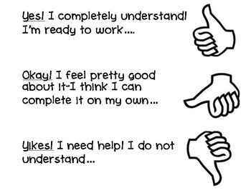

Slide 23
SUCCESS CRITERIA
#WeLoveToLearn

