Slide 1
ECONOMICS
Chapter 16.2: The Functions of Government
Learning Target: Understand the responsibilities and functions of government
Success Criteria
You should be able to…
1. Identify public goods and services
2. Explain the difference between social insurance programs and public assistance programs
3. Analyze government involvement in the economy

Slide 2
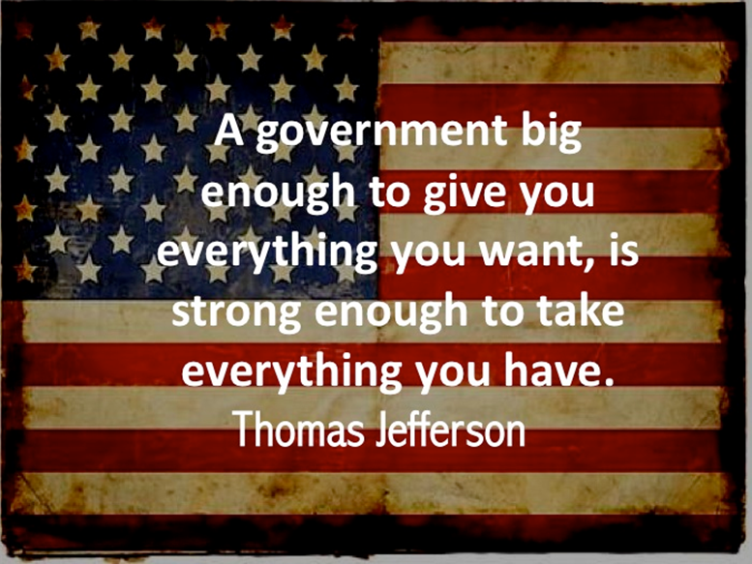

What are the general purposes of government in the U.S.? | To protect individual rights, to promote a stable legal environment for economic activity, and to support the well-being of all citizens.

Slide 3
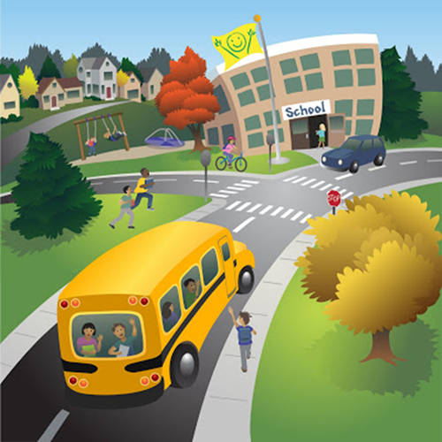
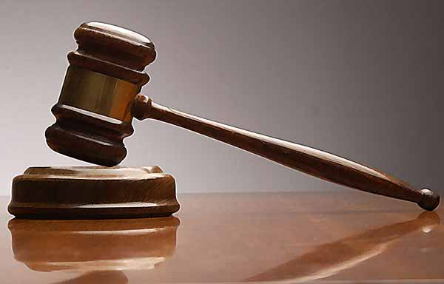

What are public goods? Examples? | Goods or services that governments supply to its citizens that can be used by many individuals at the same time. Examples: National defense, courts, prisons, police, property rights…

Slide 4
ECONOMICS
Chapter 16.2: The Functions of Government
Learning Target: Understand the responsibilities and functions of government
Success Criteria
You should be able to…
1. Identify public goods and services
2. Explain the difference between social insurance programs and public assistance programs
3. Analyze government involvement in the economy

Slide 5
What is the most important public good that only government can provide? | A sound system of property rights.
What is a merit good? Examples? | Goods that are deemed socially desirable by governmental leaders. Examples: museums, ballet, and classical music concerts

Slide 6
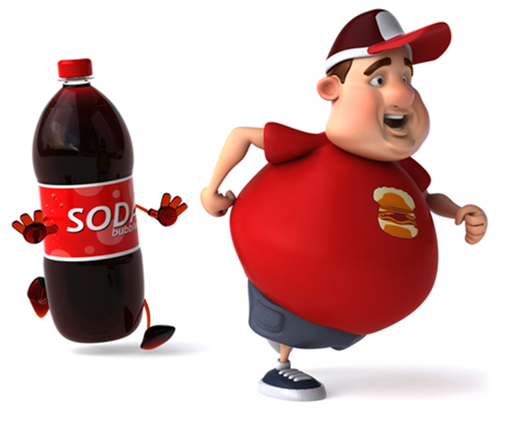

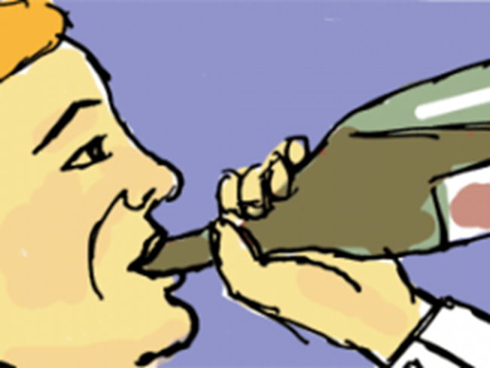
What is a demerit good? Examples? | Goods that are deemed socially undesirable by government leaders. Examples: tobacco, alcohol, and gambling
What are sin taxes? | Taxes on demerit goods like alcohol and tobacco.

Slide 7


Let’s Review
Discuss at your table.
What are some examples of public goods?
What is the most important government provided public good?
What is the difference between merit and demerit goods?
What are examples of merit and demerit goods?
What are taxes on demerit goods referred to as?
Are you on target (white, black, blue, red or yellow)?
Did you hit the bullseye?
Learning Target: Understand the responsibilities and functions of government

Slide 8

How does the government promote general welfare? | Through social-insurance and public-assistance programs.
What is income redistribution? | Government activity that takes income from some people through taxation and uses it to help citizens in need.

Slide 9
What are social-insurance programs? | Government programs that make payments to citizens based on need, such as payments to retired or disabled workers and the unemployed. Workers and their employers pay taxes for these programs.

Slide 10

What is Social Security? | A federal program that provides monthly payments to people who are retired or unable to work. Social Security is generally not enough money for retired people to live on comfortably.
What is workers’ compensation? | A government program that provides payments for medical care to workers injured on the job.

Slide 11
What is welfare? (public assistance programs) | Government programs that make payments to citizens based on need, such as those who are poor or disabled.
What is Supplemental Security Income (SSI)? | Federal program that provides payments for food (food stamps), clothing, and shelter to the aged, blind, and disabled.

Slide 12
What is Temporary Assistance for Needy Families? | Government program that provides assistance and work opportunities to needy families or single parents with young children.
What is Medicaid? | State and federal public-assistance program that helps pay health care costs for low-income and disabled persons.

Slide 13
Let’s Review
Discuss at your table.
What is income redistribution?
How does the government use income redistribution?
Explain what social insurance programs are. Give an example.
What is SSI?
What program might help needy parent(s) of young children?
Are you on target (white, black, blue, red or yellow)?
Did you hit the bullseye?
Learning Target: Understand the responsibilities and functions of government

Slide 14
What is the difference between social-insurance and public-assistance programs? | Social –insurance programs pay benefits using taxes that workers and employers have paid into the programs. Public-assistance programs make payments to individuals based on need, regardless of whether a person paid taxes into the program.

Slide 15
ECONOMICS
Chapter 16.2: The Functions of Government
Learning Target: Understand the responsibilities and functions of government
Success Criteria
You should be able to…
1. Identify public goods and services
2. Explain the difference between social insurance programs and public assistance programs
3. Analyze government involvement in the economy

Slide 16
What are some economic goals of government? | Stable growth, low unemployment, and low inflation.
How does the government regulate economic activity? | Figure 16.2: Government Regulation Protecting consumers Supervising labor and management relations Promoting competition Regulating negative by-products of the production process

Slide 17
What are Externalities? | Economic side effects or by-products that affect uninvolved third parties, such as pollution.
What does the government do to ensure economic stability? | It intervenes to shield citizens from the effects of business fluctuations, including unemployment, high inflation, bankruptcies, recessions, and depressions.

Slide 18
Let’s Review
Discuss at your table.
How are Medicare and Medicaid similar and different?
Give some examples of how the government regulates
the economy?
What is an externality? Give an example.
How does the government work to keep our economy stable?
Are you on target (white, black, blue, red or yellow)?
Did you hit the bullseye?
Learning Target: Understand the responsibilities and functions of government

Slide 19
What are some criticisms of government involvement? | Merit goods should be provided by private organizations, not tax dollars. Government assistance discourages a person’s incentive to work. Excessive regulations raise the price of goods and services.

Slide 20
ECONOMICS
Chapter 16.2: The Functions of Government
Learning Target: Understand the responsibilities and functions of government
Success Criteria
You should be able to…
1. Identify public goods and services
2. Explain the difference between social insurance programs and public assistance programs
3. Analyze government involvement in the economy

Slide 22



SUCCESS CRITERIA
#WeLoveToLearn

