Slide 1
ECONOMICS
Chapter 16.1: Growth in the Size of Government
Learning Target: Understand that the size and spending of all levels of government has increased over the last century
Success Criteria
You should be able to…
1. Identify types of government spending at the federal, state and local level
2. Explain how the government has gotten involved in the economy
3. Analyze how government spending and politics are related and how government has grown

Slide 2


How many people in the U.S. work for the government? | More than 22 million civilian workers are employed by local, state, and the federal government (2.7 million work for the federal government).
What is a civilian worker? | A government employee who is not part of the military.

Slide 3
What percent of the U.S. population worked for the government in 1929 and 2000? | 1929: U.S. population was 123 million and 3 million civilians worked for the government. 2.4% 2000: U.S. population was 281 million and 22 million civilians worked for the government. 7.7% 2010: U.S. population was 308.7 million…

Slide 4
Federal Government Civilian Employment and Payroll Data: March 2014
Data Release: 03/29/2016
Source: U.S. Census Bureau, 2014 Annual Survey of Public Employment & Payroll
Employment Functions | Total | Full-Time | Total March Payroll
 | Employment | Employment | (whole dollars)
Total | 2,700,468 | 2,475,780 | 16,995,501,047

Slide 5
STATE GOVERNMENT: EMPLOYMENT AND PAYROLL DATA
BY STATE AND BY FUNCTION: MARCH 2014
SOURCE: 2014 Annual Survey of Public Employment & Payroll. For information on sampling and nonsampling errors and definitions,
see http://www.census.gov/govs/apes/how_data_collected.html. Data users who create their own estimates from these tables
should cite the U.S. Census Bureau as the source of the original data only.
 |  |  |  |  |  |  |  | Total March
 |  |  | Full-Time |  | Part-Time |  | Full-Time | Full-Time | Total March
 |  | Full-Time | Payroll | Part-Time | Payroll | Part-Time | Equivalent | and Part-Time | Payroll
State | Government Function | Employment | (whole dollars) | Employment | (whole dollars) | Hours | Employment | Employment | (whole dollars)
US | Total | 3,751,771 | 18,929,609,482 | 1,591,917 | 2,225,243,856 | 102,727,482 | 4,341,163 | 5,343,688 | 21,154,853,338

Slide 6
LOCAL GOVERNMENT: EMPLOYMENT AND PAYROLL DATA
BY STATE AND BY FUNCTION: MARCH 2014
SOURCE: 2014 Annual Survey of Public Employment & Payroll. For information on sampling and nonsampling errors and definitions,
see http://www.census.gov/govs/apes/how_data_collected.html. Data users who create their own estimates from these tables
should cite the U.S. Census Bureau as the source of the original data only.
 |  |  | Full-Time
 |  |  | Employment | Full-Time
 |  | Full-Time | Coefficient of | Payroll
State | Government Function | Employment | Variation (%) | (whole dollars)
US | Total | 10,574,332 | 0.12 | 48,274,909,730
 | Total March
 | Full-Time
Total March | and Part-Time
Full-Time | Employment | Total March
and Part-Time | Coefficient of | Payroll
Employment | Variation (%) | (whole dollars)
13,911,453 | 0.10 | 52,079,045,912

Slide 7
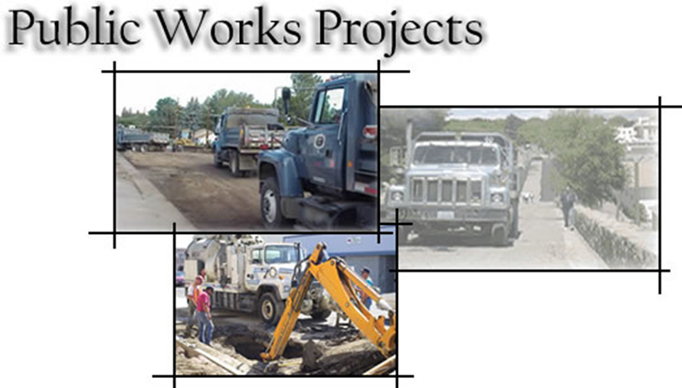
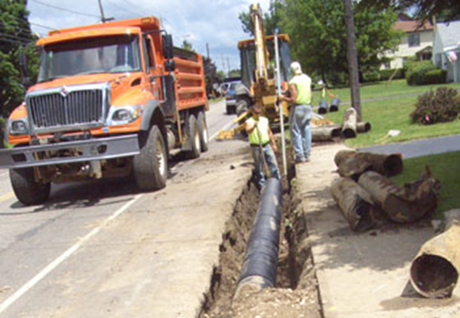
Why has the number of government workers increased so drastically over the last 80 years? | The number of government workers has increased drastically over the last 80 years because the number of government functions has increased and the population has grown.
What are public-works projects and how are they funded?

Slide 8
Why has the number of government workers increased so drastically over the last 80 years? | The number of government workers has increased drastically over the last 80 years because the number of government functions has increased and the population has grown.
What are public-works projects and how are they funded? | Publicly used facilities built by federal, state, or local governments (schools, roads, etc.) with public money (tax dollars).

Slide 9


Let’s Review
Discuss at your table.
What is a civilian worker?
Describe the change in the size of government over the
past 100 years.
Why has the number of government workers increased?
What is an example of a public works project?
Are you on target (white, black, blue, red or yellow)?
Did you hit the bullseye?
Learning Target: Understand that the size and spending of all levels of government has increased over the last century

Slide 10

What happened to governmental spending during the 1970s? | Federal government spending decreased while state and local government spending increased due to increased expenditures on public works projects.

Slide 11
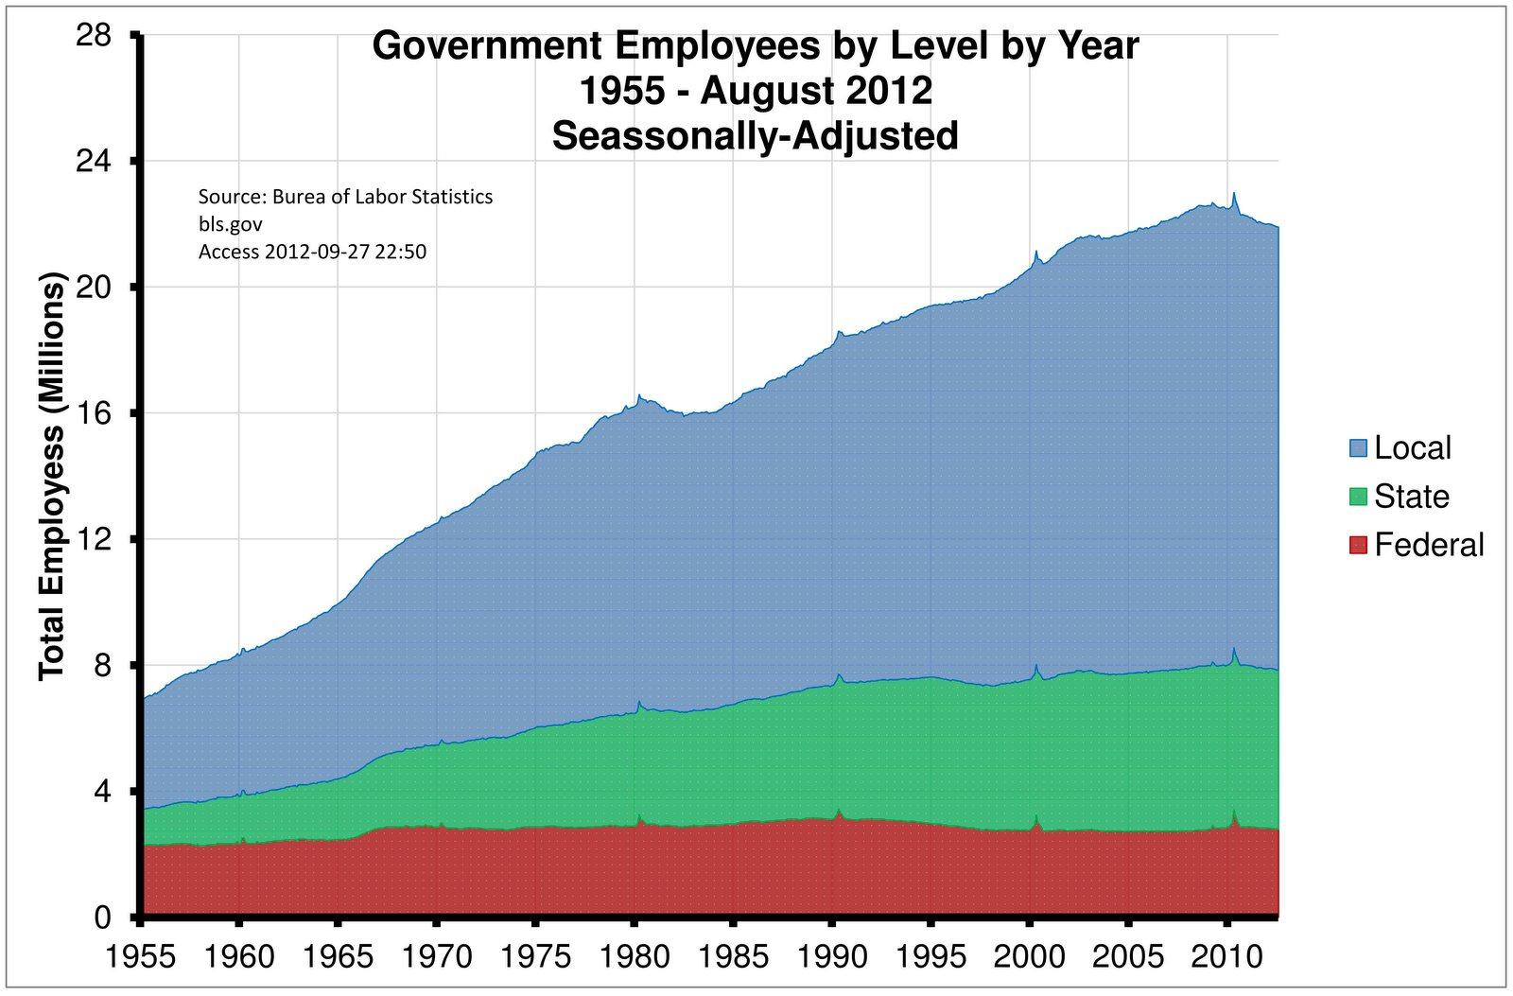

Slide 12
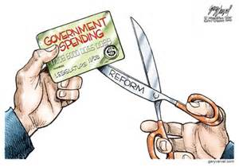

Slide 13
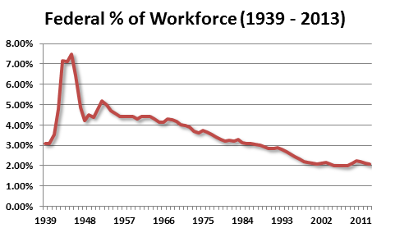

Slide 14
ECONOMICS
Chapter 16.1: Growth in the Size of Government
Learning Target: Understand that the size and spending of all levels of government has increased over the last century
Success Criteria
You should be able to…
1. Identify types of government spending at the federal, state and local level
2. Explain how the government has gotten involved in the economy
3. Analyze how government spending and politics are related and how government has grown

Slide 15
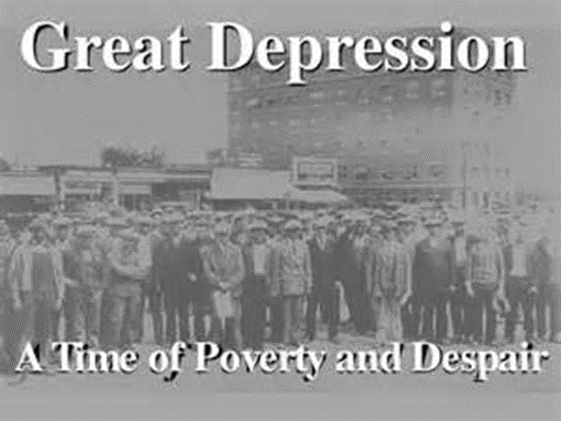
What did the Great Depression have to do with government growth? | More services appeared to be needed during the Great Depression. Examples:

Slide 16
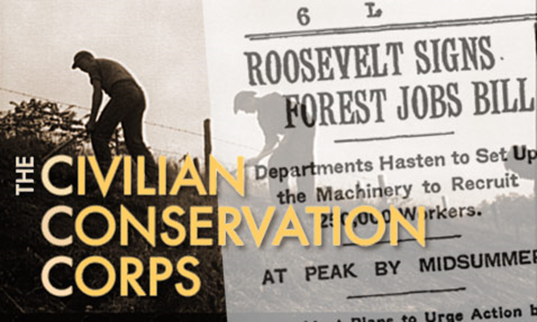
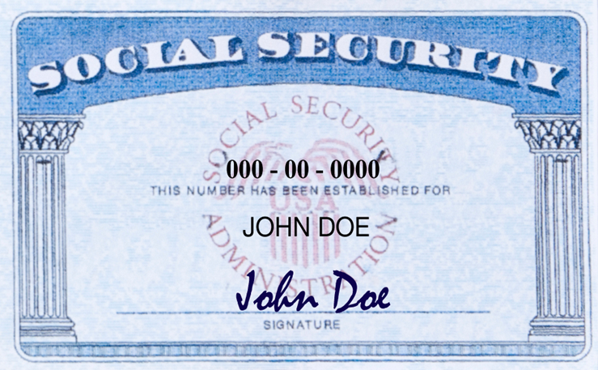

What did the Great Depression have to do with government growth? | More services appeared to be needed during the Great Depression. Examples: Civilian Conservation Corps and Social Security

Slide 17
ECONOMICS
Chapter 16.1: Growth in the Size of Government
Learning Target: Understand that the size and spending of all levels of government has increased over the last century
Success Criteria
You should be able to…
1. Identify types of government spending at the federal, state and local level
2. Explain how the government has gotten involved in the economy
3. Analyze how government spending and politics are related and how government has grown

Slide 18

What are government outlays? | Government expenditures including purchases, interest payments, and transfer payments.
Government expenditures represent what percent of GDP? | Government purchases represent about 19%. Total government expenditures including interest on the national debt and transfer payments (such as welfare programs) exceed 1/3 (33%) of GDP.

Slide 19
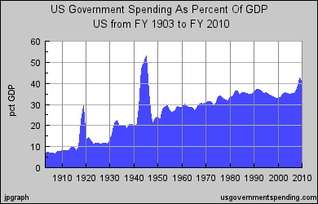

Slide 20
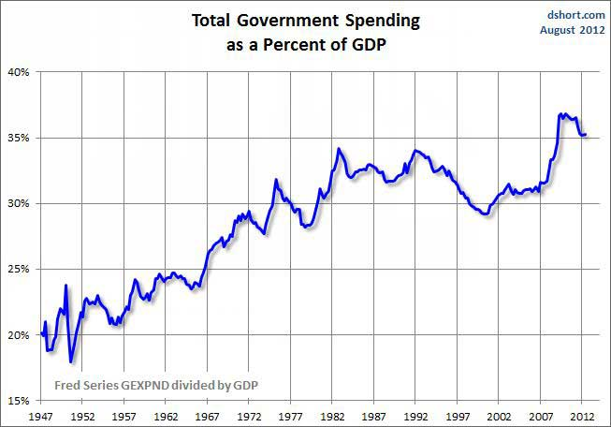

Slide 21
Let’s Review
Discuss at your table.
Compare the growth in government workers for local, state and the federal government.
How did the Great Depression impact the growth of government? Give an example?
What are government outlays?
What part of our GDP is based on government expenses?
Are you on target (white, black, blue, red or yellow)?
Did you hit the bullseye?
Learning Target: Understand that the size and spending of all levels of government has increased over the last century

Slide 22
ECONOMICS
Chapter 16.1: Growth in the Size of Government
Learning Target: Understand that the size and spending of all levels of government has increased over the last century
Success Criteria
You should be able to…
1. Identify types of government spending at the federal, state and local level
2. Explain how the government has gotten involved in the economy
3. Analyze how government spending and politics are related and how government has grown

Slide 23

Figure 16.1, p. 414-415 What are some things the government spends tax dollars on? | Transportation Education Product Safety Worker Safety
What is Medicare? | A government program that provides health care for the aged.

Slide 24
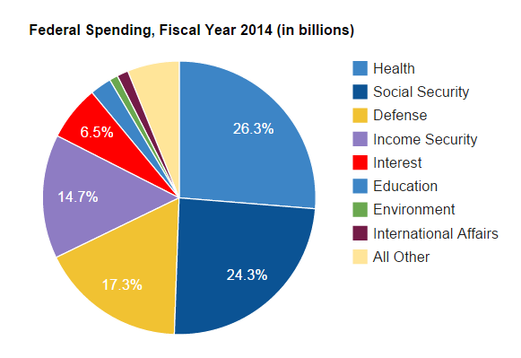

Slide 25


What is the private sector? | Privately owned parts of our economy.

Slide 26
Let’s Review
Discuss at your table.
What does the government spend money on?
What is Medicare?
Explain the difference between the public and private sectors.
Are you on target (white, black, blue, red or yellow)?
Did you hit the bullseye?
Learning Target: Understand that the size and spending of all levels of government has increased over the last century

Slide 27
In the following chart indicate whether you personally think the government should fund the items listed and why. Also give a reason or reasons for your opinion.
Should Government fund: | Yes or no | Reason
Medicare
Highway construction
Public schools
Product safety information
Worker safety information

Slide 28
ECONOMICS
Chapter 16.1: Growth in the Size of Government
Learning Target: Understand that the size and spending of all levels of government has increased over the last century
Success Criteria
You should be able to…
1. Identify types of government spending at the federal, state and local level
2. Explain how the government has gotten involved in the economy
3. Analyze how government spending and politics are related and how government has grown

Slide 30



SUCCESS CRITERIA
#WeLoveToLearn

