Slide 1
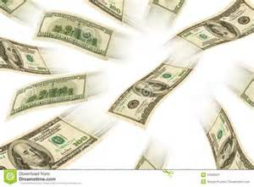
ECONOMICS
Chapter 15.3: Regulating the Money Supply
Learning Target: Understand the tools the Fed uses to control the money supply in the U.S.

Slide 2
ECONOMICS
Chapter 15.3: Regulating the Money Supply
Learning Target: Understand the tools the Fed uses to control the money supply in the U.S.
Success Criteria
You should be able to…
1. Analyze the importance of reserve requirements and their impact on the money supply
2. Explain discount rate, prime rate and federal funds rate
3. Describe how the Fed controls the money supply

Slide 3
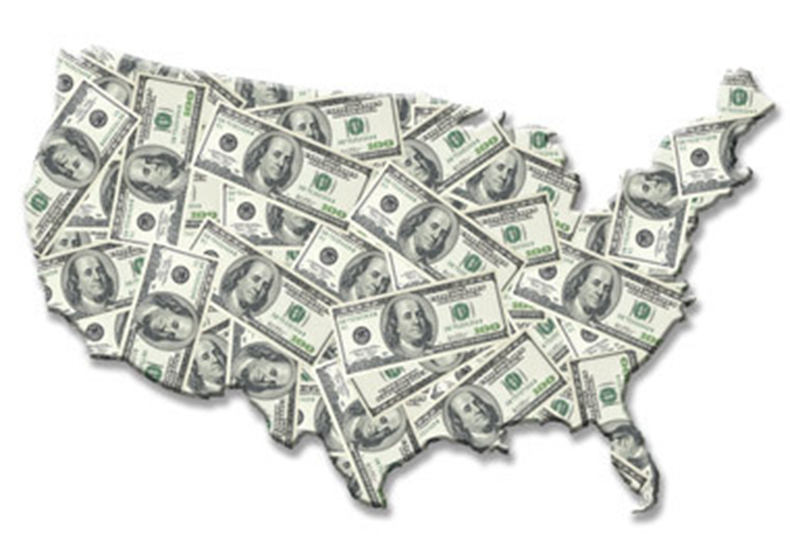
How can the Fed affect the money supply? | By changing the reserve requirements on bank deposits.
How does raising the reserve requirement slow down the economy? | It decreases the amount of money in the economy by forcing banks to increase reserve holdings, leading to fewer loans.

Slide 4
What happens if a bank finds itself without the required reserves on hand? | The bank must borrow from other banks or its Federal Reserve district bank. This can happen when customers borrow or withdraw large sums unexpectedly.
Discount rate | The interest rate the Fed charges on loans to member banks. The discount rate affects the interest rate customers pay for loans.

Slide 5


Let’s Review
Discuss at your table.
How does the FED control the money supply?
How does this impact the economy?
What happens if a bank does not meet its reserve requirements?
The interest rate the Fed charges on loans to member banks is known as what?
Are you on target (white, black, blue, red or yellow)?
Did you hit the bullseye?
Learning Target: Understand the tools the Fed uses to control the money supply in the U.S.

Slide 6
ECONOMICS
Chapter 15.3: Regulating the Money Supply
Learning Target: Understand the tools the Fed uses to control the money supply in the U.S.
Success Criteria
You should be able to…
1. Analyze the importance of reserve requirements and their impact on the money supply
2. Explain discount rate, prime rate and federal funds rate
3. Describe how the Fed controls the money supply

Slide 7
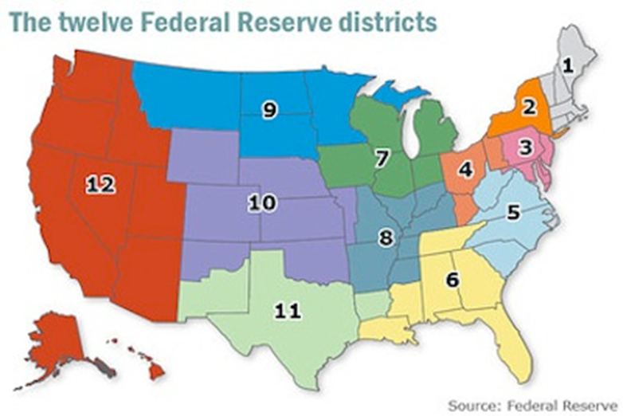

Slide 8
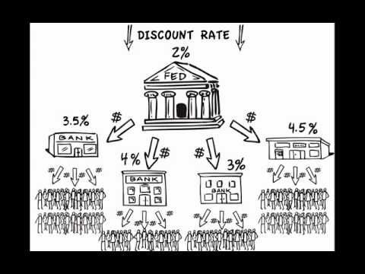

Slide 9
What happens to the money supply if the Fed raises the discount rate? Lowers it? | If the Fed raises the discount rate, the growth rate of the money supply will slow down. If the Fed lowers the discount rate, the growth rate of the money supply will increase.
Prime rate | The interest rate that banks charge on loans to their best business customers.

Slide 10
Federal funds rate | The interest rate banks charge each other on short-term loans (usually overnight). These loans are required to keep reserve requirements.
What are open-market operations?

Slide 11
ECONOMICS
Chapter 15.3: Regulating the Money Supply
Learning Target: Understand the tools the Fed uses to control the money supply in the U.S.
Success Criteria
You should be able to…
1. Analyze the importance of reserve requirements and their impact on the money supply
2. Explain discount rate, prime rate and federal funds rate
3. Describe how the Fed controls the money supply

Slide 12
Federal funds rate | The interest rate banks charge each other on short-term loans (usually overnight). These loans are required to keep reserve requirements.
What are open-market operations? | The buying and selling of U.S. securities by the Fed to affect the money supply. This is the Feds primarily tool used to control the money supply.

Slide 13
What is buying and selling securities and how does this impact the bank’s reserves? | The Fed buys securities – such as Treasury bills, notes, and bonds – and pays for them by depositing money in the dealer’s bank. This increases the banks reserves, leading to an increase in the money supply. When the Fed sells securities to a dealer, the dealer’s bank uses its deposits to buy the securities. This decreases the banks reserves, leading to a decrease in lending.

Slide 14
Let’s Review
Discuss at your table.
How do changes in the discount rate impact the money supply?
What is the Prime Rate?
What is the interest rate banks charge each other called?
What are open market operations?
What is the effect of the FED buying or selling securities?
Are you on target (white, black, blue, red or yellow)?
Did you hit the bullseye?
Learning Target: Understand the tools the Fed uses to control the money supply in the U.S.

Slide 15
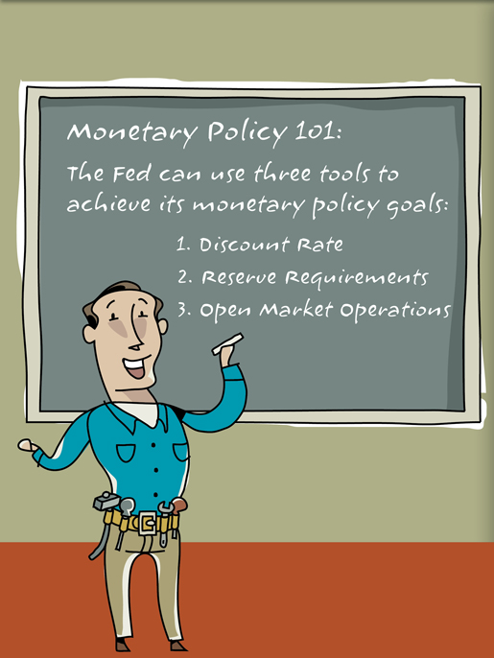

Slide 16
How long does it take to feel the effects of Monetary Policy? | Effects are not felt immediately. Researchers believe it takes 12 months to feel the full effects of policy changes.
What are some criticisms of Fed policies? | Fed has increased money in circulation, leading to increased inflation. Fed has decreased money in circulation, worsening recessions. Some say the Fed should not engage in monetary policy.

Slide 17
Why does raising reserve requirements decrease the money supply? | The bank has to put more money away so it has less to lend, decreasing the supply to borrowers.
Explain why it is more expensive for everyone to borrow when the Fed raises the federal funds rate. | When banks charge each other more to borrow (higher interest rate) to meet reserves, the cost is passed on to everyone borrowing money in the form of higher interest rates.

Slide 18
Let’s Review
Discuss at your table.
How quickly do changes in monetary policy impact the economy?
How do changes in reserve requirements affect the
money supply?
Are you on target (white, black, blue, red or yellow)?
Did you hit the bullseye?
Learning Target: Understand the tools the Fed uses to control the money supply in the U.S.

Slide 19
ECONOMICS
Chapter 15.3: Regulating the Money Supply
Learning Target: Understand the tools the Fed uses to control the money supply in the U.S.
Success Criteria
You should be able to…
1. Analyze the importance of reserve requirements and their impact on the money supply
2. Explain discount rate, prime rate and federal funds rate
3. Describe how the Fed controls the money supply

Slide 20
What is the difference between the discount rate and the prime rate? | The discount rate is charged on money lent by the Fed to banks. The prime rate is charged by banks to their best customers.

Slide 21
ECONOMICS
Chapter 15.3: Regulating the Money Supply
Learning Target: Understand the tools the Fed uses to control the money supply in the U.S.
Success Criteria
You should be able to…
1. Analyze the importance of reserve requirements and their impact on the money supply
2. Explain discount rate, prime rate and federal funds rate
3. Describe how the Fed controls the money supply

Slide 23



SUCCESS CRITERIA
#WeLoveToLearn

