Slide 1
ECONOMICS
Chapter 14.2: History of American Money and Banking
Learning Target: Understand key events in the history of U.S. money & banking; Understand present-day banking services
Success Criteria
You should be able to…
1. Explain how instability in the banking system led to
business fluctuations
2. Identify the different services banks offer to their customers
3. Describe how the banking system has become more efficient

Slide 2
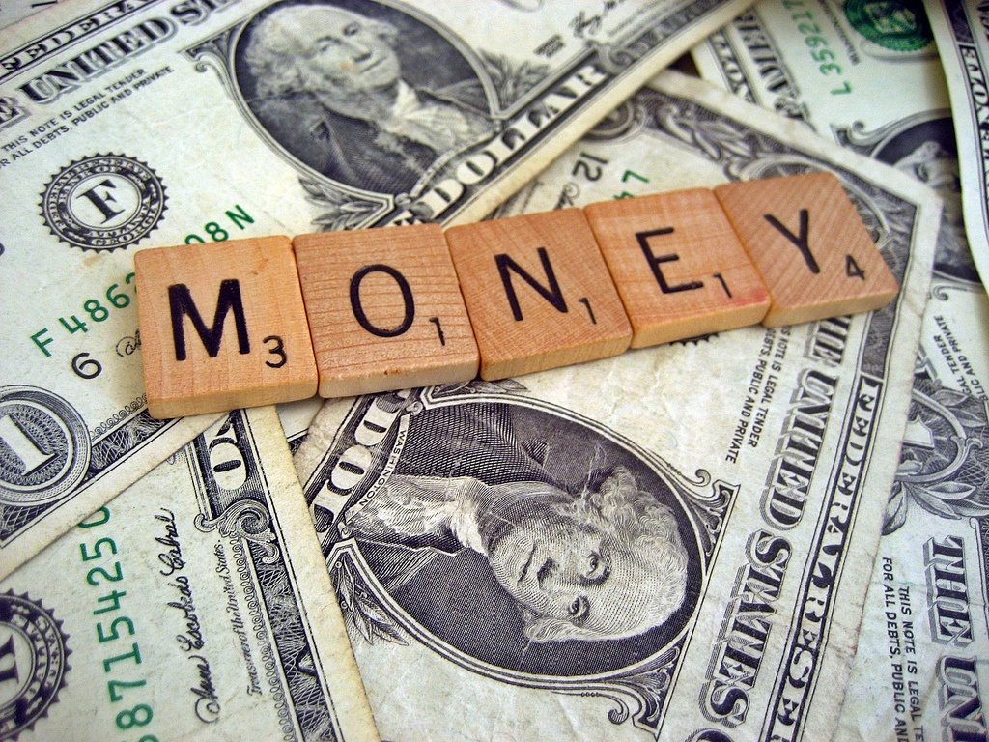
How is the history of money tied to the development of the nation’s banking system? | A form of legal tender (money) needed to be established in order to have a reliable medium of exchange, pay debts and to build a strong economy. See Figure 14.3, page 374-375

Slide 3
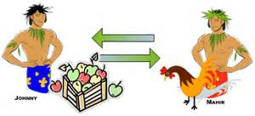

Early colonial period | England did not allow the colonies to print money or mint coins. Bartering (trading) was common. Colonists used native American wampum (a string of beads made from shells), tobacco, and to a lesser extent European coins (the Spanish dolar being the most common).

Slide 4
Revolutionary War | During the war the Continental Congress printed bills of credit called Continentals. So many were issued that they became worthless.
Constitution | The Constitution (after its ratification in 1788) gave Congress the power to mint coins.

Slide 5
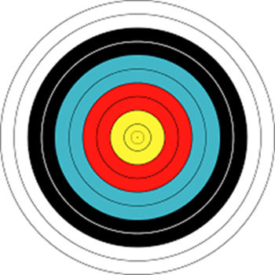

Let’s Review
Discuss at your table.
Why is money needed in a society?
Describe “money” during the colonial years.
What were Continentals?
Why does Congress have the power to make money?
Are you on target (white, black, blue, red or yellow)?
Did you hit the bullseye?
Learning Target: Understand key events in the history of U.S. money & banking; Understand present-day banking services

Slide 6
ECONOMICS
Chapter 14.2: History of American Money and Banking
Learning Target: Understand key events in the history of U.S. money & banking; Understand present-day banking services
Success Criteria
You should be able to…
1. Explain how instability in the banking system led to
business fluctuations
2. Identify the different services banks offer to their customers
3. Describe how the banking system has become more efficient

Slide 7
Coinage Act | In 1792 Congress passed the Coinage Act, establishing the dollar as our basic unit of currency.
What effects did the Revolutionary War have on the colonial money system? Why? | It made the system more unstable. The Continental Congress issued so many bills of credit (Continentals) that they became worthless.

Slide 8
Federal Reserve System | The Federal Reserve System was created in 1913 to control the amount of money in circulation and make loans to member banks.
What are some modern banking services? | Checking accounts (including interest baring), automatic deposits and payment, safety deposit boxes, wire transfers, overdraft checking, ATMs, …

Slide 9
Why have banks become more efficient? | Computers and the internet; less paper, banking done electronically.

Slide 10
Let’s Review
Discuss at your table.
What did the Coinage Act do?
How long has the Federal Reserve been around?
What is the purpose of the FED?
What is a safety deposit box?
Are you on target (white, black, blue, red or yellow)?
Did you hit the bullseye?
Learning Target: Understand key events in the history of U.S. money & banking; Understand present-day banking services

Slide 11
ECONOMICS
Chapter 14.2: History of American Money and Banking
Learning Target: Understand key events in the history of U.S. money & banking; Understand present-day banking services
Success Criteria
You should be able to…
1. Explain how instability in the banking system led to
business fluctuations
2. Identify the different services banks offer to their customers
3. Describe how the banking system has become more efficient

Slide 12
Overdraft checking | A checking account that allows customers to write checks for more money than they have in their accounts. The bank lends you the additional money and may charge a fee and/or a high interest rate. You must sign up for this. This is different from overdraft protection on a checking account. Some banks/credit unions will take the additional money from your savings account so you don’t “bounce” the check.

Slide 13
Electronic funds transfer (EFT) | A system of transferring funds (money) from one bank account to another without any paperwork or paper money changing hands. Example: You can transfer money from your savings to your checking account using the internet or an ATM.

Slide 14
Automated teller machine (ATM) Fees? | A machine that allows customers to access their banking without the help of a teller. An easy way to get cash or transfer money. If you use an ATM not owned by your bank or credit union you may be charged a fee.
What are some concerns or disadvantages of using electronic banking? | The possibility of tampering or hacking where someone could get your private information.

Slide 15
Electronic Funds Transfer Act of 1978 | Customers are responsible for only $50 in losses if someone steals or illegally uses their ATM card, as long as it is reported missing within two days. If reported after two days, they may be responsible for up to $500.
Service charges | Fees charged by banks or credit unions for certain services. They follow rules set by the state but can vary by bank.

Slide 16
Let’s Review
Discuss at your table.
What does it mean to “bounce” a check?
Explain overdraft protection.
Describe at least one negative to ATMs.
How might the Electronic Funds Transfer Act of 1978 help you?
Explain how you could avoid bank/credit union service charges.
Are you on target (white, black, blue, red or yellow)?
Did you hit the bullseye?
Learning Target: Understand key events in the history of U.S. money & banking; Understand present-day banking services

Slide 17
ECONOMICS
Chapter 14.2: History of American Money and Banking
Learning Target: Understand key events in the history of U.S. money & banking; Understand present-day banking services
Success Criteria
You should be able to…
1. Explain how instability in the banking system led to
business fluctuations
2. Identify the different services banks offer to their customers
3. Describe how the banking system has become more efficient

