Slide 1
ECONOMICS Chapter 14.1: The Functions and Characteristics of Money Learning Target: Understand the different uses, characteristics and types of money
Success Criteria
You should be able to…
1. Identify the functions of money.
2. Explain the characteristics of money.
3. Compare the different types of money.

Slide 2
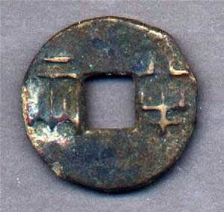
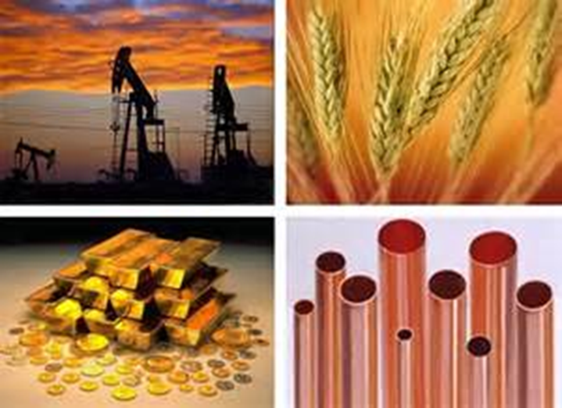
What are some items that have been used for money throughout history? | Shells, whales’ teeth, animals, salt, animal hides, gems, tobacco, gold or other precious metals…
Commodity money | Has a value as a good aside from its value as money; such as cattle, precious metals, and gems.

Slide 3
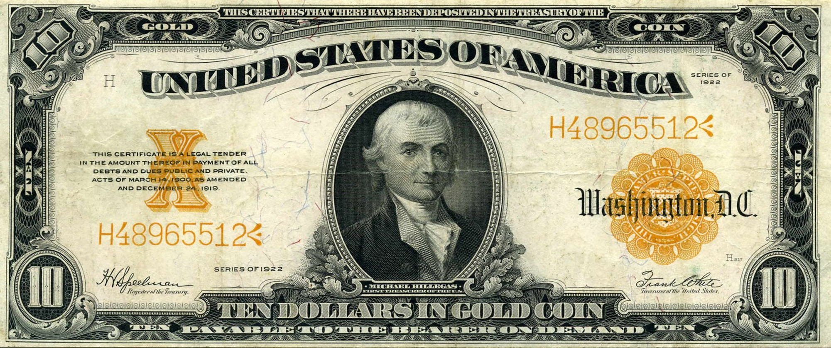
Representative money | Money that is backed by an item of value; such as gold or silver. At one time U.S. money was representative money and could be exchanged for gold or silver.

Slide 4
Let’s Review
Discuss at your table.
Explain each of the characteristics of money in detail.
What was used as money before modern currency?
What is Commodity money? Give an example.
Explain what Representative money is.
Are you on target (white, black, blue, red or yellow)?
Did you hit the bullseye?
Learning Target: Understand the different uses, characteristics and types of money

Slide 5
ECONOMICS Chapter 14.1: The Functions and Characteristics of Money Learning Target: Understand the different uses, characteristics and types of money
Success Criteria
You should be able to…
1. Identify the functions of money.
2. Explain the characteristics of money.
3. Compare the different types of money.

Slide 6
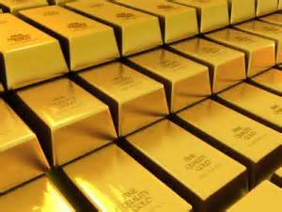
Gold Standard | A monetary system in which money is backed by gold. The gold standard ended in the U.S. in 1933 as a result of the policies of President Franklin D. Roosevelt.

Slide 7
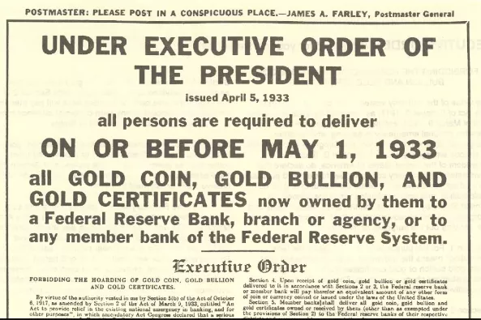

Slide 8
Fiat money | Money that has value based on the order of the government.

Slide 9
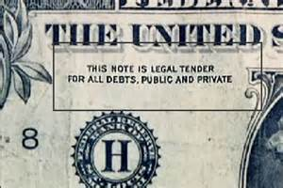
Fiat money | Money that has value based on the order of the government. It is not backed by gold, silver, or any item of value. U.S. money. “This note is legal tender for all debts, public and private.”

Slide 10
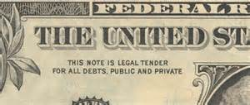
Legal tender | Money that must by law be accepted for payment of public and private debts.

Slide 11
Let’s Review
Discuss at your table.
What is (was) the Gold Standard? When did the U.S. follow it?
What is Fiat money? Who uses it?
Where does the phrase “legal tender” come from?
What type of money do we use in the U.S.?
Are you on target (white, black, blue, red or yellow)?
Did you hit the bullseye?
Learning Target: Understand the different uses, characteristics and types of money

Slide 12
ECONOMICS Chapter 14.1: The Functions and Characteristics of Money Learning Target: Understand the different uses, characteristics and types of money
Success Criteria
You should be able to…
1. Identify the functions of money.
2. Explain the characteristics of money.
3. Compare the different types of money.

