Slide 1
ECONOMICS Chapter 14.1: The Functions and Characteristics of Money Learning Target: Understand the different uses, characteristics and types of money
Success Criteria
You should be able to…
1. Identify the functions of money.
2. Explain the characteristics of money.
3. Compare the different types of money.

Slide 2
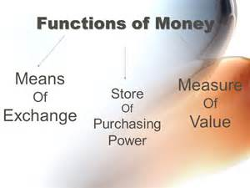
What is money and what are its functions? | Medium of exchange. Unit of accounting. A store of value. See Figure 14.1, page 368

Slide 3
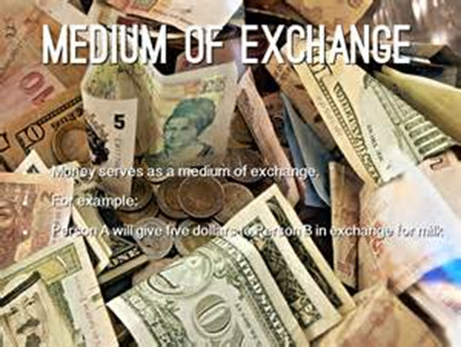
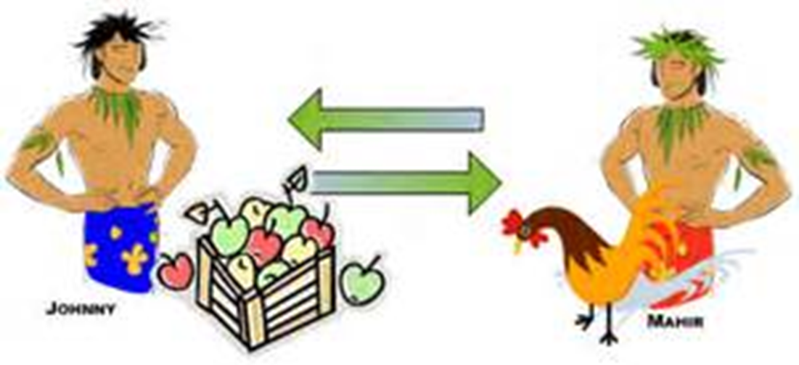
Medium of exchange | Sellers accept it for goods or services.
Barter | The exchange of goods & services for other goods and services (trade).

Slide 7
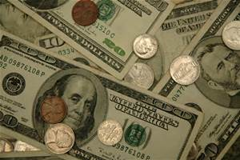
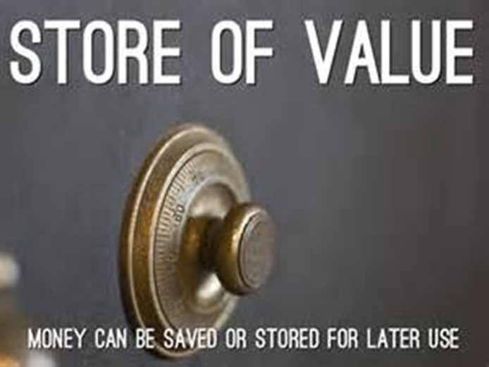
Unit of accounting | A basic unit of measurement to compare (measure) the values of goods and services. Unit of exchange; Dollar, Euro, Peso, Rupee…
Store of value | The use of money to store purchasing power for later use. You can save (store) your money for use between paychecks.

Slide 8
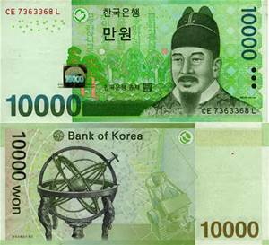
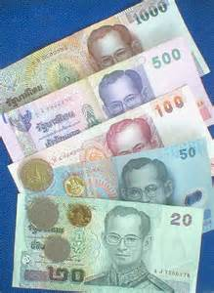
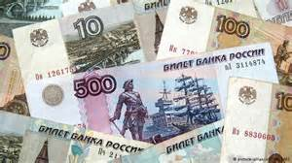
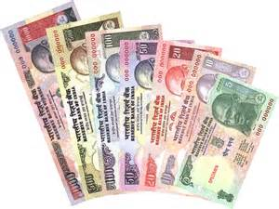
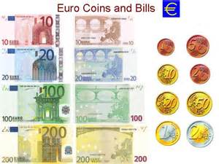
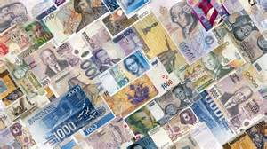

Slide 10
ECONOMICS Chapter 14.1: The Functions and Characteristics of Money Learning Target: Understand the different uses, characteristics and types of money
Success Criteria
You should be able to…
1. Identify the functions of money.
2. Explain the characteristics of money.
3. Compare the different types of money.

Slide 11
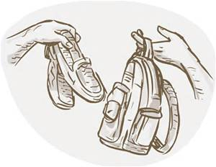
What are some possible disadvantages of bartering?

Slide 12
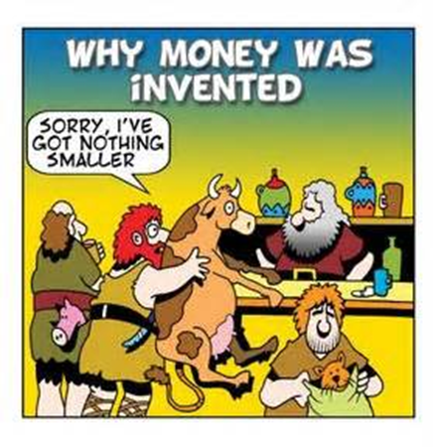

Slide 13
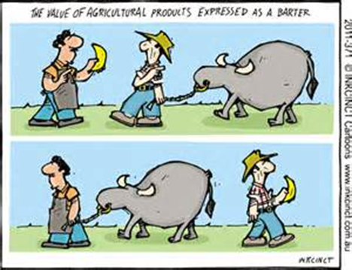

Slide 14
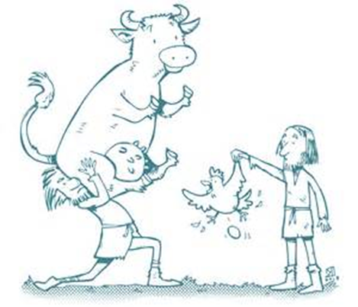

Slide 15
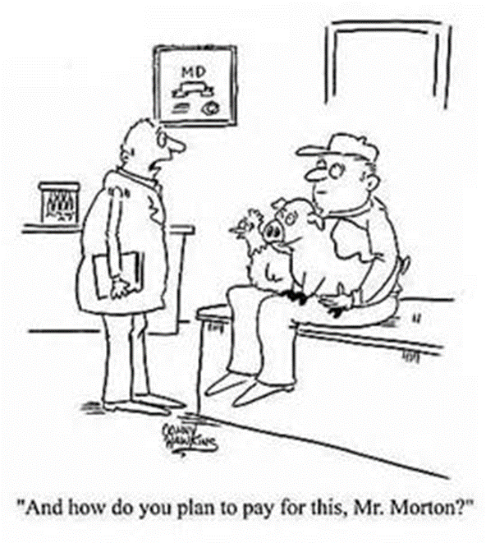

Slide 16
What are some possible disadvantages of bartering? | Each party must want what the other party has to offer (trade). It only works in small societies with very simple economies.

Slide 17
Let’s Review
Discuss at your table.
Explain each of the functions of money.
Explain several reasons why money is better than bartering.
Think of a time you bartered? What were the items? Who got the better deal?
Is bartering ever better than using money? Explain.
Are you on target (white, black, blue, red or yellow)?
Did you hit the bullseye?
Learning Target: Understand the different uses, characteristics and types of money

Slide 18
ECONOMICS Chapter 14.1: The Functions and Characteristics of Money Learning Target: Understand the different uses, characteristics and types of money
Success Criteria
You should be able to…
1. Identify the functions of money.
2. Explain the characteristics of money.
3. Compare the different types of money.

Slide 19
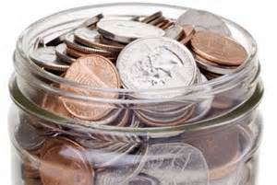
What are the six characteristics of money? (See chart on page 370) | 1. Durable – Must be able to withstand the wear and tear of use.

Slide 20
What are the six characteristics of money? (See chart on page 370) | 1. Durable – Must be able to withstand the wear and tear of use. 2. Portable – Must be easy to carry (paper v. gold).

Slide 21
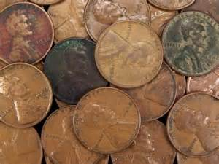
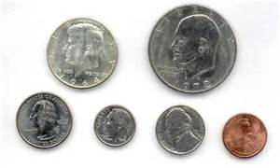
What are the six characteristics of money? (See chart on page 370) | 1. Durable – Must be able to withstand the wear and tear of use. 2. Portable – Must be easy to carry (paper v. gold). 3. Divisible – Must be easily divided into small parts (change).

Slide 22
What are the six characteristics of money? (See chart on page 370) | 1. Durable – Must be able to withstand the wear and tear of use. 2. Portable – Must be easy to carry (paper v. gold). 3. Divisible – Must be easily divided into small parts (change). 4. Stable in value – Value cannot change rapidly.

Slide 23
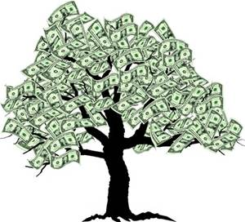
What are the six characteristics of money? (See chart on page 370) | 1. Durable – Must be able to withstand the wear and tear of use. 2. Portable – Must be easy to carry (paper v. gold). 3. Divisible – Must be easily divided into small parts (change). 4. Stable in value – Value cannot change rapidly. 5. Scarce – Scarcity gives it its value.

Slide 24
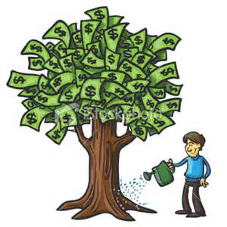
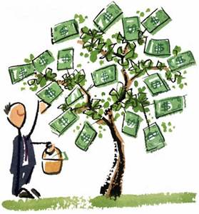

Slide 25
What are the six characteristics of money? (See chart on page 370) | 1. Durable – Must be able to withstand the wear and tear of use. 2. Portable – Must be easy to carry (paper v. gold). 3. Divisible – Must be easily divided into small parts (change). 4. Stable in value – Value cannot change rapidly. 5. Scarce – Scarcity gives it its value. 6. Accepted – Must be accepted as payment for debts (gold v. Fed.)

