Slide 1
ECONOMICS Chapter 13.5: Causes and Indicators of Business Fluctuations Learning Target: Understand the causes of business fluctuations & Economic Indicators
Success Criteria
You should be able to…
1. Identify the causes of business fluctuations.
2. Give examples of innovations and explain their impact.
3. Describe the different economic indicators and give examples of each.

Slide 2
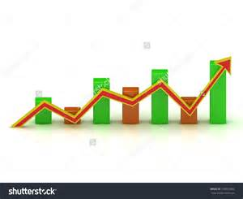
What are some possible causes of business fluctuations? | Changes in business investment. Government activity / policies (taxing and spending, control over the supply of money). External factors (war and availability of raw materials). Psychological factors (reaction to an event; Sept. 11, 2001).

Slide 3
ECONOMICS Chapter 13.5: Causes and Indicators of Business Fluctuations Learning Target: Understand the causes of business fluctuations & Economic Indicators
Success Criteria
You should be able to…
1. Identify the causes of business fluctuations.
2. Give examples of innovations and explain their impact.
3. Describe the different economic indicators and give examples of each.

Slide 4
Innovation | Transforming an invention into something useful (new techniques).

Slide 5
What are five innovations that have helped the U.S. economy expand? | 1. 2. 3. 4. 5.

Slide 6
ECONOMICS Chapter 13.5: Causes and Indicators of Business Fluctuations Learning Target: Understand the causes of business fluctuations & Economic Indicators
Success Criteria
You should be able to…
1. Identify the causes of business fluctuations.
2. Give examples of innovations and explain their impact.
3. Describe the different economic indicators and give examples of each.

Slide 7
What are two major ways that the government influences business activity? | By its policies on taxing and spending and by its control over the money supply.

Slide 8
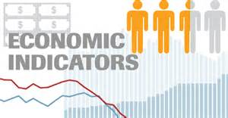
Economic Indicators | Statistics that measure variables in the economy. They assess the economy and predict what will happen in the future.

Slide 9
Let’s Review
Discuss at your table.
Describe several factors that could impact business activity.
Describe an example of an innovation.
What are some ways the government influences business activity?
Who cares about Economic Indicators? Should you?
Are you on target (white, black, blue, red or yellow)?
Did you hit the bullseye?
Learning Target: Understand Inflation & how to measure it

Slide 10
ECONOMICS Chapter 13.5: Causes and Indicators of Business Fluctuations Learning Target: Understand the causes of business fluctuations & Economic Indicators
Success Criteria
You should be able to…
1. Identify the causes of business fluctuations.
2. Give examples of innovations and explain their impact.
3. Describe the different economic indicators and give examples of each.

Slide 11
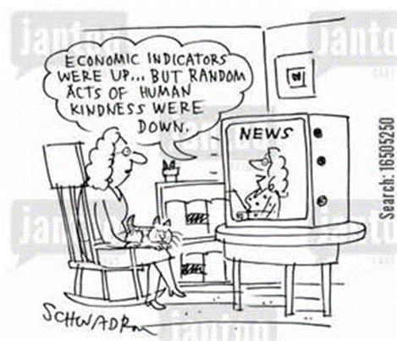

Slide 12
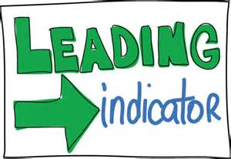
Leading Indicators (See chart on page 358) | Statistics that point to what will happen in the economy. - New orders for consumer goods - Number of building permits issued - Stock prices - Changes in interest rates

Slide 13
Coincident Indicators (See chart on page 358) | Economic indicators that usually change at the same time as changes in overall business activity. - Personal income less transfer payments - Rate of industrial production - Sales of manufacturers and retailers

Slide 14
Lagging Indicators (See chart on page 358) | Economic indicators that seem to lag behind changes in overall business activity. - Size of inventories - Length of unemployment - Labor cost per unit of output - Change in CPI for services

Slide 15
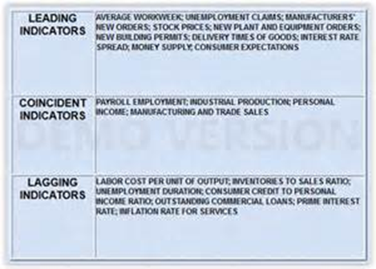

Slide 16
Let’s Review
Discuss at your table.
What are the three types of economic indicators?
Describe each of the economic indicators.
Increased sales at Home Depot would be what type of indicator?
A news report saying new subdivisions are being built would likely be what type of indicator?
Are you on target (white, black, blue, red or yellow)?
Did you hit the bullseye?
Learning Target: Understand Inflation & how to measure it

Slide 17
ECONOMICS Chapter 13.5: Causes and Indicators of Business Fluctuations Learning Target: Understand the causes of business fluctuations & Economic Indicators
Success Criteria
You should be able to…
1. Identify the causes of business fluctuations.
2. Give examples of innovations and explain their impact.
3. Describe the different economic indicators and give examples of each.

Slide 18
SUCCESS CRITERIA
#WeLoveToLearn

Slide 19
Proof of Success / Success Criteria (review your Learning Target(s))
1) I now know that…
a. ___________________________________________________________________________
___________________________________________________________________________
b. ___________________________________________________________________________
___________________________________________________________________________
c. ___________________________________________________________________________
___________________________________________________________________________
2) ONE word that might summarize today’s topic(s) is
___________________________________________________________________________
3) My question is ___________________________________________________________
___________________________________________________________________________
___________________________________________________________________________
___________________________________________________________________________
Did you hit the Learning Target? Circle a color. White Black Blue Red Yellow or Bullseye

