Slide 1
ECONOMICS
Chapter 13.4: Business Fluctuations
Learning Target: Understand the forces that cause business fluctuations & the Model of the Business Cycle
Success Criteria
You should be able to…
1. Describe business fluctuations in the economy.
2. Explain the business cycle and identify the different parts of the business cycle.
3. Provide examples of past recessions and expansions in the U.S. economy.

Slide 2

Business fluctuations | Ups and downs in an economy.

Slide 3
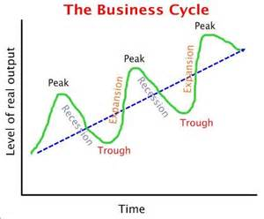
What is a Business Cycle? | Irregular changes in the level of total output measured by real GDP.

Slide 4
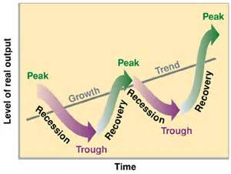
Peak / boom | A period of prosperity when economic activity is at its highest point.

Slide 5
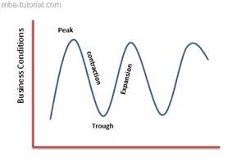
Contraction | A point when economic activity is slowing down.

Slide 6
Recession | A point when the nation’s output (real GDP) declines for at least 6 months.

Slide 7
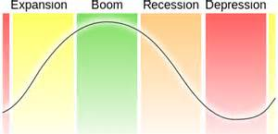
Depression | A major slowdown of economic activity.

Slide 8


Let’s Review
Discuss at your table.
How could you describe the Business Cycle to someone?
When would the business cycle be at a peak?
Economic activity slows during what point of the business cycle?
How is a recession similar and different from a depression?
Are you on target (white, black, blue, red or yellow)?
Did you hit the bullseye?
Learning Target: Understand the forces that cause business fluctuations & the Model of the Business Cycle

Slide 9
ECONOMICS
Chapter 13.4: Business Fluctuations
Learning Target: Understand the forces that cause business fluctuations & the Model of the Business Cycle
Success Criteria
You should be able to…
1. Describe business fluctuations in the economy.
2. Explain the business cycle and identify the different parts of the business cycle.
3. Provide examples of past recessions and expansions in the U.S. economy.

Slide 10
Trough | The lowest point at which the downward spiral levels off.

Slide 11
Expansion / recovery | The point when economic activity slowly increases.

Slide 12
What are the positives and negatives for people when the economy hits a trough? | Negatives: the economy has reached a low point, people experience hard times.

Slide 13
What are the positives and negatives for people when the economy hits a trough? | Negatives: the economy has reached a low point, people experience hard times. Positives: the GDP has stopped falling, recovery will soon follow.

Slide 14
What factors might cause a recession to deepen into a depression? | Failing businesses will close plants and lay off workers, leaving some with less money for purchases. More businesses will then fail due to less demand and few new ones will open. More people will become unemployed… See Figure 13.6, page 353

Slide 15
Let’s Review
Discuss at your table.
What is the lowest point of the business cycle known as?
What could be good about the low point mentioned above?
The point when the economy begins to rebound is knows as this. How might a recession turn into a depression?
Are you on target (white, black, blue, red or yellow)?
Did you hit the bullseye?
Learning Target: Understand the forces that cause business fluctuations & the Model of the Business Cycle

Slide 16
ECONOMICS
Chapter 13.4: Business Fluctuations
Learning Target: Understand the forces that cause business fluctuations & the Model of the Business Cycle
Success Criteria
You should be able to…
1. Describe business fluctuations in the economy.
2. Explain the business cycle and identify the different parts of the business cycle.
3. Provide examples of past recessions and expansions in the U.S. economy.

Slide 17
How have wars generally affected the American economy? Why? | Business activity increases during wars but falls off after. War production and fewer workers (less unemployment).

Slide 18
What was the largest drop in the business cycle historically? | The stock market crash in October 1929. People became nervous and sold stocks quickly, causing the value of all stocks to drop by $14 billion in one day.

Slide 19
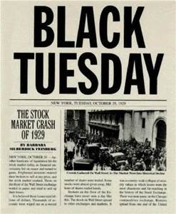
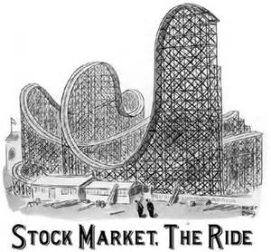

Slide 20
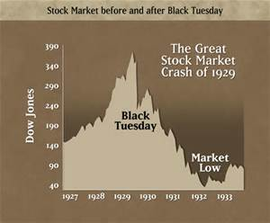

Slide 21
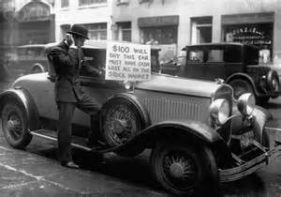

Slide 22
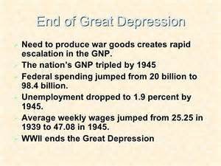
What brought about the end of the Great Depression? | World War II and the increased production as a result of it.

Slide 23
Let’s Review
Discuss at your table.
How do wars generally impact the business cycle?
What caused the largest drop in the business cycle in the U.S.?
What did the above drop lead to?
What brought an end to this drop?
Are you on target (white, black, blue, red or yellow)?
Did you hit the bullseye?
Learning Target: Understand the forces that cause business fluctuations & the Model of the Business Cycle

Slide 24
ECONOMICS
Chapter 13.4: Business Fluctuations
Learning Target: Understand the forces that cause business fluctuations & the Model of the Business Cycle
Success Criteria
You should be able to…
1. Describe business fluctuations in the economy.
2. Explain the business cycle and identify the different parts of the business cycle.
3. Provide examples of past recessions and expansions in the U.S. economy.

Slide 25
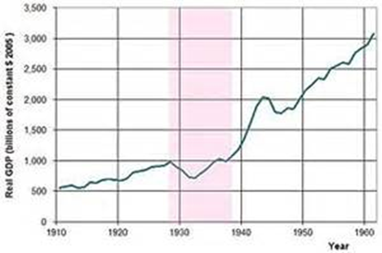

Slide 26
Explain how each event listed affected the nation’s economy.
Great Depression
W.W. II
Tech Boom
9/11

Slide 27
What was 'The Great Recession‘?
The Great Recession is a term that represents the sharp decline in economic activity during the late 2000s, which is considered the most significant downturn since the Great Depression. The term “Great Recession” applies to both the U.S. recession, officially lasting from December 2007 to June 2009, and the ensuing global recession in 2009. The economic slump began when the U.S. housing market went from boom to bust, and large amounts of mortgage-backed securities (MSBs) and derivatives lost significant value.
BREAKING DOWN 'The Great Recession'
The term "Great Recession" is a play on the term "Great Depression." The latter occurred during the 1930s and featured gross domestic product (GDP) decline of more than 10 percent and an unemployment rate that at one point reached 25 percent. While no explicit criteria exist to differentiate depression from a severe recession, there is near consensus among economists that the late-2000s downturn, during which U.S. GDP declined by 0.3 percent in 2008 and 2.8 percent in 2009, and unemployment briefly touched 10 percent, did not reach depression status. However, the event is unquestionably the worst economic downturn in the intervening years; the term accurately conveyed its severity by invoking such a well-known economic calamity.
www.investopedia.com/terms/g/great-recession.asp#ixzz5XyprcgRP

Slide 28
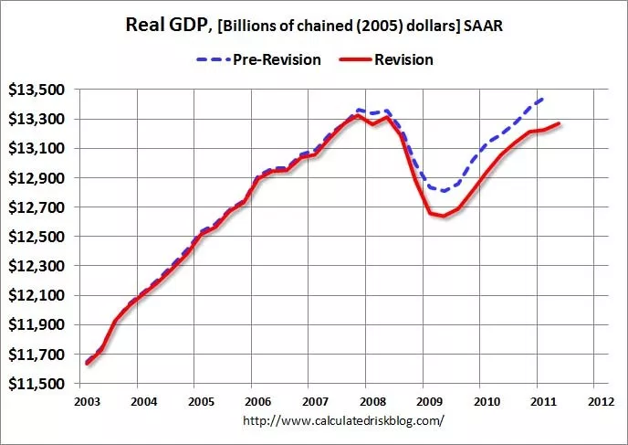

Slide 29
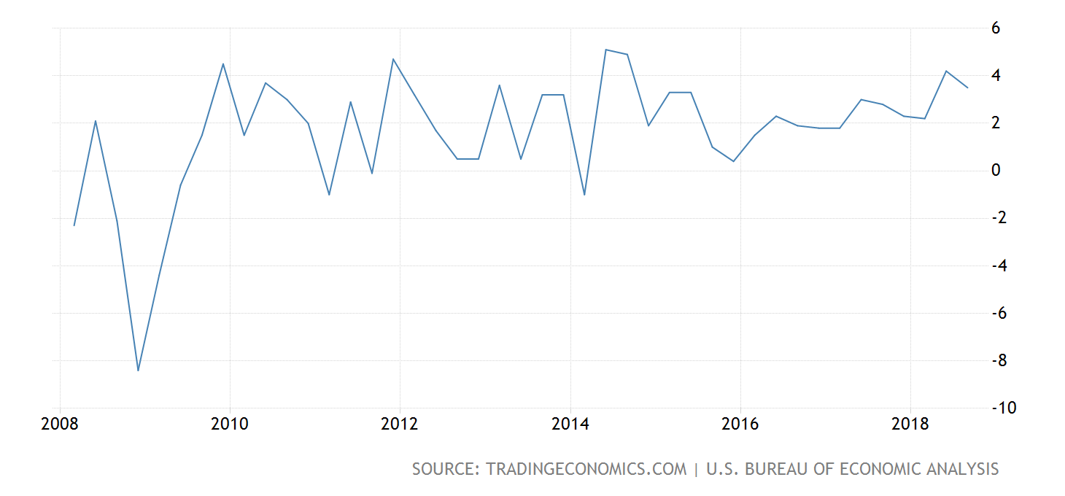

Slide 30
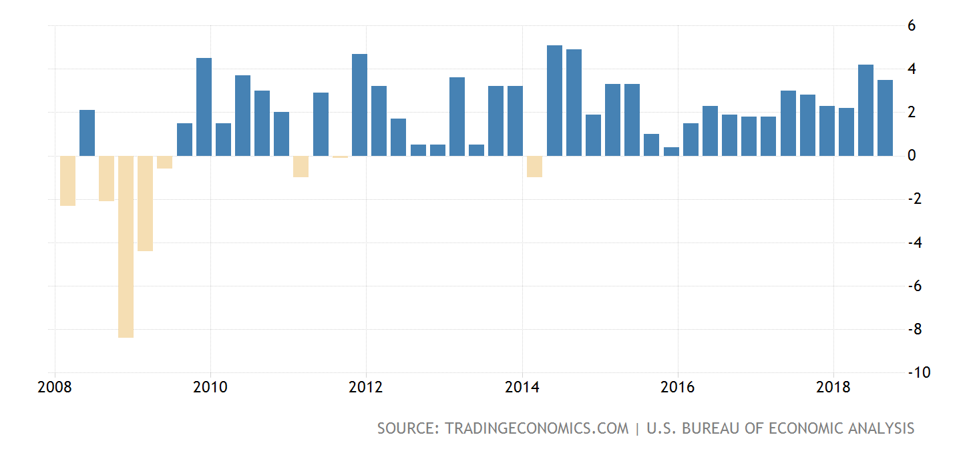

Slide 31
ECONOMICS
Chapter 13.4: Business Fluctuations
Learning Target: Understand the forces that cause business fluctuations & the Model of the Business Cycle
Success Criteria
You should be able to…
1. Describe business fluctuations in the economy.
2. Explain the business cycle and identify the different parts of the business cycle.
3. Provide examples of past recessions and expansions in the U.S. economy.

