Slide 1
ECONOMICS Chapter 13.3: Aggregate Demand and Supply Learning Target: Apply the Laws of Supply & Demand
Success Criteria
You should be able to…
1. Compare and contrast aggregate supply and aggregate demand.
2. Graph aggregate supply and aggregate demand.
3. Explain equilibrium price point and how it is impacted by aggregate supply and demand.

Slide 2
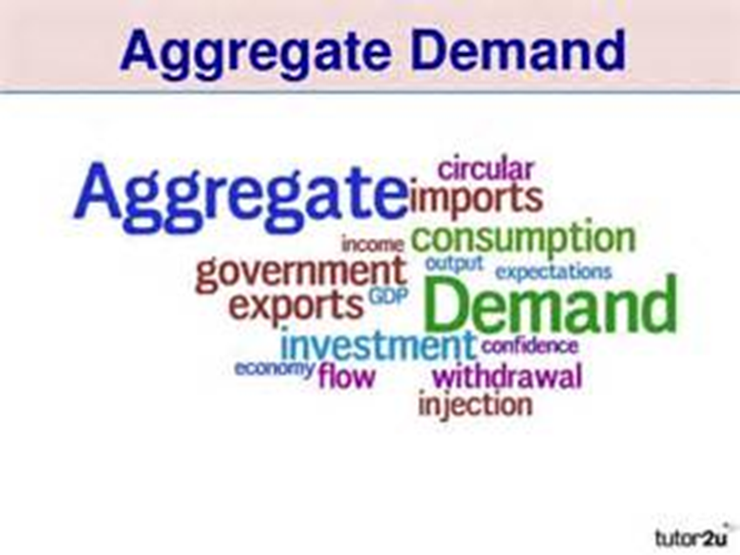
Aggregates | The sum of all the individual parts of the economy.
Aggregate demand | The total of all planned expenditures in the entire economy.

Slide 3
Aggregate demand curve | A downward sloping line graph showing the inverse relationship between aggregate demand and the average of all prices. See Figure 13.5, page 348 (read description)

Slide 4
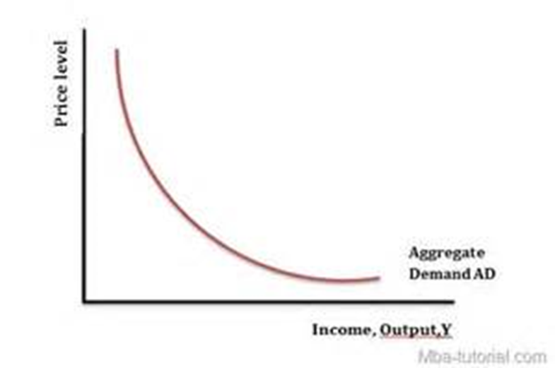
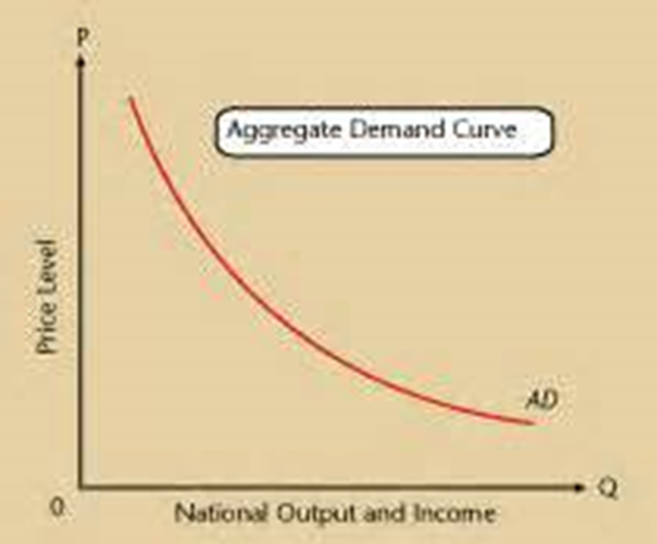

Slide 5
How is aggregate demand related to spending? | Inflation causes the purchasing power of cash to go down, and deflation causes it to go up. When price level goes down, the purchasing power of cash goes up causing people to spend more. It also makes our goods more attractive to foreigners.

Slide 6
How would increased competition in the economy likely affect aggregate demand? | It would lower prices and thus increase demand.

Slide 7
Let’s Review
Discuss at your table.
What are Aggregates?
How does Aggregate demand differ from what we learned
about demand previously?
How does inflation and deflation relate to aggregate demand?
How does competition relate to aggregate demand?
Are you on target (white, black, blue, red or yellow)?
Did you hit the bullseye?
Learning Target: Apply the Laws of Supply & Demand

Slide 8
ECONOMICS Chapter 13.3: Aggregate Demand and Supply Learning Target: Apply the Laws of Supply & Demand
Success Criteria
You should be able to…
1. Compare and contrast aggregate supply and aggregate demand.
2. Graph aggregate supply and aggregate demand.
3. Explain equilibrium price point and how it is impacted by aggregate supply and demand.

Slide 9
Aggregate supply | The real domestic output of producers based on the rise and fall of the price level.

Slide 11
Aggregate supply curve | An upward sloping line graph showing the relationship between aggregate supply and the average of all prices. As production costs go down, businesses will likely produce more leading to increased profits. See Figure 13.5, page 349 (read description)

Slide 12
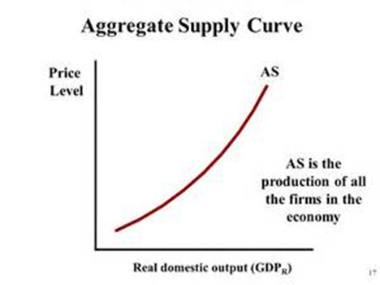

Slide 13
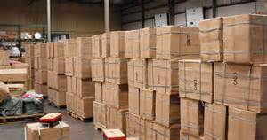
What problem might a company encounter if it increases production of an item? How would the company likely deal with the problem? | A possible oversupply or surplus. The supply could outpace demand. Reduce production of the item(s).

Slide 14
How is aggregate demand and supply used to find an equilibrium price level? | The equilibrium price is where the aggregate demand curve crosses the aggregate supply curve. See graph on page 350.
What will happen to the equilibrium price level if there is an increase in aggregate demand? | The equilibrium price will increase.

Slide 15
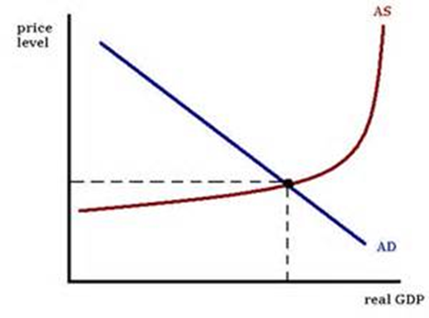

Slide 16
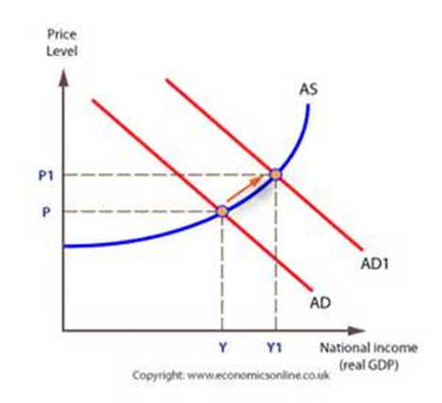
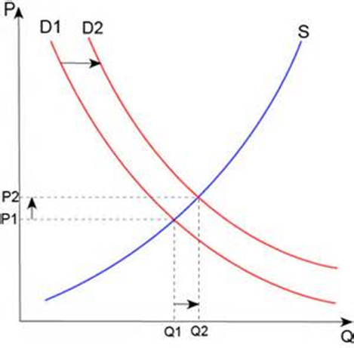

Slide 17
How could a story in the media cause the equilibrium price to fall? | Reports of bad economic times ahead (a recession). The demand curve could shift to the left, resulting in less demand and a lower equilibrium price.

Slide 18
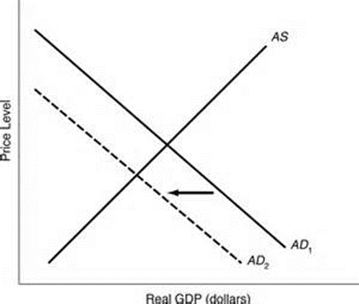

Slide 19
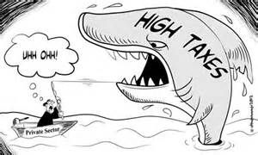
How might high taxes and interest rates hurt aggregate supply? | Higher production costs (taxes, interest rates, etc.) cause producers to produce fewer goods.

Slide 20
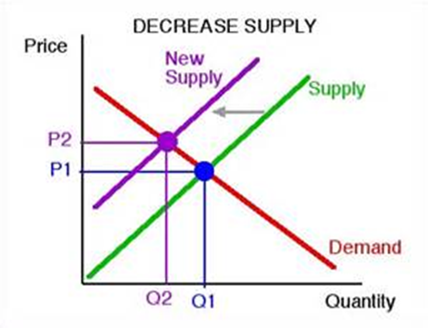

Slide 21
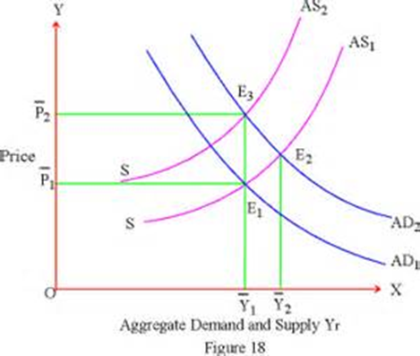

Slide 22
Let’s Review
Discuss at your table.
How is Aggregate supply different from what we learned
about supply previously?
What is equilibrium price?
What could cause the equilibrium price to change?
What could cause aggregate supply to change?
Are you on target (white, black, blue, red or yellow)?
Did you hit the bullseye?
Learning Target: Apply the Laws of Supply & Demand

Slide 23
ECONOMICS Chapter 13.3: Aggregate Demand and Supply Learning Target: Apply the Laws of Supply & Demand
Success Criteria
You should be able to…
1. Compare and contrast aggregate supply and aggregate demand.
2. Graph aggregate supply and aggregate demand.
3. Explain equilibrium price point and how it is impacted by aggregate supply and demand.

Slide 24
Proof of Success / Success Criteria (review your Learning Target(s))
1) I now know that…
a. ___________________________________________________________________________
___________________________________________________________________________
b. ___________________________________________________________________________
___________________________________________________________________________
c. ___________________________________________________________________________
___________________________________________________________________________
2) ONE word that might summarize today’s topic(s) is
___________________________________________________________________________
3) My question is ___________________________________________________________
___________________________________________________________________________
___________________________________________________________________________
___________________________________________________________________________
Did you hit the Learning Target? Circle a color. White Black Blue Red Yellow or Bullseye

Slide 25
The END ☹

