Slide 1
ECONOMICS Chapter 13.2: Correcting Statistics for Inflation Learning Target: Understand Inflation & how to measure it
Success Criteria
You should be able to…
1. Explain inflation, purchasing power and deflation.
2. Explain how inflation is measured.
3. Describe the different price indexes and how they impact each other.

Slide 2
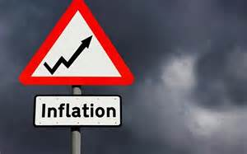
Inflation | The prolonged rise in the general price level of final goods and services.
Purchasing power | The real goods and services that money can buy (the value of money).

Slide 3
Real | Real values have been adjusted for inflation. Example: Real wages
Nominal | Current values, not adjusted for inflation.

Slide 4
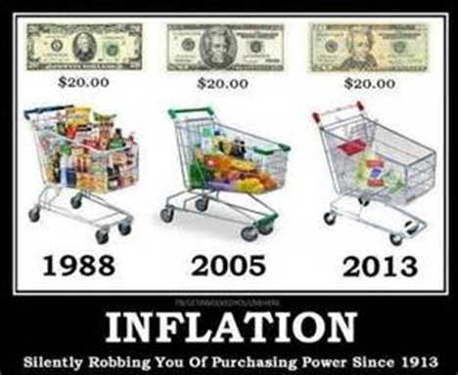
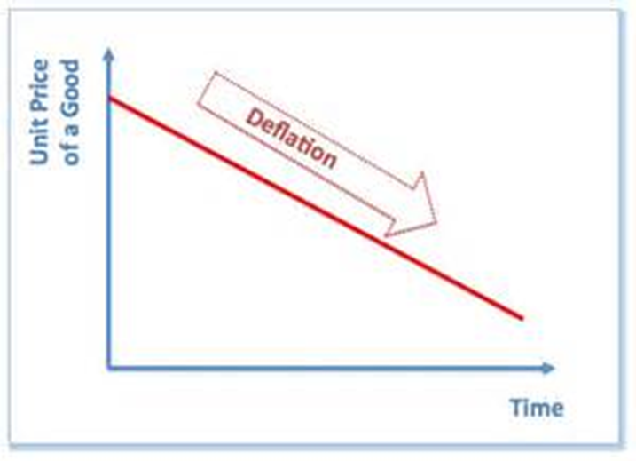
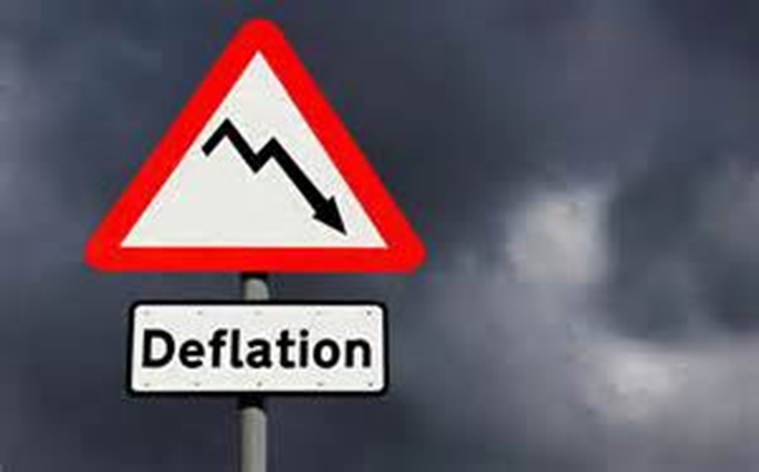
What happens when inflation occurs? | The purchasing power of the dollar declines.
Deflation | The prolonged decline in the general price levels of goods and services.

Slide 6
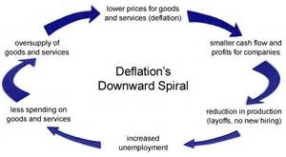

Slide 7
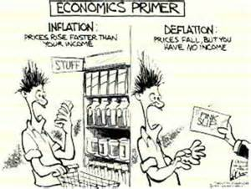

Slide 8
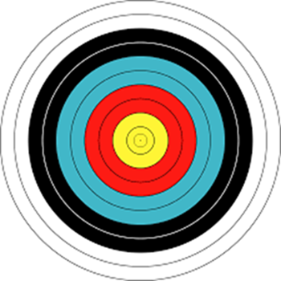
Let’s Review
Discuss at your table.
Describe an example of the effect of inflation.
Describe Purchasing Power in your own words.
Compare and contrast inflation and deflation.
Are you on target (white, black, blue, red or yellow)?
Did you hit the bullseye?
Learning Target: Understand Inflation & how to measure it

Slide 9
ECONOMICS Chapter 13.2: Correcting Statistics for Inflation Learning Target: Understand Inflation & how to measure it
Success Criteria
You should be able to…
1. Explain inflation, purchasing power and deflation.
2. Explain how inflation is measured.
3. Describe the different price indexes and how they impact each other.

Slide 10
How is the value of the dollar determined? | By its purchasing power – the real goods and services it can buy.
How does the drop in the dollar’s purchasing power skew GDP? | The change in dollar value doesn’t represent an increase in output, just a change in price.

Slide 11
How can inflation be measured? | The government measures inflation in 3 common ways (statistics). 1. Consumer Price Index (CPI) 2. Producer Price Index (PPI) 3. GDP price deflator

Slide 12
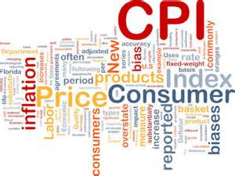
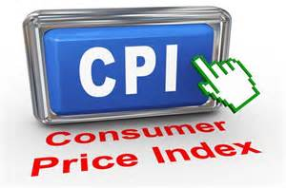
What is the Consumer Price Index (CPI)? | The measure of the change in price (average) over time of a specific group of goods and services purchased by households.

Slide 13
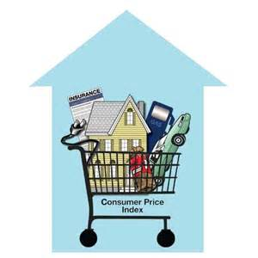

Slide 14
Market basket | The group of goods and services used to compile the Consumer Price Index (CPI). This includes common items like food, housing, education, recreation, and medical care.

Slide 15
Let’s Review
Discuss at your table.
How is inflation measured?
What is CPI?
What things are used to measure CPI?
What are the things above called?
Are you on target (white, black, blue, red or yellow)?
Did you hit the bullseye?
Learning Target: Understand Inflation & how to measure it

Slide 16
ECONOMICS Chapter 13.2: Correcting Statistics for Inflation Learning Target: Understand Inflation & how to measure it
Success Criteria
You should be able to…
1. Explain inflation, purchasing power and deflation.
2. Explain how inflation is measured.
3. Describe the different price indexes and how they impact each other.

Slide 17
Base year | A year used as a point of comparison for other years in a series of statistics.
What is the Producer Price Index (PPI)? | The measure of (average) change in the prices producers charge for the goods they sell. Prices included in the PPIs include mining, manufacturing and agriculture. PPIs usually increase before the CPI.

Slide 18
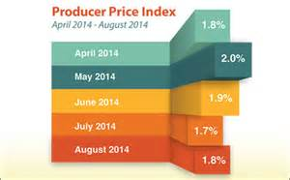

Slide 19
Let’s Review
Discuss at your table.
What is PPI?
What things are used to measure PPI?
What is the relationship between CPI and PPI?
Why might a Base Year be important?
Are you on target (white, black, blue, red or yellow)?
Did you hit the bullseye?
Learning Target: Understand Inflation & how to measure it

Slide 20
ECONOMICS Chapter 13.2: Correcting Statistics for Inflation Learning Target: Understand Inflation & how to measure it
Success Criteria
You should be able to…
1. Explain inflation, purchasing power and deflation.
2. Explain how inflation is measured.
3. Describe the different price indexes and how they impact each other.

Slide 21
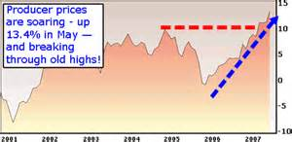

Slide 22
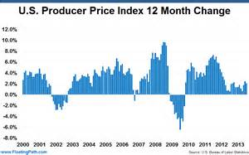

Slide 23
Why should consumers care about the producer price index? | The PPI measures factors that affect the CPI. So an increase in PPIs signals the possibility of increased inflation and an increase in the CPI.
What is the GDP price deflator? | A price index that removes the effect of inflation from GDP so the overall economy in one year can be compared to another year.

Slide 24
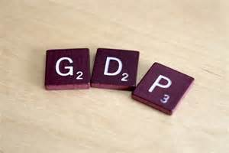
Real GDP | GDP that has been adjusted (by the price deflator) for inflation.
How does the PPI affect the CPI? | Increases in PPIs usually lead to CPI increases. When the cost of production goes up, consumers will eventually pay more for final products.

Slide 25
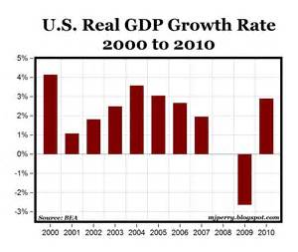
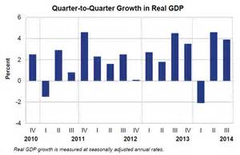

Slide 26
Let’s Review
Discuss at your table.
Why does an increase in PPI matter?
What does the GDP Price Deflator do?
Why is the GDP Price Deflator used?
What is Real GDP?
Are you on target (white, black, blue, red or yellow)?
Did you hit the bullseye?
Learning Target: Understand Inflation & how to measure it

Slide 27
ECONOMICS Chapter 13.2: Correcting Statistics for Inflation Learning Target: Understand Inflation & how to measure it
Success Criteria
You should be able to…
1. Explain inflation, purchasing power and deflation.
2. Explain how inflation is measured.
3. Describe the different price indexes and how they impact each other.

Slide 28
Proof of Success / Success Criteria (review your Learning Target(s))
1) I now know that…
a. ___________________________________________________________________________
___________________________________________________________________________
b. ___________________________________________________________________________
___________________________________________________________________________
c. ___________________________________________________________________________
___________________________________________________________________________
2) ONE word that might summarize today’s topic(s) is
___________________________________________________________________________
3) My question is ___________________________________________________________
___________________________________________________________________________
___________________________________________________________________________
___________________________________________________________________________
Did you hit the Learning Target? Circle a color. White Black Blue Red Yellow or Bullseye

